Slide 1
JET's Z. B. Patil College, Dhule
Department of Chemistry
Essay Writing Assignment for M.Sc.-I students (chemistry) This activity is a part of curriculum of Practicing Cleanliness ( AC-101)Subjects:
Safety measures in laboratories and industries
Pollution control
Control of global warming
Preservation of ground water
Twelve principles of Green Chemistry
Rules:1) This activity is compulsory for all MSc-I students. 2) Students are required to provide their Full Name, Exam seat no, Mob.no and Email Id on the first page 3) Students should start writing the essay from the second page. 4) Students are required to write an essay on any one of the above subjects in English in five hundred words in own handwriting on one side of A4 size paper. 5) Students should submit their essay in hard copy in Lab no. - 9 on or before 6 January 2022 and do the signature after submitting essay.
HOD, Department of Chemistry

Slide 2
Tree Plantation

Slide 3
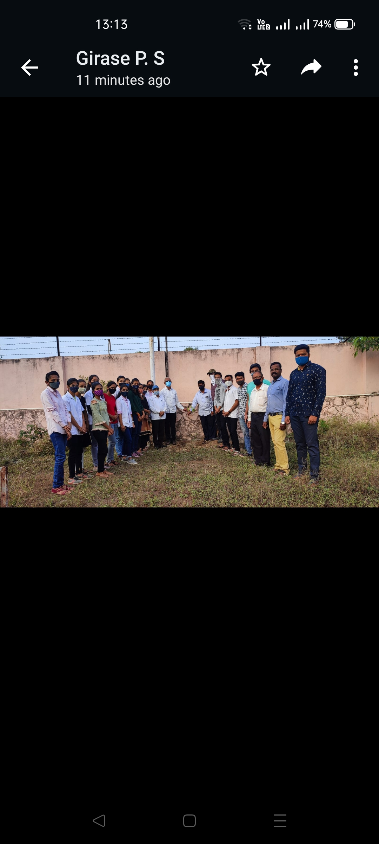
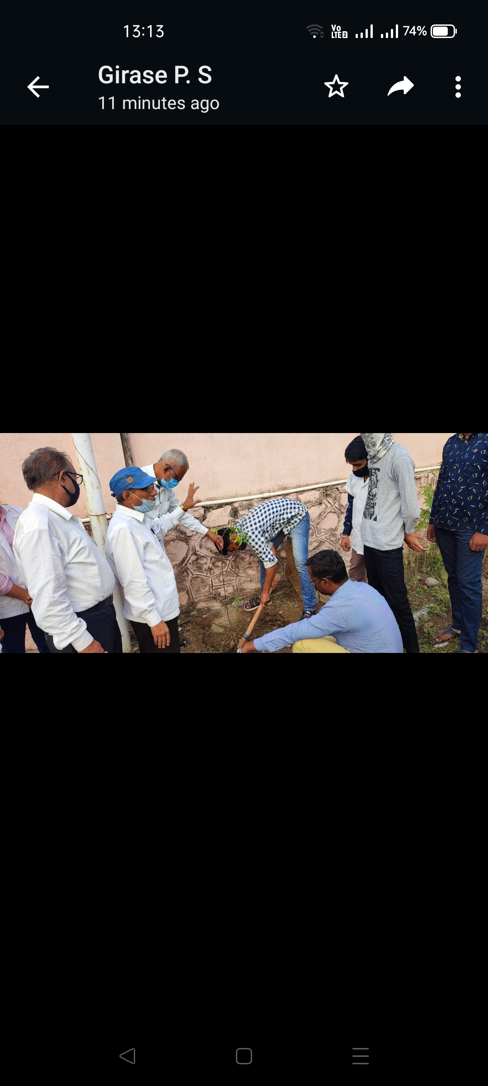
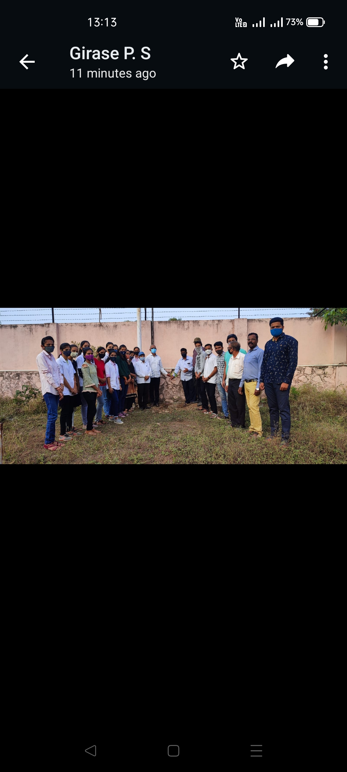
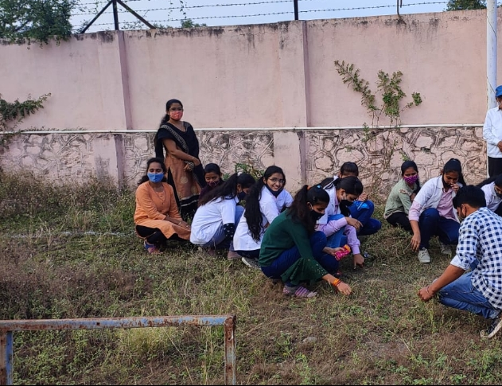

Slide 4
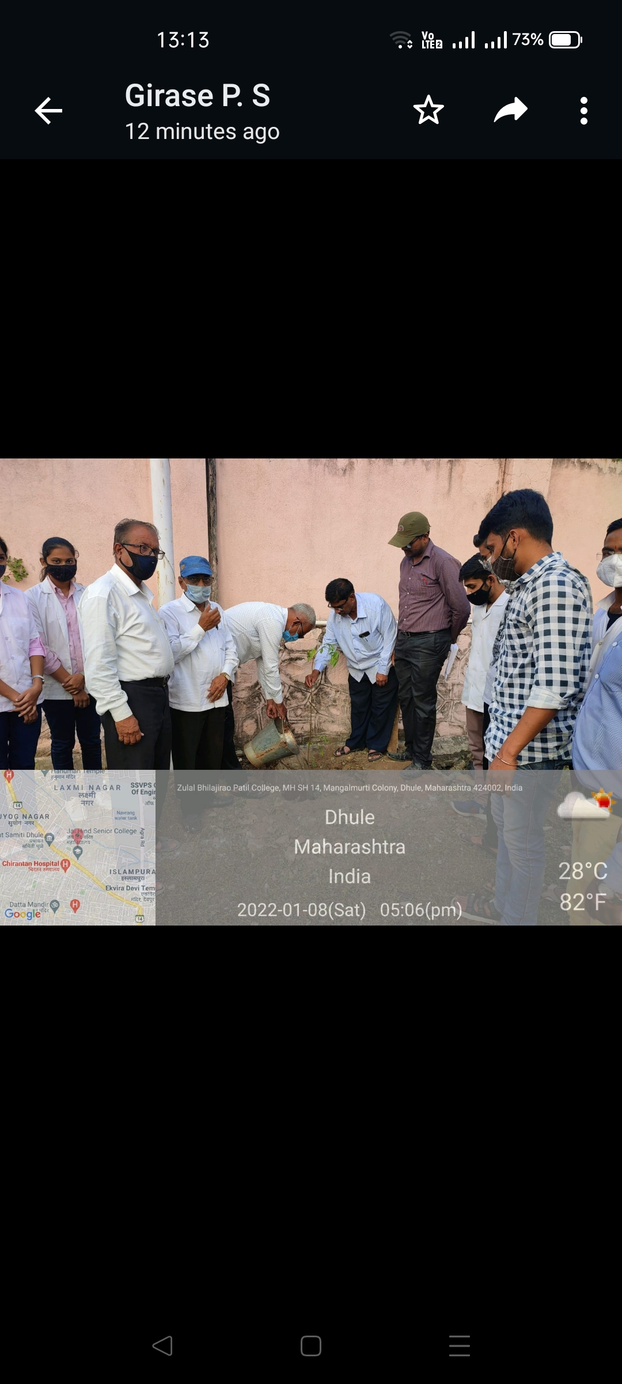
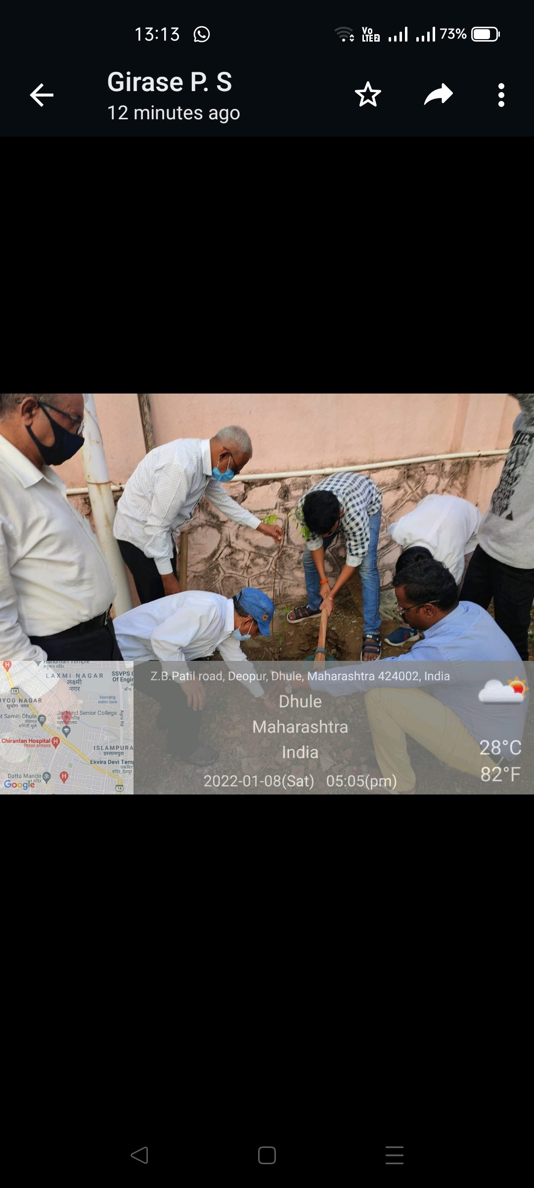


Slide 5
Laboratories Cleaning

Slide 6
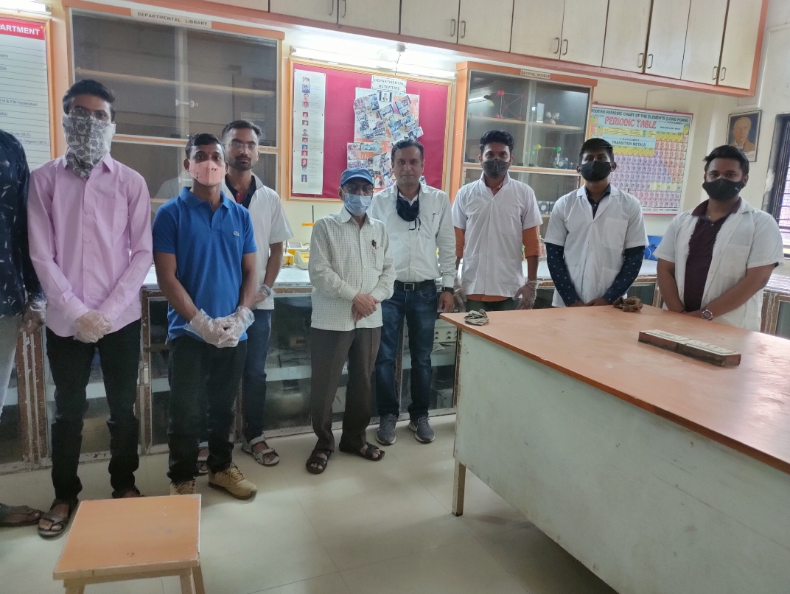
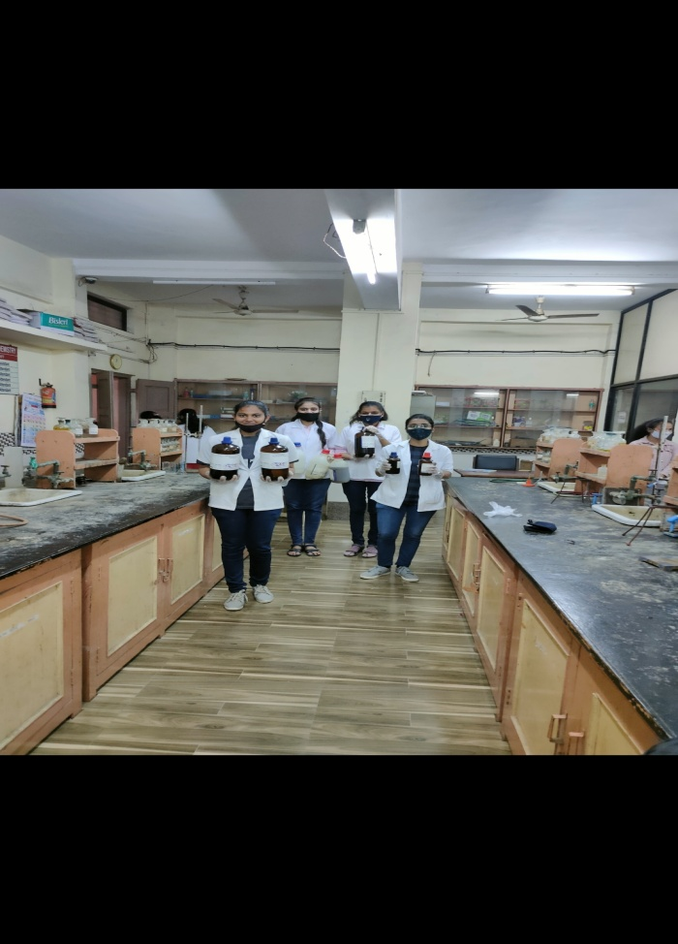
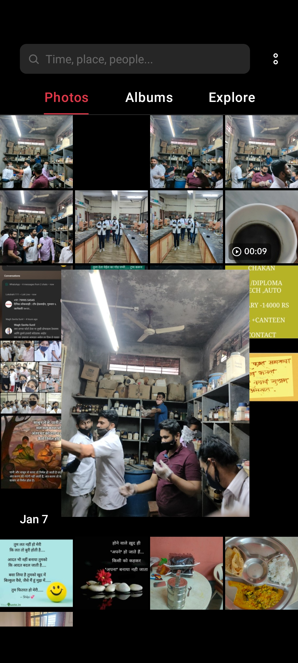
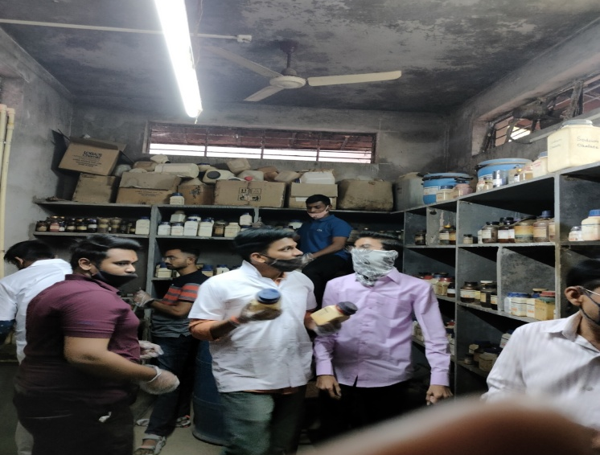

Slide 7
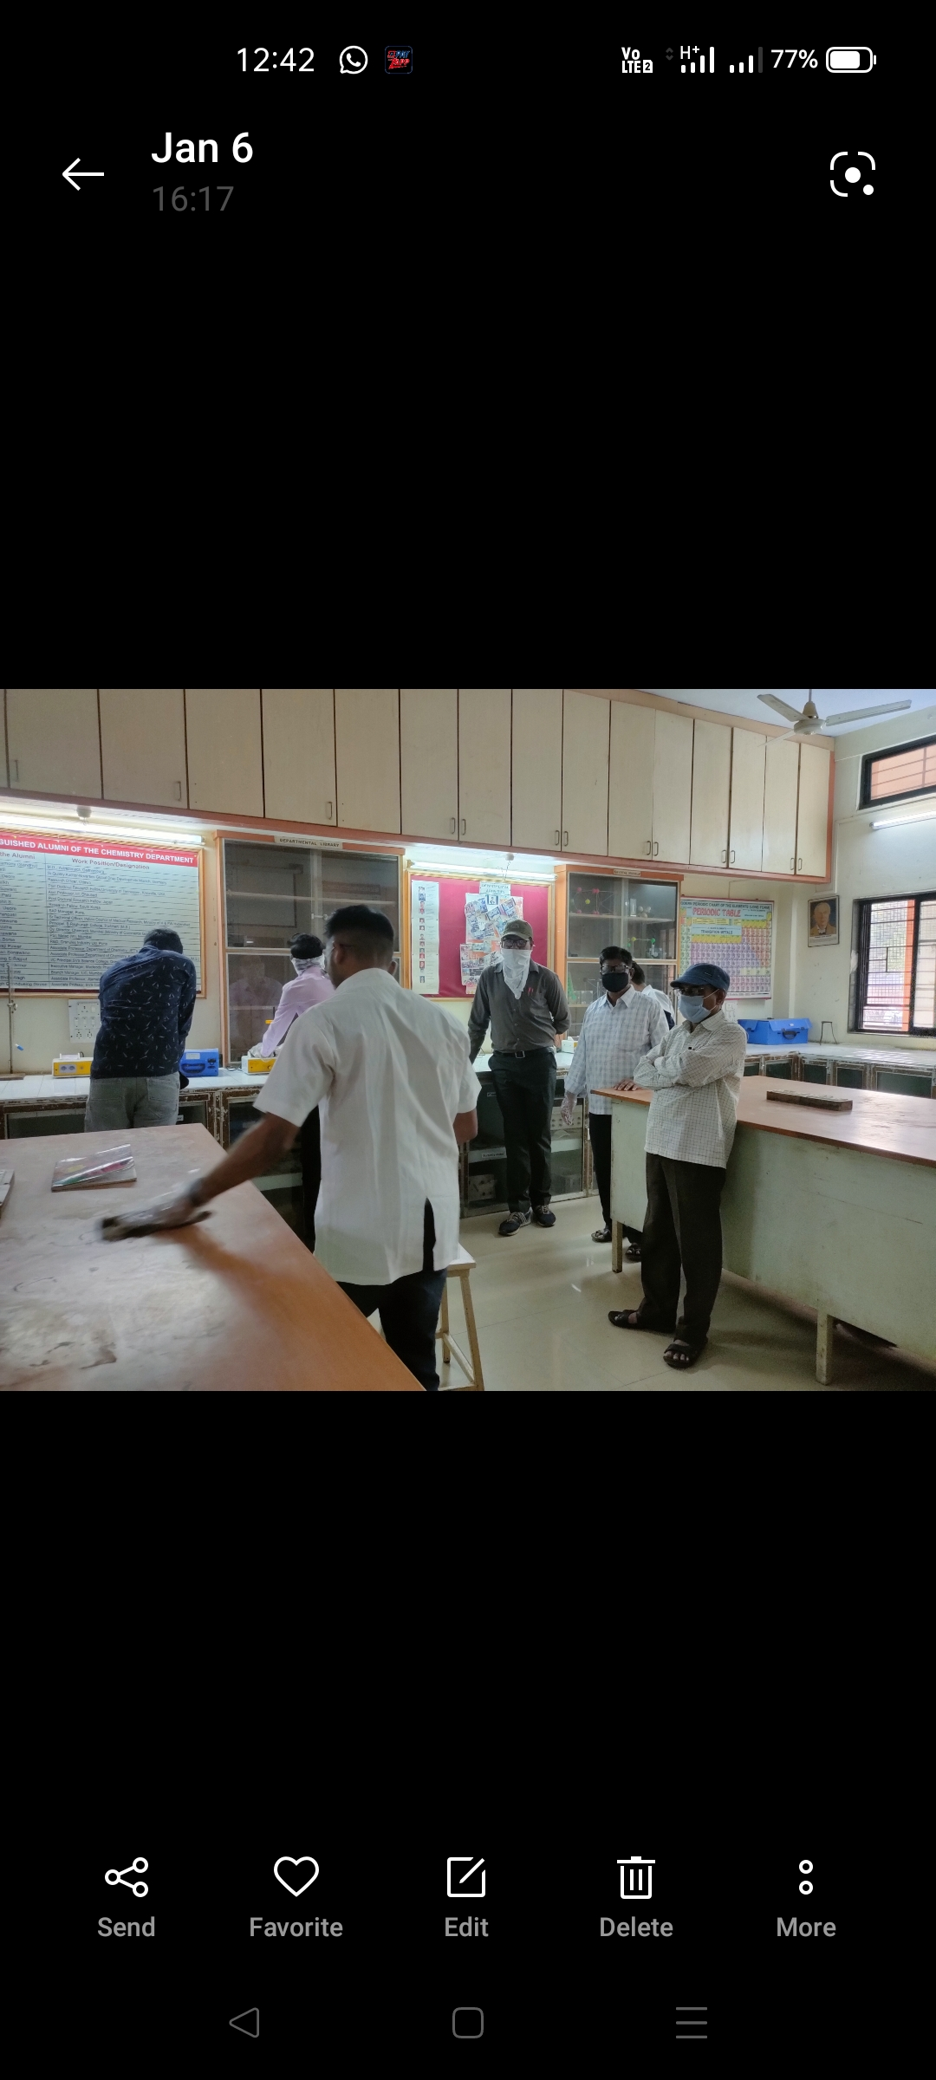
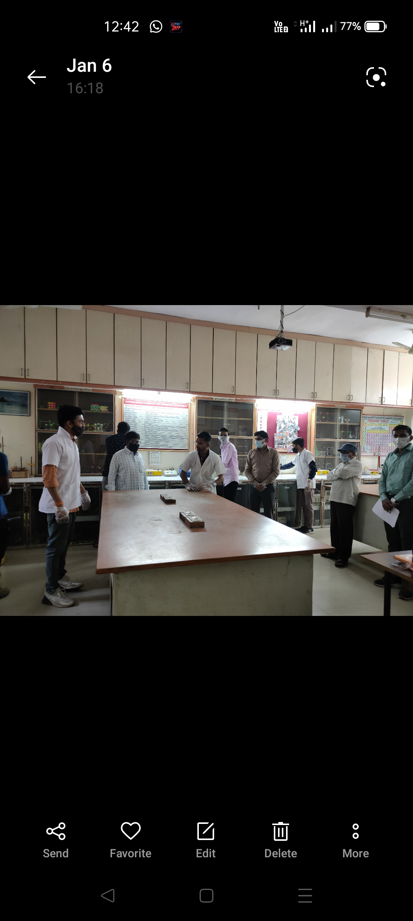
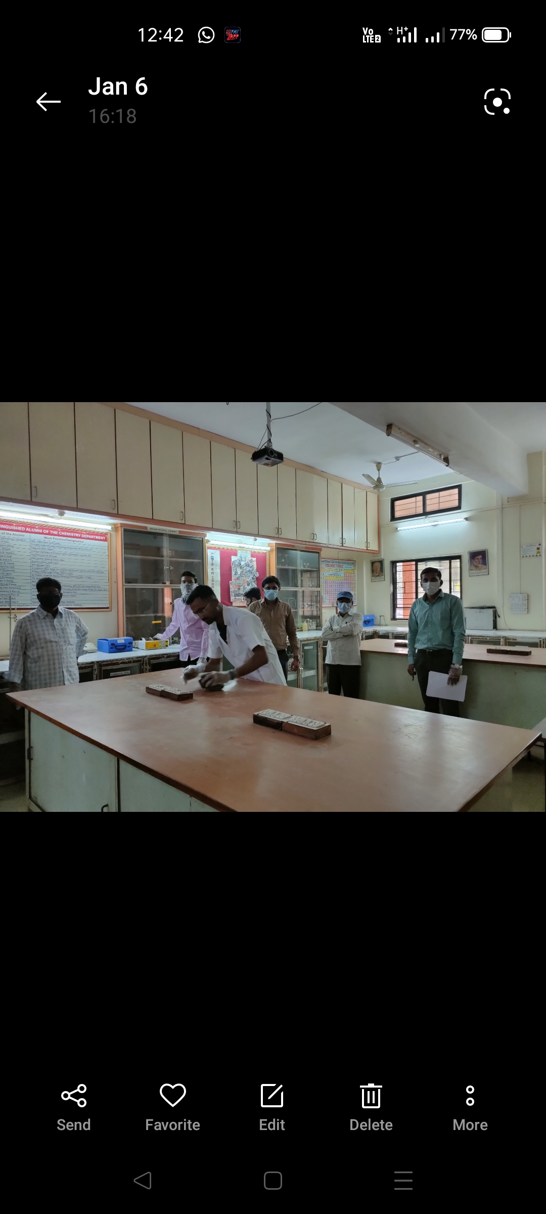
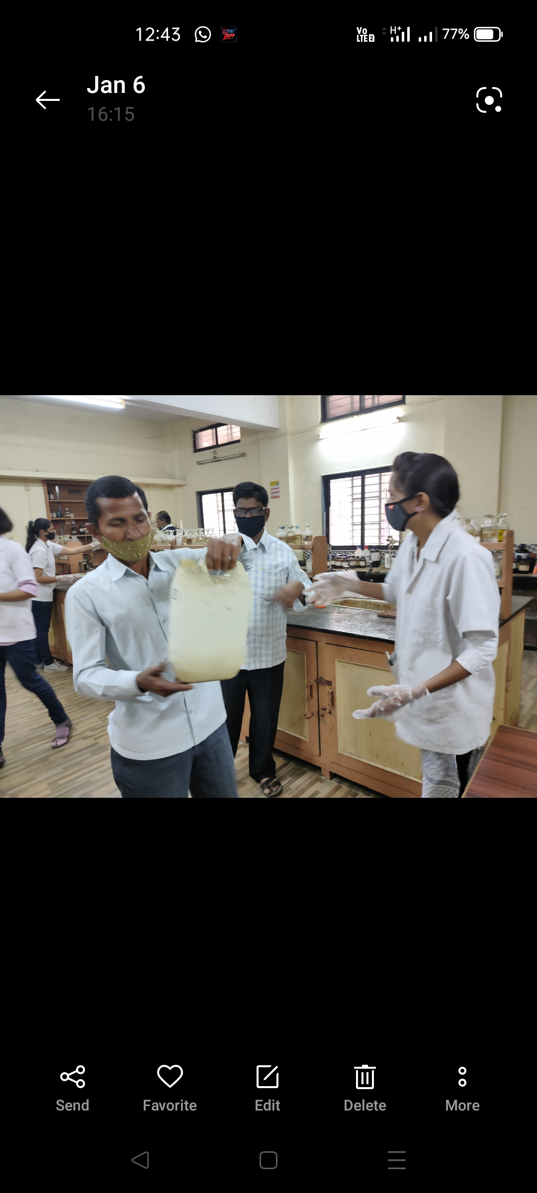

Slide 8
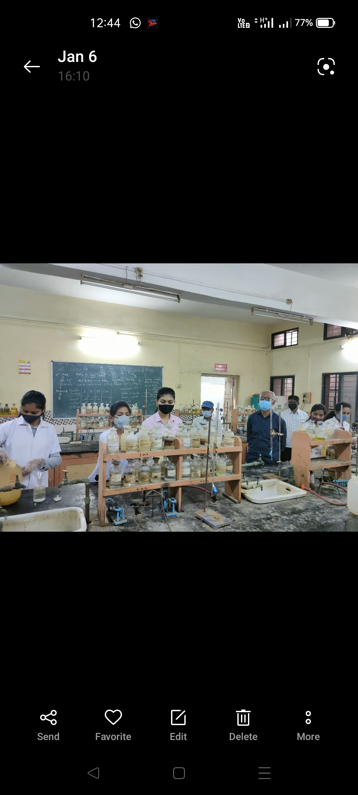
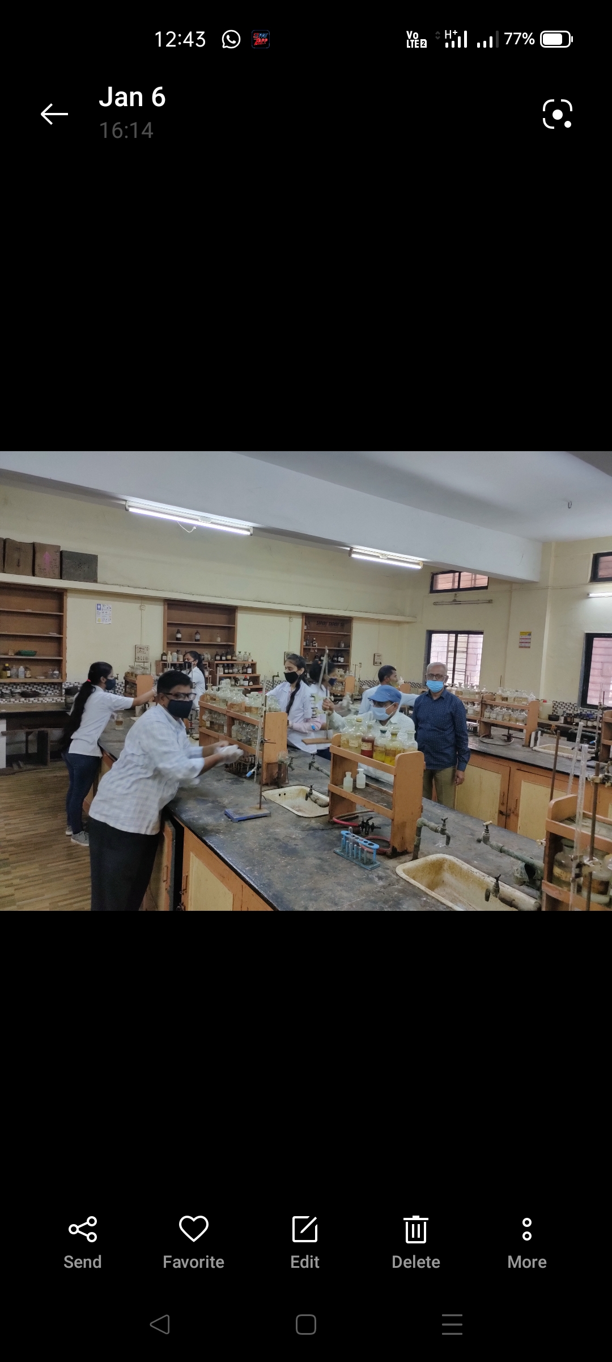
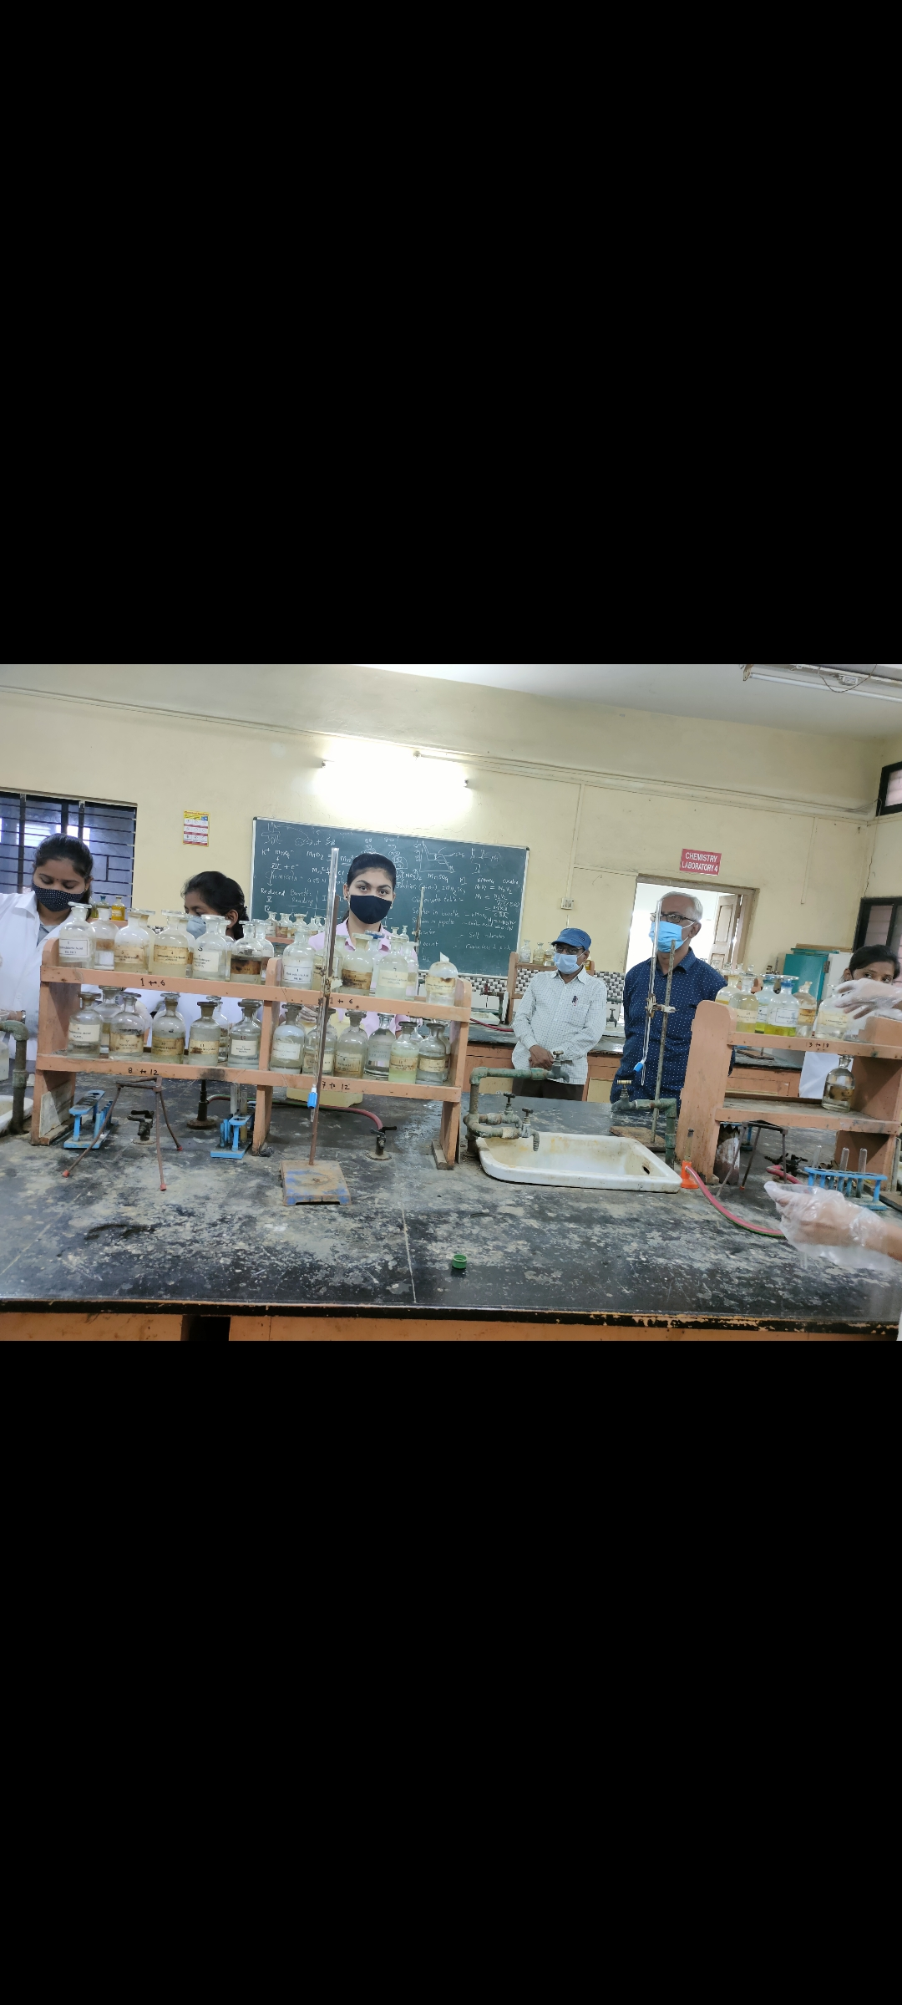
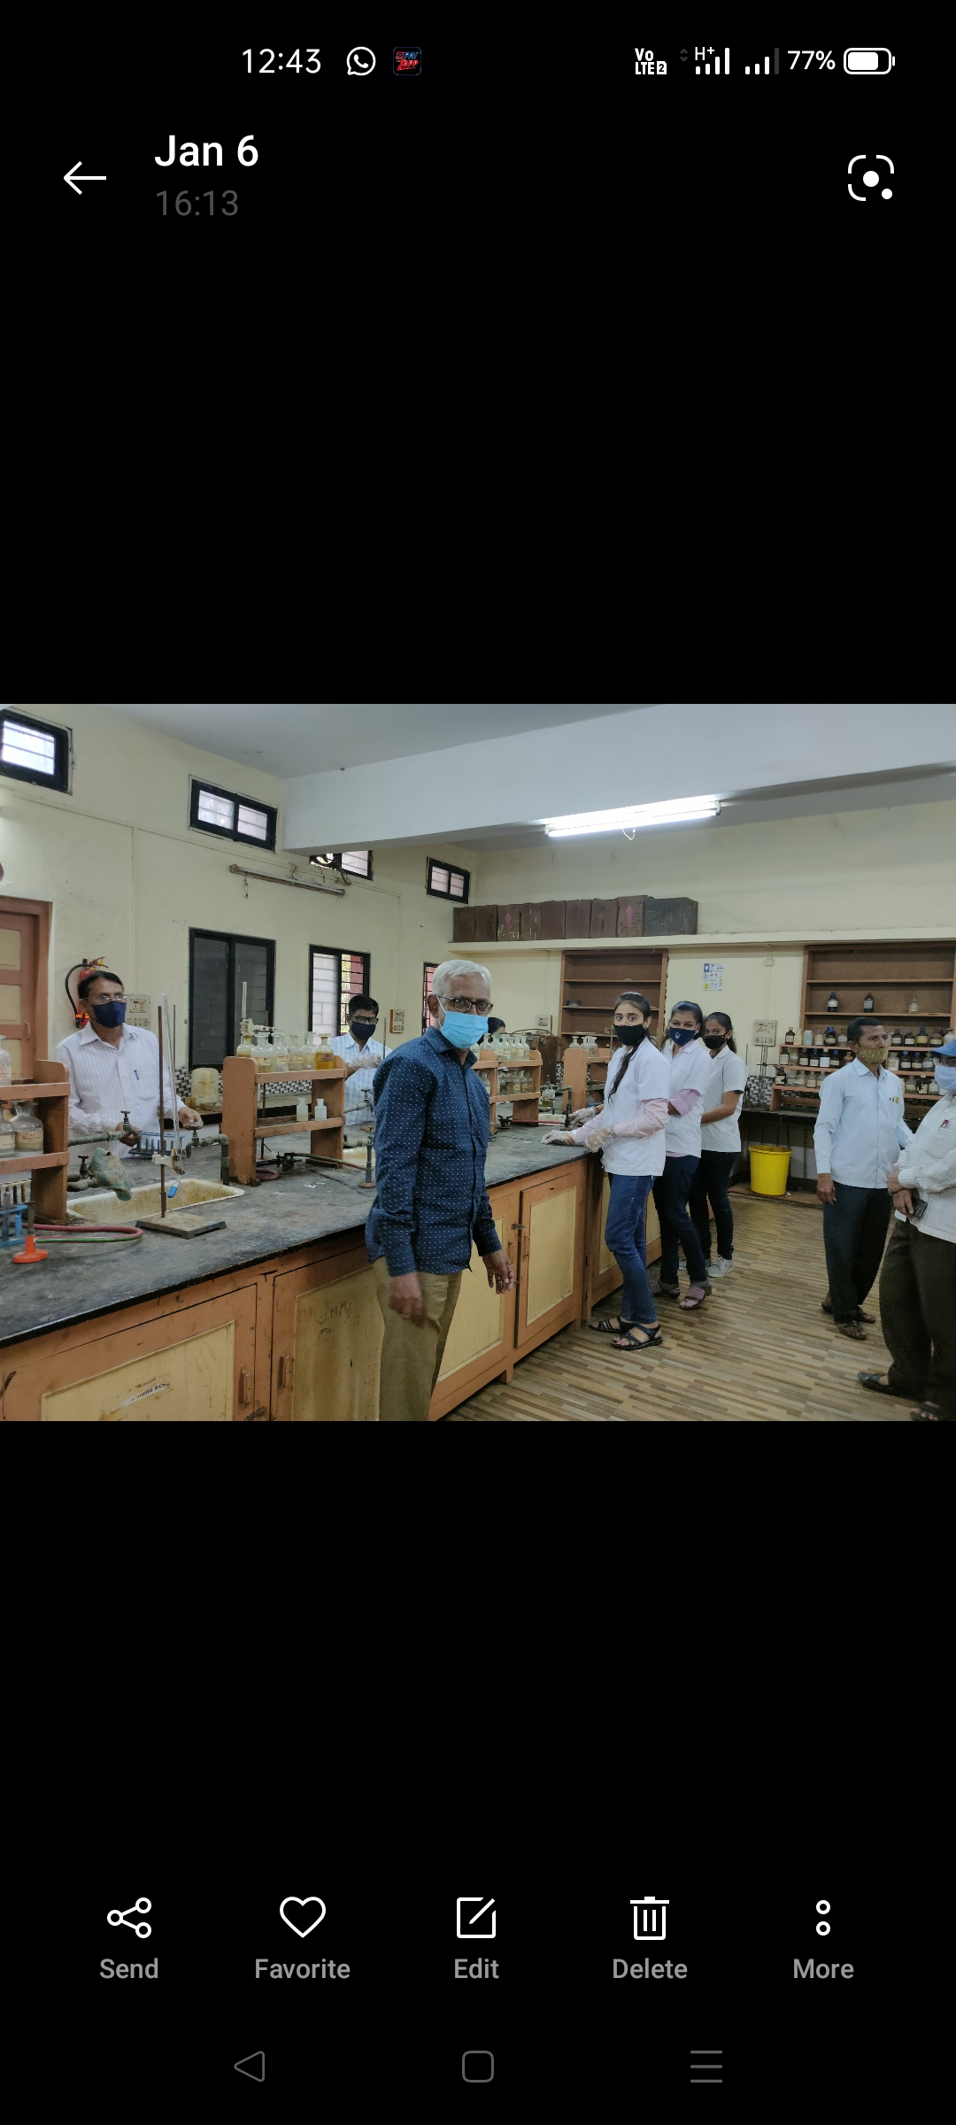

Slide 9
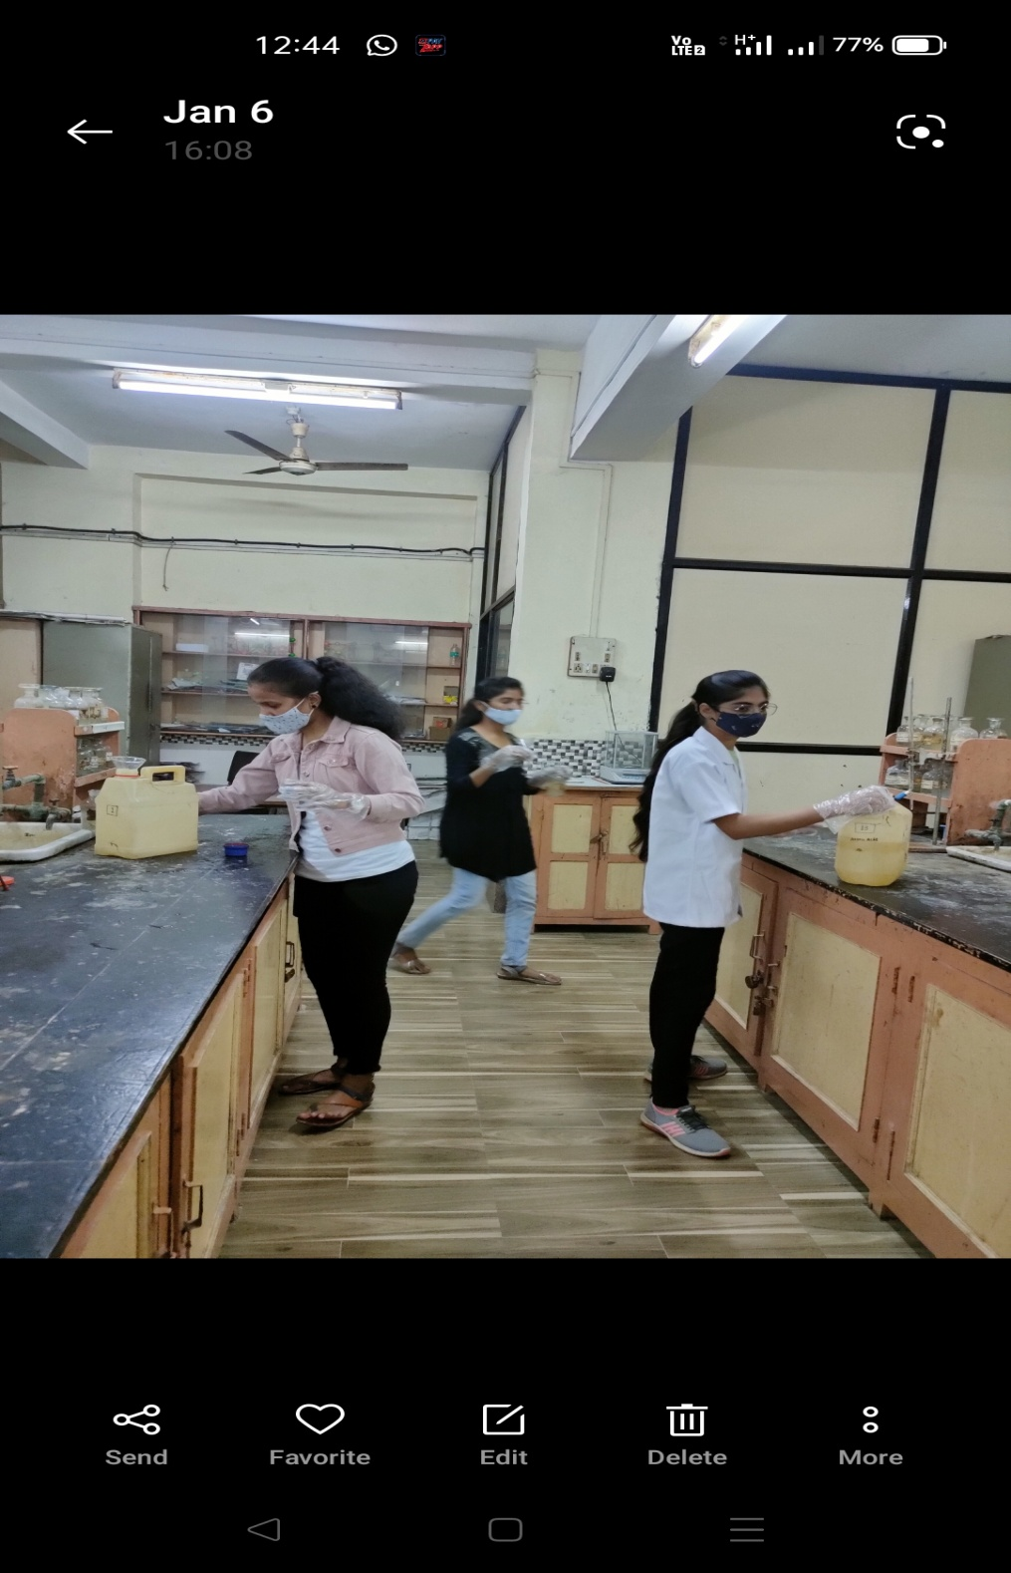
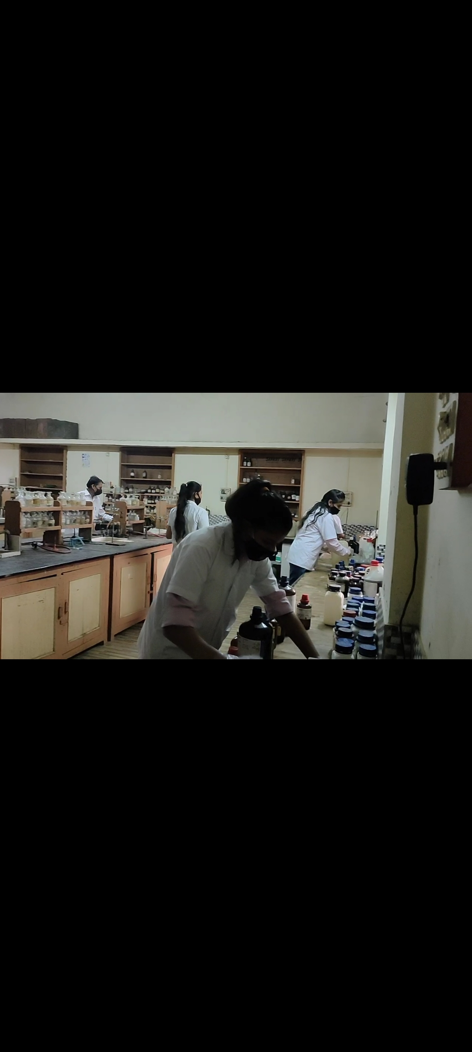
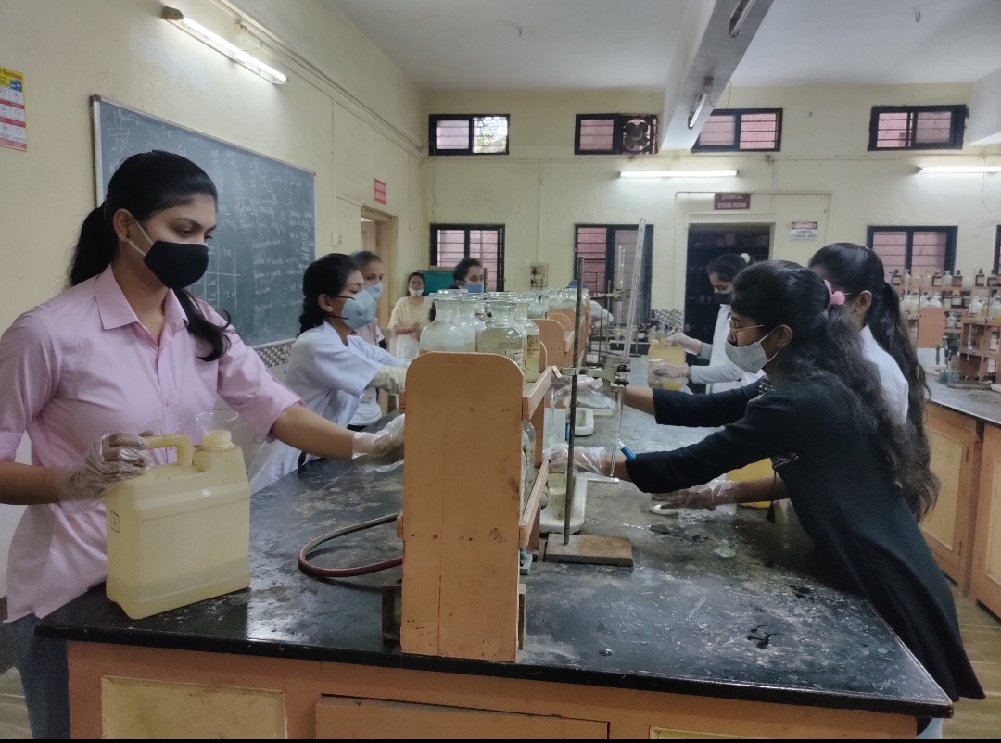
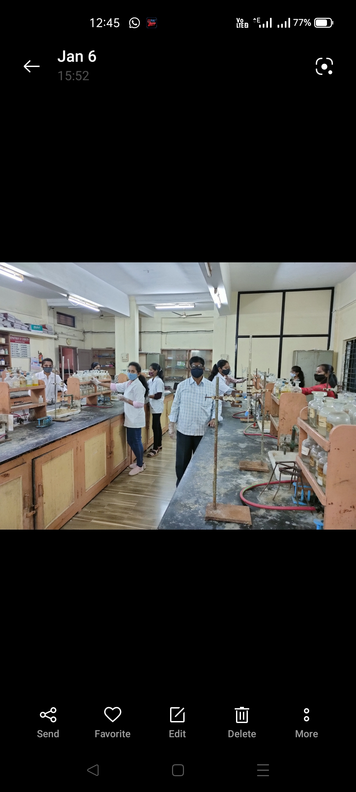

Slide 10
