Slide 1
The Ionic Bond (16 marks)
Introduction-
Solids are characterized by incompressibility, rigidity and mechanical strength.
The molecules, atoms or ions are closely packed in a solid, i.e. the molecules, atoms or ions are held together by strong forces and cannot move at random.
Hence in solids there is well-ordered arrangement of molecules, atoms or ions. The properties of solids depend upon the number and type of constituents and also on their arrangements.
The Solids can be classified into the following two types
Crystalline Solids-
A substance whose constituents are arranged in an orderly manner in a definite geometric form is called a crystalline solid.
According to X-ray diffraction studies of solids, the regular arrangement of the constituents (molecules, atoms or ions) extends over large distances in three-dimensional network of crystals.
The crystalline solids shows long range order e.g. Sodium chloride, Sulphur, diamond, sugar, etc.

Slide 2
Amorphous Solids-
A substance whose constituents are not arranged in an orderly manner is called an amorphous solid.
These substances possess properties such as incompressibility and rigidity to a certain extent but they do not have definite geometric forms.
Some amorphous solids may have some orderly arrangement but it does not extend to more than a few Angstrom units.
The amorphous solids have only short range order. e.g. glass, rubber, plastics.
Therefore solid state refers only to crystalline state, i.e., only a crystalline material can be considered to be a true solid.
The crystals classified into the following four types depending upon the nature of the units which occupy the lattice points.
Ionic crystals in which the units are positively and negatively charged ions.
Covalent crystals in which the units are atoms.
Metallic crystals in which the units are positive metallic ions surrounded by a 'sea' of electrons.
Molecular crystals in which the units occupying the lattice points
are molecules.

Slide 3
Ionic Crystals-
In ionic crystals, the units occupying lattice points are positive and negative ions. For example, in sodium chloride, the units are Na⁺ ions and Cl⁻ ions.
These ions are held together by coulombic forces of attraction.
X-ray studies have shown that in ionic solids, each ion is surrounded by a number of ions of opposite charge. For example, in NaCl, each Na⁺ ion is surrounded by six Cl⁻ ions and each Cl- ion is surrounded by six Na+ ions.
The coulombic forces of attraction between the oppositely charged ions are very strong and, therefore, the amount of energy required to separate ions from one another is very high.
The ionic crystals show following main and important characteristics properties
The heats of vaporization of ionic crystals are high.
The vapour pressures of ionic crystals at ordinary temperatures are very low.
The melting and boiling points of ionic crystals are very high.
Ionic crystals are hard and brittle.
Ionic crystals are insulators in the solid state because ions are entrapped in fixed places in the crystal lattice and cannot move. When electric field is applied. But when melted they become good conductors of electricity because in the molten state, the well-ordered arrangement of ions in the crystal is destroyed and the

Slide 4
ions are in a position to move about in the liquid medium when an electric field is applied.
Ionic crystals are soluble in water and also in other polar solvents. They are insoluble or very slightly soluble in non-polar solvents such as benzene, chloroform, carbon tetrachloride etc.
Ionic crystals are good conductors of electricity when dissolved in water. The ions held by coulombic forces fall away from one another when dissolved in water or in any other solvent having high dielectric constant on the basis of Coulomb's law that forces of attraction between oppositely charged particles vary inversely as the dielectric constant.
Lattice- It is regular three dimensional arrangements of atoms or ions or molecules in the crystalline solid.
Lattice energy- The energy released when ions of oppositely charged ions are brought together from infinity distance to form one mole of crystal is called as lattice energy. It is a measure of stability of ionic substance w. r. t. ions in gaseous

Slide 5
Unit cell - “ It is smallest repeating unit of the structure” or “solid that stacked randomly reproduced structure of the whole solid.”. Or
“ It is smallest group of atoms or ions or molecules that when repeated at regular intervals in three dimensions will produce lattice of crystal system.
The crystalline solid is made up of infinite number of unit cells.
The size and shape of unit cell denoted by lengths a, b, c .
There are seven basic types of unit cells represented in the following table

Slide 6
Parameters of Unit Cells
System | Intercepts | Crystal Angles | Examples | Number of Maximum Axes and Planes of Symmetry | Minimum Symmetry Elements | Bravais Lattices
Cubic | a = b = c | α = β = γ = 90⁰ | NaCl, KCl, CaF₂, ZnS, Cu₂O, Diamond , Alums Pb, Ag , Au | Nine planes of symmetry and Thirteen axes of symmetry | Four 3·fold axes and Three 4·fold axes | Primitive, Face centred Body centred = 3
Orthorhombic | a ≠ b ≠ c | α = β = γ=90⁰ | KNO₃, K₂SO₄, Ba SO₄, PbCO₃, MgzSiO₄, Rhombic sulphur | Three planes of symmetry and Three axes of symmetry | Three mutually perpendicular2·fold axes | Primitive, Face centred, Body centred End centred = 4
Tetragonal | a = b ≠ c | α = β = γ = 90⁰ | SnO₂, TiO₂, ZrSiO₄, KH₂PO₄, PbWO₄ , Sn | Five planes of symmetry and Five axes of symmetry | One 4-fold axis | Primitive, Body centred =2
Monoclinic | a ≠ b ≠ c | α ≠90⁰ β = γ = 90⁰ | Na₂SO₄.10H₂0, Na₂B₄O₇.10H₂O, CaSO₄.2H₂O, Monoclinic sulphur | One plane of symmetry and One axis of symmetry | One 2-fold axis | Primitive, End centred =2
Triclinic | a ≠ b ≠ c | α ≠ β ≠ γ ≠ 90⁰ | CuSO₄.5H₂O, K₂Cr₂O₇, H₃BO₃ | No plane of symmetry and No axis of symmetry | One 1-fold axis | Primitive = 1
Hexagonal | a = b ≠ c | α = β =90⁰ γ = 120⁰ | ZnO, CdS, HgS, Graphite, Ice, PbI₂ , Beryl , Mg, Zn, Cd | Seven planes of symmetry and Seven axes of symmetry | One 6-fold axis | Primitive = 1 .
Rhombohedral | a = b = c | α = β = γ ≠ 90⁰ | NaNO₃, ICI, Calcite, Quartz,Magnesite, As, Sb, Bi | Seven planes of symmetry and Seven axes of symmetry | One 3-fold axis | Primitive = 1

Slide 7
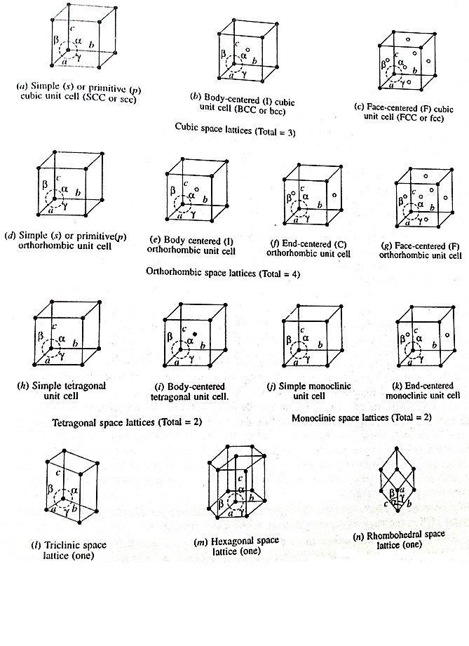

Slide 9
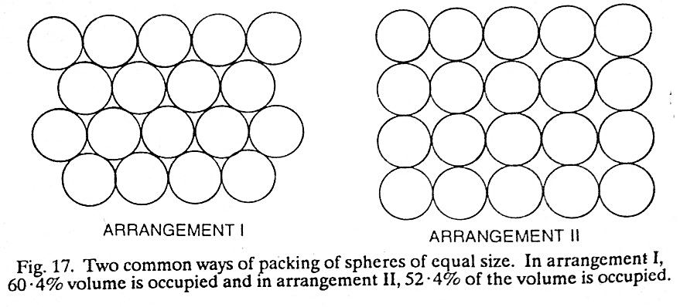
Simple cubic structure contains the units only at all corners.
BCC structure contains the units at centre and at all corners.
FCC structure contains units at midpoint (centre) of all faces and at all corners.
Close packing of identical spheres-
The arrangement in which maximum available space is occupied by spheres is called as close packing. Therefore closest packing of spheres gives greater stability to close packed system.
Consider the packing of spheres of equal size in two dimensions (in a layer) and in three dimensions arrangement by placing the layers of spheres one above another.
There are two common ways of packing of spheres of equal size in the layer as shown in the following figure
Arrangement I Arrangement II

Slide 10
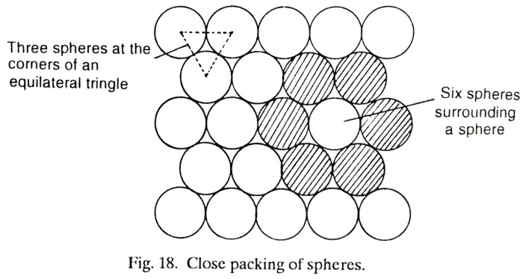
In the arrangement I the spheres are more closely packed than in the arrangement II.
In the arrangement I - 60.4% of available space is occupied by spheres and 39.6% space is empty.
In the arrangement II- 52.4% of available space is occupied by spheres and 47.6% space is empty . The empty space in both arrangements is called as void or holes interstitial sites.
Therefore arrangement I is more correct and represents close packing of spheres than arrangement II.
In close packing arrangement, the spheres arrange themselves in such a way that their centres are at the corners of an equilateral triangle.
Each sphere is in contact with six other similar spheres indicate co-ordination number is six.
The number of possible and nearest neighbour spheres in contact with a particular sphere is called as co-ordination number.

Slide 11
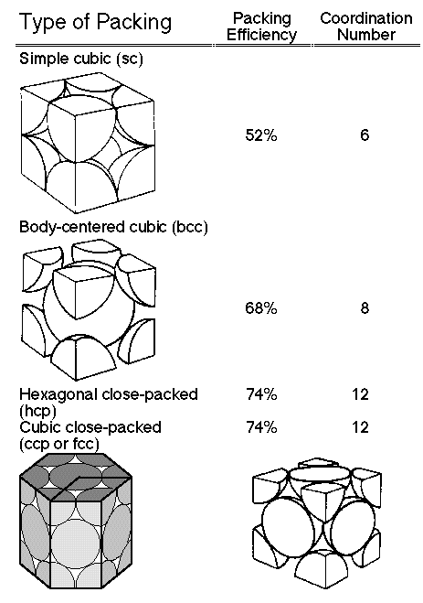

Slide 12
Interstitial sites - In closed packed arrangement of spheres 26℅ space is unoccupied is called as holes or hollows or interstitial site in the crystal lattice.
There are two types of holes or interstitial sites
1) Octahedral holes 2) Tetrahedral holes
1)Octahedral holes-
Each sphere is surrounded octahedrally by 6 spheres and One octahedral hole per sphere.
Therefore number of octahedral holes is equal to number of spheres in the crystal lattice.
These octahedral holes are large and each can accommodate sphere of radius 0.414 (0.414 to 0.732) times that of closed packed sphere without causing distortion of the crystal lattice.
2) Tetrahedral holes –
Each sphere is tetrahedrally surrounded by 4 spheres and Two tetrahedral holes per sphere.
These tetrahedral holes are much smaller and each can accommodate only sphere of radius 0.225 (0.225 to 0.414) times that of closed packed structure.
For every closed packed arrangement there is one octahedral hole and two tetrahedral holes.
The octahedral holes are larger than tetrahedral holes.

Slide 13
For every closed packed arrangement there is one octahedral hole and two tetrahedral holes.
The octahedral holes are larger than tetrahedral holes.
An ionic structure is composed of oppositely charged ions.
If the larger ions are close packed then the smaller ions may occupy either octahedral hole or tetrahedral hole depending on their size.
Normally the types of holes occupied can be determined from the radius ratio
The ion occupying a tetrahedral hole has co-ordination number 4.
The ion occupying an octahedral hole has co-ordination number 6.
Limiting Radius Ratios (r⁺ / r⁻) | Permitted Coordination Number | Structural Arrangement | Example
Less than 0·155 | 2 | Linear | BeH₂
0·155 – 0.225 | 3 | Plane trigonal | Boron oxide, BO₃³⁻, Boron nitride (BN)
0.225 – 0.414 | 4 | Tetrahedral | ZnS type structure e.g. ZnO, CuCl, CuBr, CuI, SiO₄²⁻
0.225 – 0·414 | 4 | Square planar
0.414 – 0·732 | 6 | Octahedral | NaCl type structure e.g. AgF, AgCl, AgBr
0.732 – 1.0 | 8 | Cubic | CsCl type structure e.g. CsBr, CsI, TlCl, TlBr

Slide 14
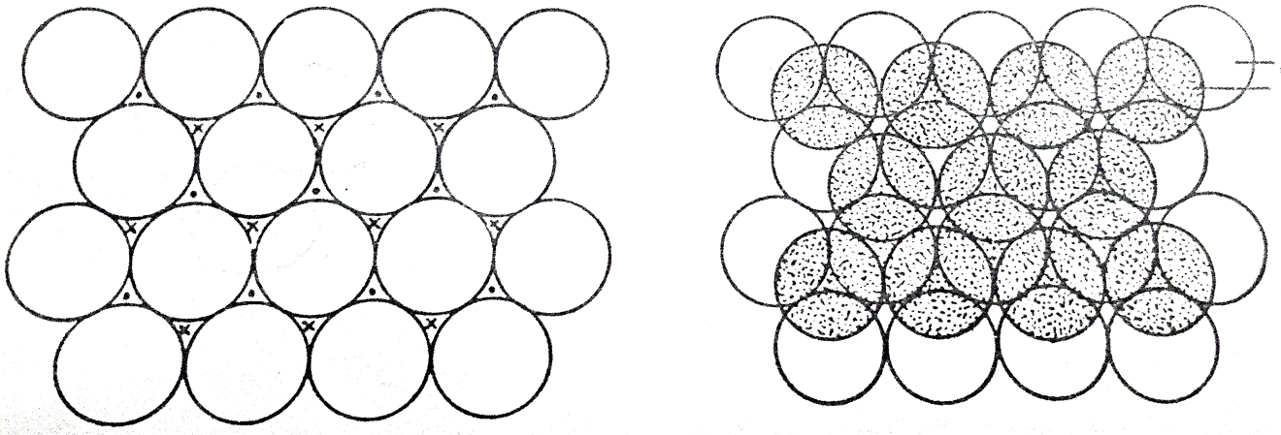
All holes are similar but they are marked as dot and stars.
It is not possible to place spheres on dot and star types of holes simultaneously.
The close packing of spheres as in arrangement I is called as layer A (First layer) which can be extended in three dimensions by placing other closest packed layers on the top of all holes marked by dots is called as layer B.
layer A
layer B
The spheres of third layer is formed by two ways gives hcp and ccp structures as follows

Slide 15
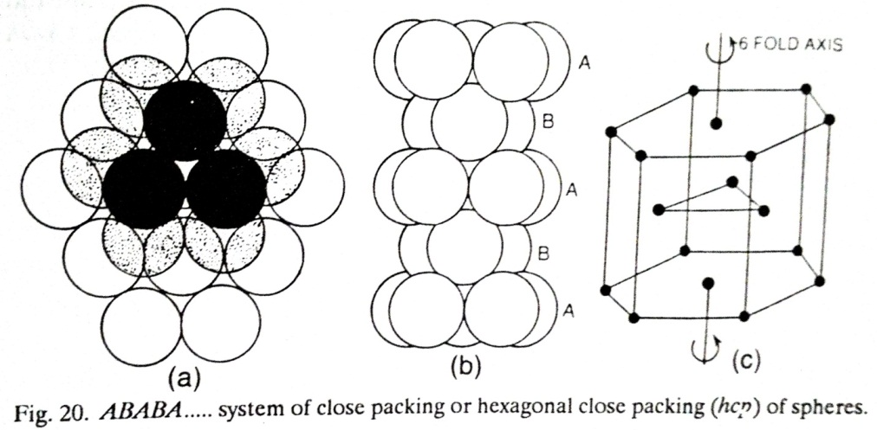
Hexagonal close packing arrangement (hcp) formed as follows
Place the spheres of Third layer on the holes of layer B (Second layer)
so that each sphere of third layer lies directly above spheres in the first layer
hence first and third layers becomes identical.
This arrangement is continued indefinitely in the same sequence is represented as A B A B A B A B - - - - is called as hexagonal close packing arrangement (hcp).

Slide 16
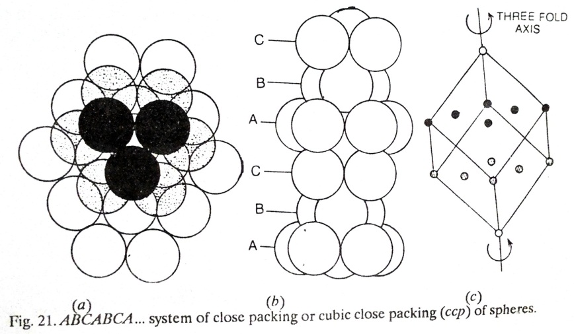
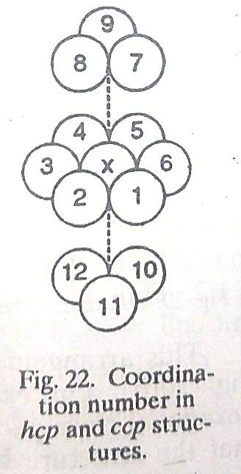
Hexagonal close packing arrangement (hcp) formed as follows
Place the spheres of third layer over the unoccupied holes (marked as stars) of layer B (Second layer).
The third layer is different than first and second layer hence third layer is called as layer C.
Therefore a first and fourth layer as well as second and fifth layers becomes identical.
This arrangement is continued indefinitely in the same sequence is represented as A B C A B C A B C A B C- - - - - - - is called as cubic close packing arrangement (ccp).
In hcp and ccp type of structures each sphere is surrounded by 12 other spheres.
Consider sphere x is in contact with six nearest spheres such as 1,2,3,4,5,6.
and sphere x is also in contact with six spheres which are 7,8,9 in the layer above and 10,11,12 in the layer below.
Therefore the co-ordination number in hcp and ccp structure is 12 as shown in the figure

Slide 17
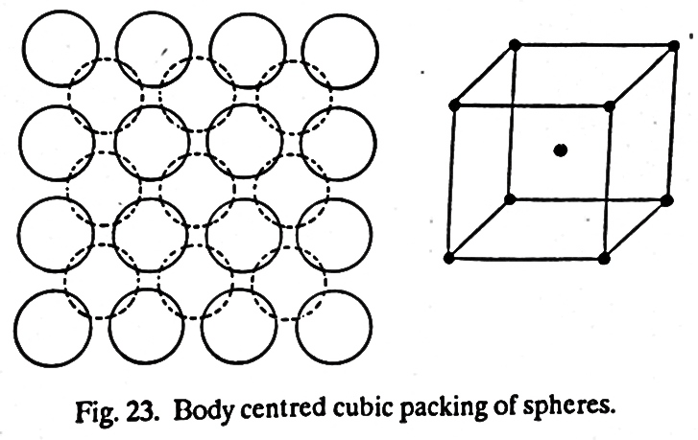
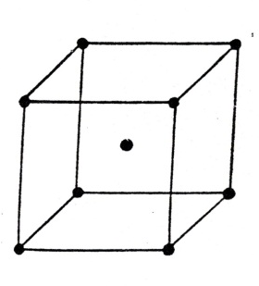
Body Centre Cubic (BCC) close packing-
The spheres can be packed other than hcp and ccp is body centre cubic close packing.
In the bcc close packing arrangement the spheres in the first layer of close packing are not in contact with each other.
The second layer shown by dotted circles are placed at the top of holes in the first layer.
Each sphere in the second layers is in contact with four spheres of first layer.
The third layer is formed by placing spheres exactly above the first layer.
Therefore in body centre cubic close packing structure each sphere is in contact with eight spheres i.e. 4 spheres in the layer below and 4 spheres in the layer above.
Hence co-ordination number of each sphere is 8. In body centre cubic close packing arrangement, there are 8 spheres at the corners of the cube and one sphere is at the centre (body) of cube therefore the structure is called as body centre cubic (bcc) structure.
The volume occupied by the ccp arrangement is 74% of the total volume.
The volume occupied by the bcc arrangement is 68% of the total volume.

Slide 18
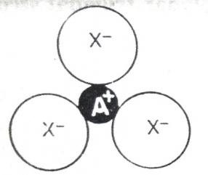


Radius ratio rules and shapes of the Ionic Crystals- The structures of many ionic solids can be explained on the basis of the relative sizes of the positive and negative ions as well as their relative numbers. The simple geometric calculations can give the prediction about how many ions of a given size can be in contact with smaller ions in order to predict the co-ordination number from the relative sizes of the ions.
Example 1- In an ionic compounds AX having co-ordination number three where three X- ions are in contact with one A⁺ ion but these three X⁻ ions do not touches to each other then by simple geometry gives radius ratio as
= 0.225
0.225 is the higher limit for CN = 3
The stable structure of ionic compound AX with CN =3
Example 2- In an ionic compounds AX having co-ordination number three where three X- ions are in contact with one A+ ion and these three X- ions also in contact with each other then by simple geometry gives radius ratio as
= 0.155
0.155 is the lower limit for CN = 3
The stable structure of ionic compound AX with CN =3

Slide 19

Example 3- In an ionic compounds AX having co-ordination number three where three X⁻ ions are not in contact with one A⁺ ion and these three X⁻ ions are in contact with each other then by simple geometry gives radius ratio as
< 0.155
The radius ratio less than 0.155 indicate that A⁺ ion is trapped in the hole and structure becomes unstable.
The Unstable structure of ionic compound AX with CN =3
Relation between radius ratio, co-ordination number and geometry-
The permitted coordination numbers and structural arrangements of anions around cations for different radius ratios are given in the following Table
Limiting Radius Ratios (r⁺ / r ⁻) | Permitted CN | Structural Arrangement | Example
Less than 0·155 | 2 | Linear | BeH₂
0·155 – 0.225 | 3 | Plane trigonal | Boron oxide, BO₃³⁻, Boron nitride (BN)
0.225 – 0.414 | 4 | Tetrahedral | ZnS type structure e.g. ZnO, CuCl, CuBr, CuI, SiO₄²⁻
0.225 – 0·414 | 4 | Square planar
0.414 – 0·732 | 6 | Octahedral | NaCl type structure e.g. AgF, AgCl, AgBr
0.732 – 1.0 | 8 | Cubic | CsCl type structure e.g. CsBr, CsI, TlCl, TlBr

Slide 20
If the radius ratio is greater than 0.155 then it is possible to fit three X- ions around the A+ ion.
If difference in the size of two ions increases then radius ratio also increases and at same point (when ratio exceeds 0.225) it becomes possible to fit 4 ions around one ion or 6 ions around one ion or 8 ions around one ion.
The co-ordination number 3, 4, 6, 8 are common and limiting radius ratio can be determined from simple geometry.
If ionic radius of cations and anions are known then radius ratio can be calculated and from radius ratio co-ordination number as well as geometry (shape or structure) may be predicted.
The radius ratio is a very important factor in determining the most stable form of arrangement of ions in the crystal lattice of an ionic solid.
According to radius ratio, maximum stability is attained for the structure of ionic solids when every ion is surrounded by maximum possible ions of opposite charge i.e. by maximum co-ordination number. This assumption is simple but difficult to apply.
If the positive ion is not touching any of the negative ions then the force of attraction is weak. At the same time the negative ions are in direct contact with one another, therefore force of repulsion will be strong. Hence, such a structure is unstable and cannot exist.

Slide 21
It would be useful to remember that
For coordination number 3, the lowest i.e. the limiting radius ratio is 0·155.
For AX type crystals,
if the radius ratios is 0.732 or above then crystal would have CsCl type structure i.e. body- centered cubic structure in which each ion has CN = 8.
If the radius ratio is less than 0·732 but equal to or greater than 0·414 then crystal would have NaCl type structure in which each ion has a CN= 6.
If the radius ratio is less than 0·414 but equal to or higher than 0.225 then crystal would have a ZnS type structure in which each ion has a CN = 4
If the radius ratio is less than 0.225 but equal to or higher than 0.155 then crystal would adopt a planar trigonal structure in which the CN of each ion is 3.
3. For AX₂ type crystals,
If the radius ratio lies between 0·414 and 0.732, the crystal would adopt rutile (TiO₂) type structure in which coordination number of cation is 6 and that of anion is 3.

Slide 22
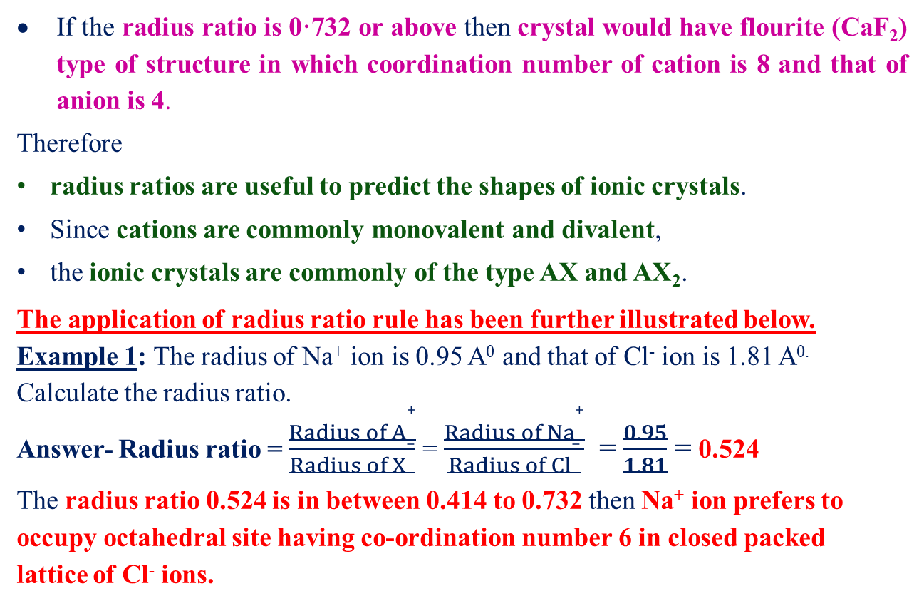
If the radius ratio is 0·732 or abovethencrystal would have flourite (CaF₂) type of structure in which coordination number of cation is 8 and that of anion is 4.
Therefore
radius ratios are useful to predict the shapes of ionic crystals.
Since cations are commonly monovalent and divalent,
the ionic crystals are commonly of the type AX and AX₂.
The application of radius ratio rule has been further illustrated below.
Example 1: The radius of Na⁺ ion is 0.95 A⁰ and that of Cl⁻ ion is 1.81 A^{0.} Calculate the radius ratio.
Answer- Radius ratio = $\frac{{Radius of A}^{+}}{{Radius of X}^{−}}$ = $\frac{{Radius of Na}^{+}}{{Radius of Cl}^{−}}$ = $\frac{0.95}{1.81}$ = 0.524
The radius ratio 0.524 is in between 0.414 to 0.732 then Na⁺ ion prefers to occupy octahedral site having co-ordination number 6 in closed packed lattice of Cl⁻ ions.

Slide 23
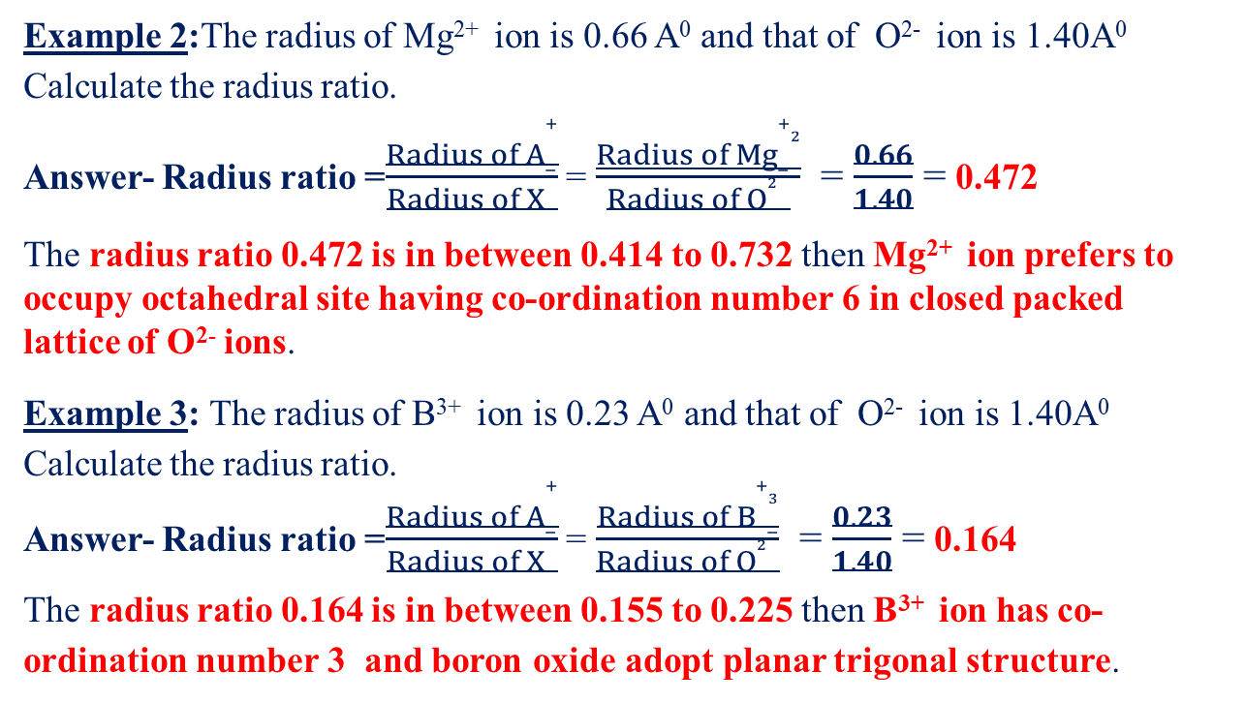
Example 2:The radius of Mg²⁺ ion is 0.66 A⁰ and that of O²⁻ ion is 1.40A⁰ Calculate the radius ratio.
Answer- Radius ratio =$\frac{{Radius of A}^{+}}{{Radius of X}^{−}}$ = $\frac{{Radius of Mg}^{+2}}{{Radius of O}^{2−}}$ = $\frac{0.66}{1.40}$ = 0.472
The radius ratio 0.472 is in between 0.414 to 0.732then Mg²⁺ ion prefers to occupy octahedral site having co-ordination number 6 in closed packed lattice of O²⁻ ions.
Example 3: The radius of B³⁺ ion is 0.23 A⁰ and that of O²⁻ ion is 1.40A⁰ Calculate the radius ratio.
Answer- Radius ratio =$\frac{{Radius of A}^{+}}{{Radius of X}^{−}}$ = $\frac{{Radius of B}^{+3}}{{Radius of O}^{2−}}$ = $\frac{0.23}{1.40}$ = 0.164
The radius ratio 0.164 is in between 0.155 to 0.225 then B³⁺ ion has co-ordination number 3 and boron oxide adopt planar trigonal structure.

Slide 24
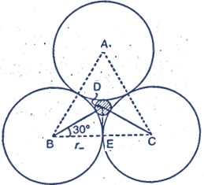
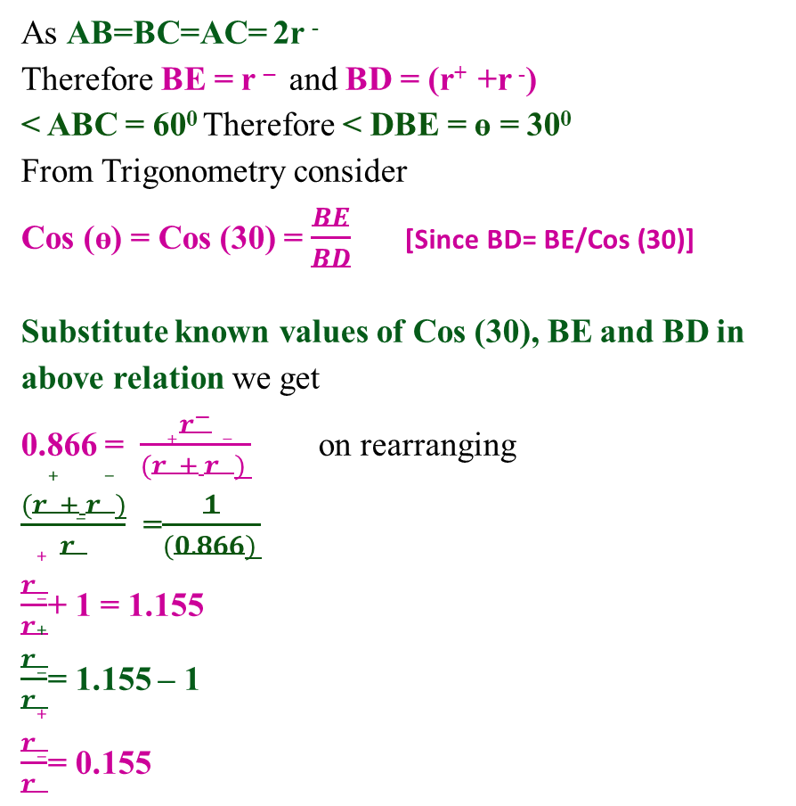
Calculation of some limiting radius ratio values -
1) Co-ordination number Three (Planar triangular)- The smaller positive charge of radius r⁺ is in contact with three negative ions of radius r ⁻ as shown in figure
As AB=BC=AC= 2r ⁻ Therefore BE = r – and BD = (r⁺ +r ⁻)
< ABC = 60⁰ Therefore < DBE = ө = 30⁰
From Trigonometry consider
Cos (ө) = Cos (30) = $\frac{BE}{BD}$ [Since BD= BE/Cos (30)]
Substitute known values of Cos (30), BE and BD in above relation we get
0.866 = $\frac{r^{−}}{(r^{+}+ r^{ −}) }$ on rearranging
$\frac{(r^{+}+ r^{ −})}{r^{−}}$ =$\frac{1}{(0.866) }$
$\frac{r^{+}}{r^{−}}$+ 1 = 1.155
$\frac{r^{+}}{r^{−}}$= 1.155 – 1
$\frac{r^{+}}{r^{−}}$= 0.155

Slide 25
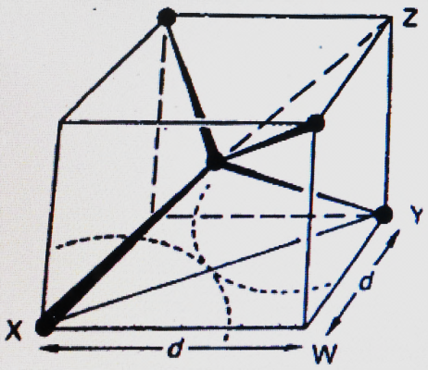
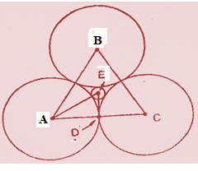
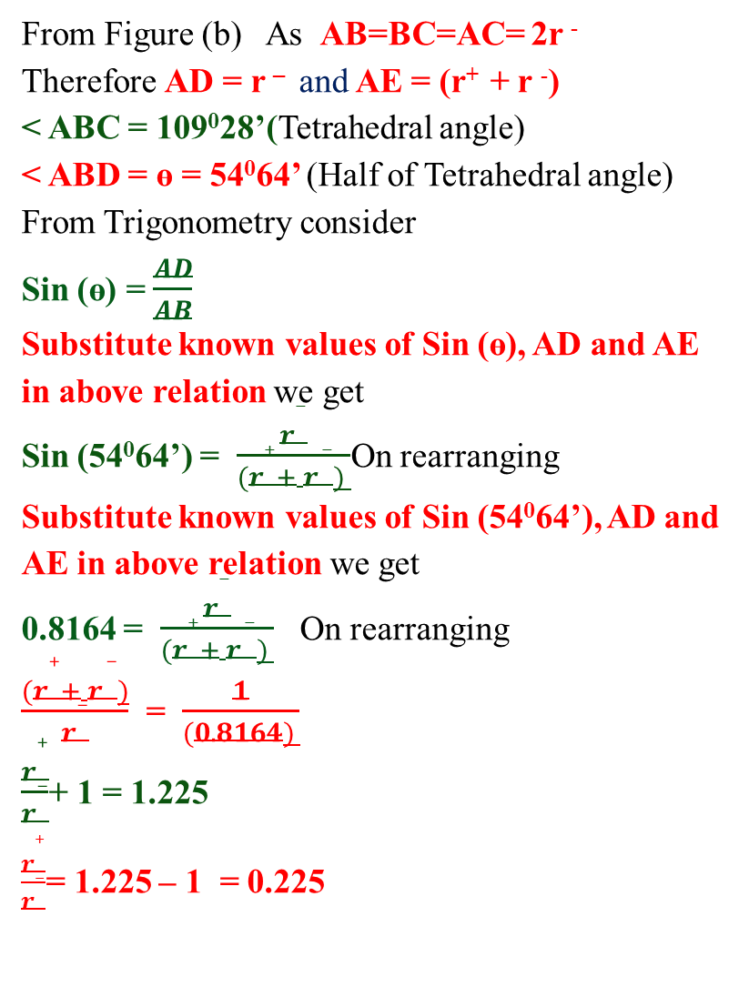
2) Co-ordination number Four (Tetrahedral)-The smaller positive charge of radius r⁺ is in contact with three negative ions of radius r ⁻ as shown in figure
From Figure (b) As AB=BC=AC= 2r ⁻ Therefore AD = r – and AE = (r⁺ + r ⁻)
< ABC = 109⁰28’(Tetrahedral angle)
< ABD = ө = 54⁰64’ (Half of Tetrahedral angle)
From Trigonometry consider
Sin (ө) = $\frac{AD}{AB}$
Substitute known values of Sin (ө), AD and AE in above relation we get
Sin (54⁰64’) = $\frac{r^{−}}{(r^{+}+ r^{ −}) }$On rearranging
Substitute known values of Sin (54⁰64’), AD and AE in above relation we get
0.8164 = $\frac{r^{−}}{(r^{+}+ r^{ −}) }$ On rearranging
$\frac{(r^{+}+ r^{ −})}{r^{−}}$ = $\frac{1}{(0.8164) }$
$\frac{r^{+}}{r^{−}}$+ 1 = 1.225
$\frac{r^{+}}{r^{−}}$= 1.225 – 1 = 0.225
Figure (a)
Figure (b)

Slide 26
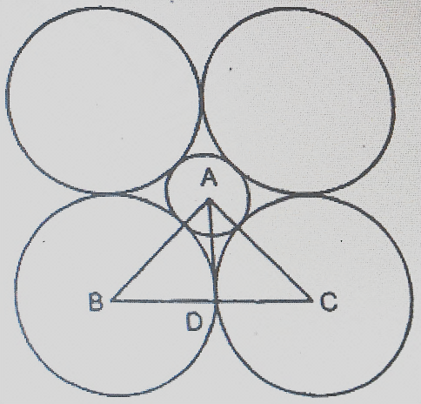
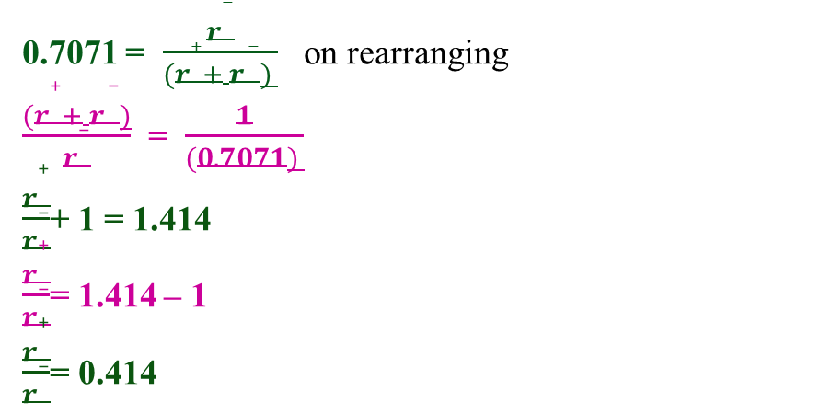
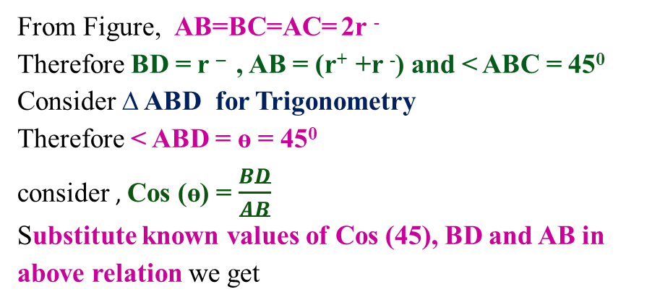
3) Co-ordination number Six (Octahedral)- The smaller positive charge of radius r⁺ is in contact with three negative ions of radius r ⁻ as shown in figure
The smaller positive ion having radius r⁺ touches with 6 larger negative ions having radius r⁻. Only four negative ions are shown in figure but there are two more anions are present i.e. one anion above plane and another anion present below the plane of the paper.
From Figure, AB=BC=AC= 2r ⁻
Therefore BD = r – , AB = (r⁺ +r ⁻) and < ABC = 45⁰
Consider ∆ ABD for Trigonometry
Therefore < ABD = ө = 45⁰
consider , Cos (ө) = $\frac{BD}{AB}$
Substitute known values of Cos (45), BD and AB in above relation we get
0.7071 = $\frac{r^{−}}{(r^{+}+ r^{ −}) }$ on rearranging
$\frac{(r^{+}+ r^{ −})}{r^{−}}$ = $\frac{1}{(0.7071) }$
$\frac{r^{+}}{r^{−}}$+ 1 = 1.414
$\frac{r^{+}}{r^{−}}$= 1.414 – 1
$\frac{r^{+}}{r^{−}}$= 0.414

Slide 27
A cautionary word on radius ratio- On the basis of geometric consideration the radius ratio provides useful information about the possibility of co-ordination number and possible structure for ionic solid. The radius ratio does not necessarily and completely reliable method for predicting which structure is actually adopted but there are some other factors also considered.
The radius ratio predicts the correct structure but there are some exceptions where they predict the wrong prediction for the structure. Therefore it is essential to examine the assumptions of radius ratio concept.
Assumptions of radius ratio concept–
Accurate radii of cations and anions must be known-
The values of ionic radii cannot be measured absolutely but are estimated.
The ionic radii are not completely accurate and reliable.
The inter-ionic distance between cation and anions is determined by X- ray crystallography but it is difficult to obtain individual values for radius of cation and radius of anion.
The radius of ions is not constant but changes with its environment. Thus radius ratio changes with change in co-ordination number

Slide 28
Ex: 1- The ionic radius increases 3% when co-ordination number increases from 6 to 8.
Ex: 2- The ionic radius decreases 6% when co-ordination number decreases from 6 to 4.
The ions behaves as hard inelastic spheres – If the ions are not hard inelastic spheres then they are sometimes fitted into holes (interstitial sites) that are slightly too small therefore ions gets compressed and lattice structure may be distorted.
The stable arrangements are possible only if the positive and negative ions touch each other –
This assumption is necessary to calculate the critical lower limit for radius ratio.
The positive and negative ions should touch each other so that cations and anions sufficiently close together to obtain maximum electrostatic attraction.
Theoretically obtained structures where the smaller metal ions trapped in its holes (cations not touches with anions) should be unstable.
More electrostatic attraction is obtained by adopting different geometric arrangements with smaller co-ordination number so that ions can get closer to each other.

Slide 29
The ions must be spherical in shape –
The ions with a inert gas structure are considered to have spherical shape. This includes majority of ions formed by elements in the main groups (S and P block elements).
The ions such as Ga⁺, In⁺, Tl⁺, Sn⁺², Pb⁺², I⁺,⁺³ I etc. contain inert pairs. These ions do not have centre of symmetry hence the structure show some distortions with metal ion not at centre. Since some transition metal ions with partially filled d orbitals are not spherical.
4. The ions always adopt highest possible co-ordination number – In order to obtain ionic compounds with stable geometric arrangement the ions must adopt highest possible co-ordination number. The maximum stability for ionic solids obtained when every ion is surrounded by maximum co-ordination number.
Ex.:1- In AX type salt (A is cation and X is anion) the co-ordination number A and X are same. If co-ordination number of A⁺ ion will increases then more X⁻ ions are nearest neighbours which have more A⁺ ions as next nearest neighbors. So that increase in electrostatic attraction is cancelled by subsequent increase in electrostatic repulsion. Therefore higher co-ordination number predicted on the basis radius ratio rule considerations cannot be applied in actual practice.

Slide 30
Ex.:2- If A⁺ ion and X⁻ ion have same size then it is possible to packed 12 X⁻ ions around A⁺ ion but it is impossible to surround each X⁻ ion by A⁺ ion.
The bonding in ionic solids must be 100% ionic– It is most unlikely that bonding is ever 100% ionic. The retention of NaCl type structure by number of ionic compounds which might be expected to adopt CsCl type structure due to slight covalent contribution to the bond.
The ionic compounds formed particular structure due to most favourable lattice energy- The radius ratio rules provide guideline about possibility of geometry or structure for ionic compounds. The radius ratio often but not always predicts the correct structure for ionic solids. Therefore ionic compound with higher negative lattice energy is most stable ionic compound.
Structures or Ionic Crystals-
The salts such as halides, oxides, sulphides, carbides, arsenides etc. and majority of ionic crystals belongs to ionic compounds.
Ionic crystals consist entirely of positively and negatively charged units called as ions.
For maximum stability the arrangements of ions in the crystal should be such that force of attraction must be maximum and force of repulsion must be minimum.
Hence for maximum stability of ionic crystals, the oppositely charged ions should be as close as possible to one another and similar charged ions as far away from one another as possible.

Slide 31
The structure of an ionic compound depend largely on relative sizes of the cations and anions. For example, if anions are larger then anions form a close-packed arrangement and the cations just fit into or occupy tetrahedral or octahedral holes (interstitial sites).
In the case of ionic compound having general formula AX, [e.g. Sodium chloride (NaCl) or Zinc sulphide (ZnS)], in which the number of cations and anions are same i.e. the coordination number of the positive ion is the same as that of the negative ion.
But in the case of ionic compound having general formula AX₂ [e.g.CaCl₂] or A₂X [e.g.Na₂S) in which the number of cations and anions are different i.e. coordination number of positive ion is different than that of negative ions. E.g In calcium chloride, chloride ions are twice as many as calcium ions. Hence coordination number of calcium ion is twice the coordination number of chloride ion.
Classification of Ionic compounds- The ionic compounds classified as A) AX B) AX₂. C) AX₃ depending on relative numbers of positive and negative ions. The ionic structures can be described in terms of close-packed arrangements of large anions with small cations occupying the tetrahedral or octahedral holes (interstitial sites).
A) AX type ionic compounds- AX type arrangements is commonly found in three structural arrangements such as 1) NaCl 2) ZnS 3) CsCl discussed as follows

Slide 32
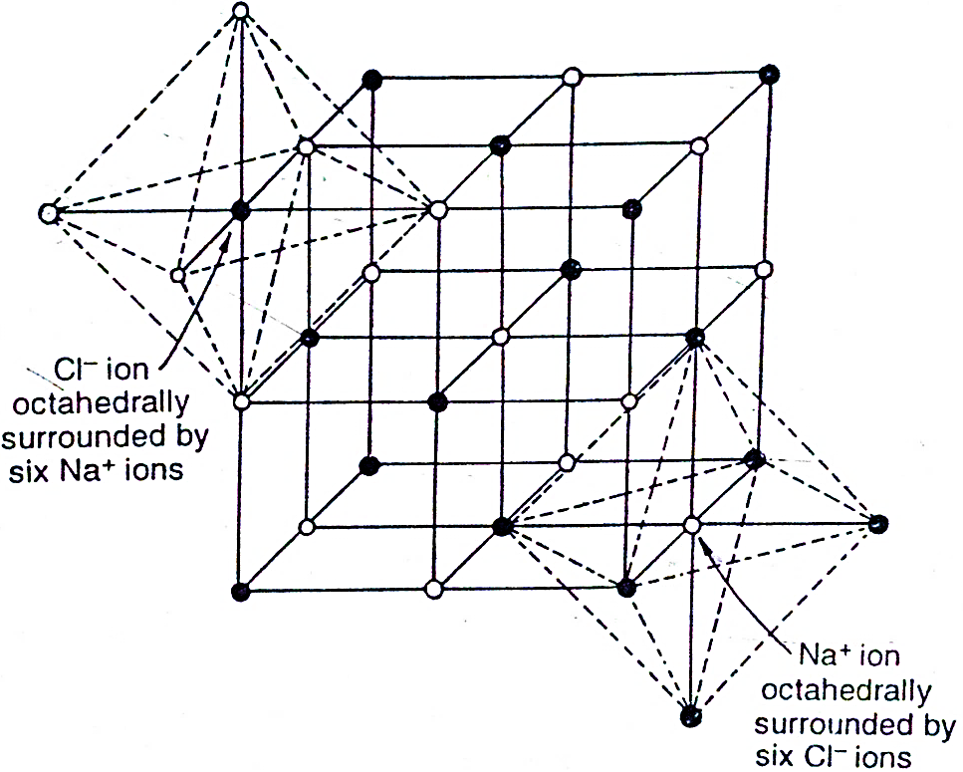
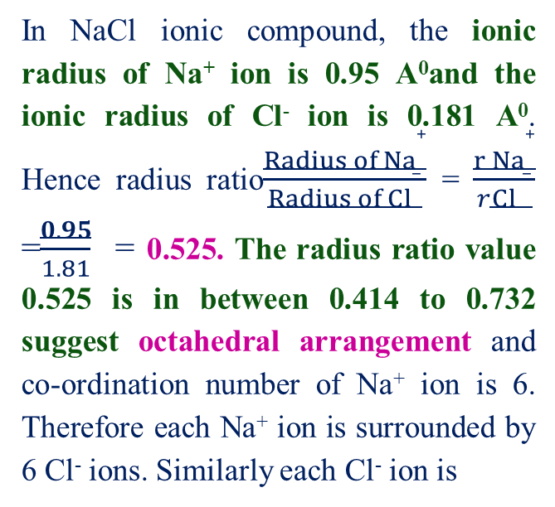
Structure of Sodium Chloride (NaCl)- The unit cell of sodium chloride crystal is shown in the following figure. The sodium ions are represented by hollow circles and chloride ions by solid circles.
In NaCl ionic compound, the ionic radius of Na⁺ ion is 0.95 A⁰and the ionic radius of Cl⁻ ion is 0.181 A⁰. Hence radius ratio$\frac{{Radius of Na}^{+}}{{Radius of Cl}^{−}}$ = $\frac{{r Na}^{+}}{r{Cl }^{−}}$ =$\frac{0.95}{1.81}$ = 0.525. The radius ratio value 0.525 is in between 0.414 to 0.732 suggest octahedral arrangementand co-ordination number of Na⁺ ion is 6. Therefore each Na⁺ ion is surrounded by 6 Cl⁻ ions. Similarly each Cl⁻ ion is
surrounded by 6 Na⁺ ions which indicate that co-ordination number of Na⁺ and Cl⁻ ions is 6. Therefore NaCl shows 6:6 arrangement or structure.
The main or important features of NaCl structure are as follows
The chloride ions are arranged in cubic close packing (ccp) arrangement. In this arrangement, there are Cl⁻ ions at the corners of the cube as well as at the centre of each face (face centred cubic arrangement).

Slide 33
The sodium ions occupy all the octahedral sites.
There is only one octahedral site per atom in a close packed lattice. Therefore, there will be one Na⁺ ion for every Cl⁻ ion. This corresponds to 1 : 1 (A:X) stoichiometry for sodium chloride crystal.
1:1 stoichiometry of NaCl can also be understood by counting the number of Na⁺ and Cl⁻ ions which contribute to the unit cell discussed as follows
In NaCl, eight Cl⁻ ions at the corners and six at the faces of the cubic unit cell. Thus each ion at the corner is shared between eight unit cells and its contribution per unit cell is 1/8. Similarly each ion on a six face is shared by two unit cells so that its contribution per unit cell is 1/2.
Number of Cl⁻ ions for the cubic unit cell= [(8 x 1/8) + 6x(1/2)]= 4.
The number of sodium ions can also be calculated in a similar way. There are twelve Na⁺ ions on the edges and one inside the cell. It can be easily seen that each Na⁺ ion on the edge is shared by four unit cells and its contribution per unit cell is 1/4, while the Na⁺ ion at the body centre contributes only to one unit cell.
Number of Na⁺ ions for the cubic unit cell = [(12 x 1/4)+ 1]= 4
The NaCl structure is adopted by most of the alkali metal halides (e.g. NaCl, KCl, RbCl), alkaline earth metal oxides (e.g. MgO, CaO), silver halides (e.g. AgF, AgCl, AgBr), ammonium salts (NH₄Cl, NH₄Br)

Slide 34
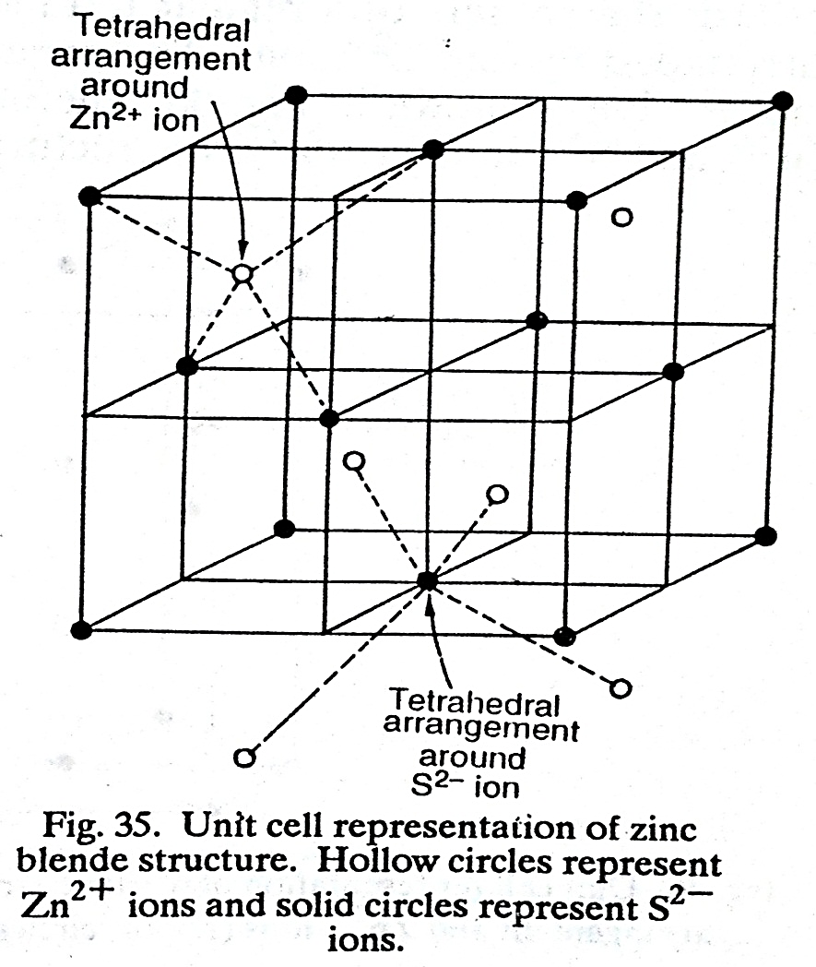
Zinc blende Structure- The unit cell for Zinc blende structure is shown in following figure In ZnS ionic compound, the ionic radius of Zn²⁺ ion is 0.74 A⁰ and the ionic radius of S²⁻ ion is 1.84 A⁰. Hence radius ratio = 0.525.
The radius ration value 0.402 is in between 0.225 to 0.414 suggest tetrahedral arrangement
In Zinc blende structure of ZnS, each Zn²⁺ ion is represented by a hollow circle and each S²⁻ ion is represented by a solid circle. The Zinc blende structure may be described as follows
The sulphide ions are arranged in cubic closed packed (ccp) arrangement i.e. sulphide ions are at the corners of the cube and at the centre of each face.
There are two tetrahedral holes (interstitial sites) per atom in a close packed lattice i.e. there are two tetrahedral sites per S²⁻ ion.
In this arrangement, only half of the tetrahedral sites are occupied by Zn²⁺ ions so that each S²⁻ ion has one Zn²⁺ ion. hence stoichiometry of ZnS compound is 1 : 1.
Each zinc ion is surrounded by four sulphide ions which are inclined towards the corners of a regular tetrahedron. Similarly each S²⁻ion is surrounded by four Zn²⁺ ions. Thus co-ordination number of Zn²⁺ ions and S²⁻ ions is 4. Therefore Zinc blende shows 4:4 arrangement or structure.
Zinc blende structure is also adopted by some other compounds such as ZnO, CuCl, CuBr, CuI, etc.

Slide 35
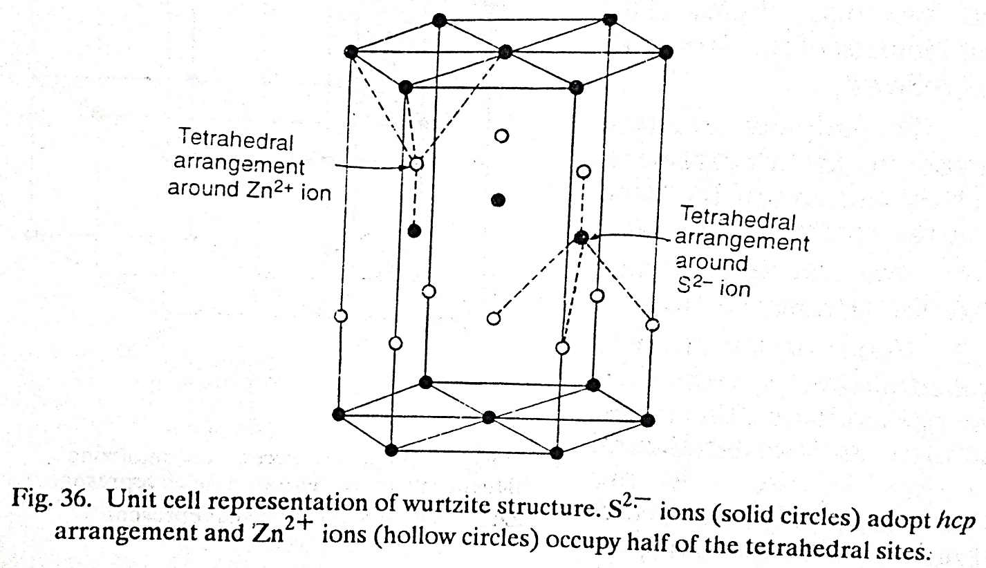
b) Wurtzite Structure- In the unit cell for Wurtzite structure of ZnS, each Zn²⁺ ion is represented by a hollow circle and each S²⁻ ion is represented by a solid circle. The Wurtzite structure may be described as follows
The sulphide ions are arranged in a hexagonal close packed (hcp) arrangement.
The zinc ions occupy half of the tetrahedral sites.
There are two tetrahedral sites for each S²⁻ ion in the lattice. Since only half of them are occupied by Zn²⁺ ions, the stoichiometry of the compound is 1 : 1.
Each S²⁻ ion is surrounded by four Zn²⁺ ions which are inclined towards the corners of a regular tetrahedron.
Similarly, each Zn²⁺ ion is surrounded by four S²⁻ ions.
Therefore coordination numbers of Zn²⁺ and S²⁻ ions in Wurtzite structure is 4. The ZnS Wurtzite structure shows 4 : 4 arrangement.
The compounds such as AgI, ZnO, NH₄F and AlN adopt Wurtzite structure.

Slide 36
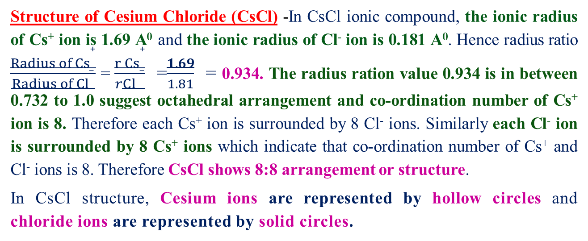
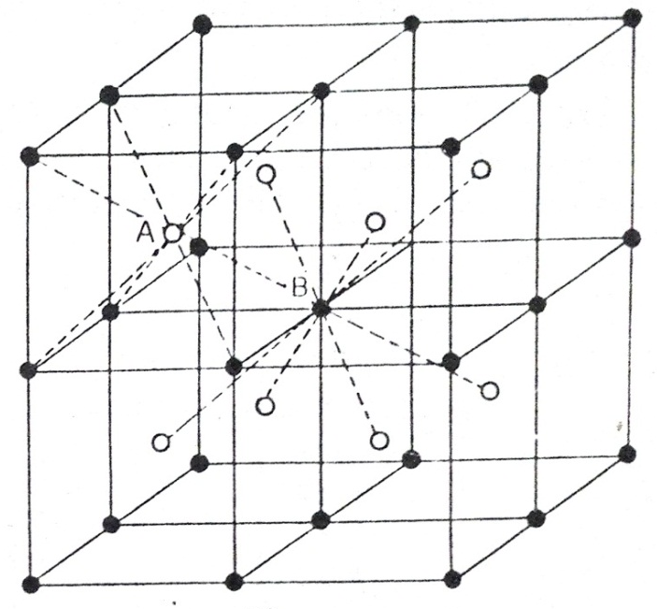


Slide 37
The CsCl structure may be described as body centred cubic structure. But this would be a misnomer because the body centred cubic structure is one which has the same atoms at the body centre as well as the corners. But in CsCl, the atoms at the corners are different from the atoms at the centre.
Since coordination numbers of ions in CsCl (8 : 8) are higher than those in NaCl (6 : 6) so that Cesium chloride lattice would be more stable because each ion would have more ions of opposite charge as its neighbours. Therefore Cesium chloride lattice is 1 per cent more stable than the sodium chloride lattice.
If CsCI lattice is more stable then why the halides of Li, Na, K and Rb do not adopt CsCl arrangement (lattice) ?
Answer- The radius ratio in the halides of Li, Na, K and Rb is in between 0·414 and 0.732 therefore the coordination number has to be 6.
If an attempt is made to pack 8 halide ions around a smaller positive ion like Na⁺ ion then some of the negative ions will touch each other as compared to a positive ion.
Hence the lattice (structure) would becomes unstable which can be overcome by packing 6 negative ions around the central positive ion and the coordination number of 6 is preferred instead of 8.
CsCl type of structure is adopted by CsBr, CsI, TICl, TlBr, etc.

Slide 38
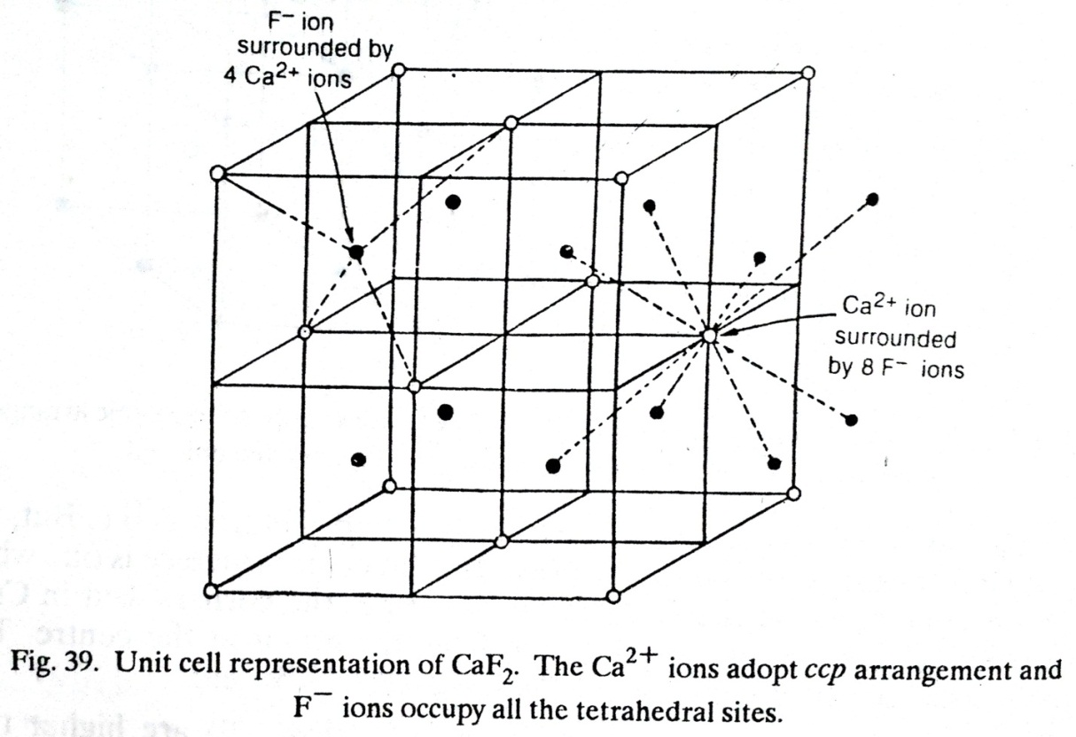
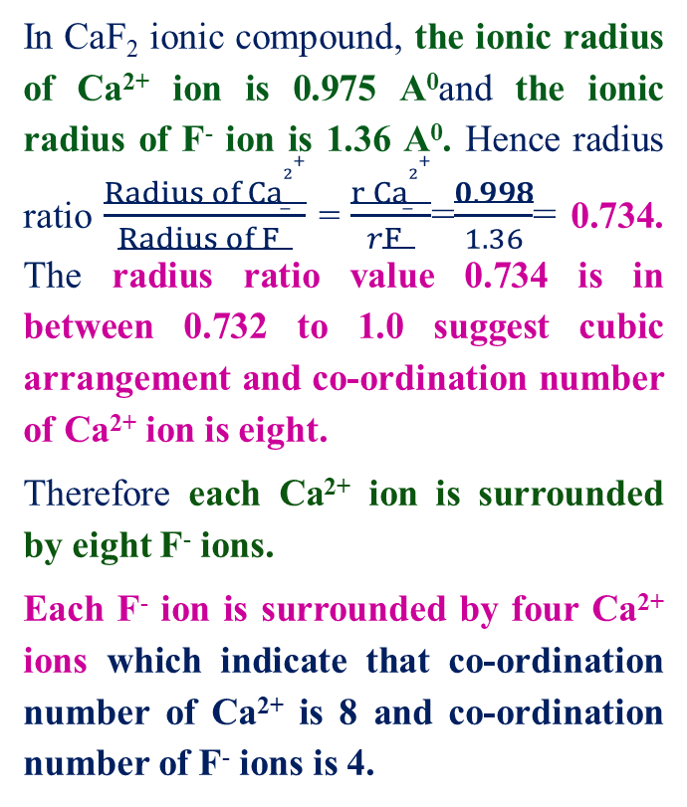
B] AX₂ type ionic compounds- AX₂ type arrangements is commonly found in three structural arrangements such as 1) CaF₂ 2) TiO₂ 3) CaC₂ 4) CdI₂ discussed as
Structure of Calcium Fluoride (CaF₂) – In the unit cell of CaF₂ , the calcium ions are represented by hollow circles and fluoride ions are represented by solid circles.
In CaF₂ ionic compound, the ionic radius of Ca²⁺ ion is 0.975 A⁰and the ionic radius of F⁻ ion is 1.36 A⁰. Hence radius ratio $\frac{{Radius of Ca}^{2+}}{{Radius of F}^{−}}$ = $\frac{{r Ca}^{2+}}{rF^{−}}$=$\frac{0.998}{1.36}$= 0.734. The radius ratio value 0.734 is in between 0.732 to 1.0 suggest cubic arrangement and co-ordination number of Ca²⁺ ion is eight.
Therefore each Ca²⁺ ion is surrounded by eight F⁻ ions.
Each F⁻ ion is surrounded by four Ca²⁺ ions which indicate that co-ordination number of Ca²⁺ is 8 and co-ordination number of F⁻ ions is 4.
Therefore CaF₂ shows 8:4 arrangement or structure.

Slide 39
The CaF₂ structure may be described as follows:
The Ca²⁺ ions are arranged in cubic closed packed (ccp) arrangement so that Ca²⁺ ions are situated at all the corners of cube and at the centre of each face of the cube.
There are two tetrahedral sites for each Ca²⁺ ion and F⁻ ions occupy all the tetrahedral sites hence there will be two F⁻ ions for each Ca²⁺ ion. Therefore stoichiometry of the CaF₂ compound is 1: 2.
The CaF₂ structure is adopted by a large number of fluorides such as BaF₂, SrF₂, PbF₂, HgF₂, CuF₂etc.

Slide 40
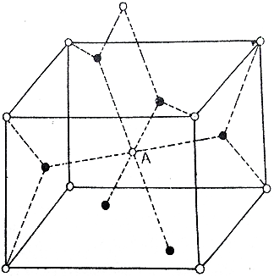
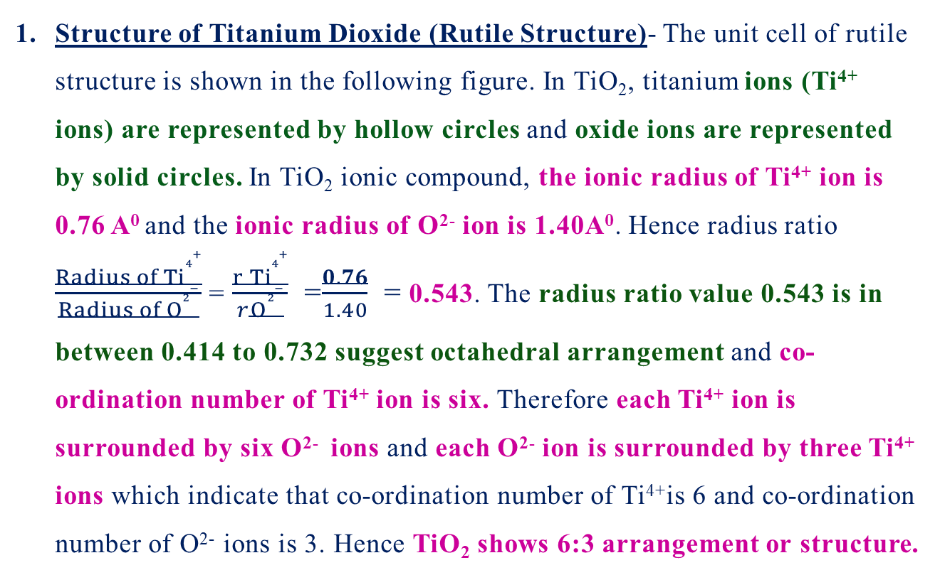
Structure of Titanium Dioxide (Rutile Structure)- The unit cell of rutile structure is shown in the following figure. In TiO₂, titanium ions (Ti⁴⁺ ions) are represented by hollow circles and oxide ions are represented by solid circles. In TiO₂ ionic compound, the ionic radius of Ti⁴⁺ ion is 0.76 A⁰ and the ionic radius of O²⁻ ion is 1.40A⁰. Hence radius ratio $\frac{{Radius of Ti}^{4+}}{{Radius of O}^{2−}}$ = $\frac{{r Ti}^{4+}}{rO^{2−}}$ =$\frac{0.76}{1.40}$ = 0.543. The radius ratio value 0.543 is in between 0.414 to 0.732 suggest octahedral arrangement and co-ordination number of Ti⁴⁺ ion is six. Therefore each Ti⁴⁺ ion is surrounded by six O²⁻ ions and each O²⁻ ion is surrounded by three Ti⁴⁺ ions which indicate that co-ordination number of Ti⁴⁺is 6 and co-ordination number of O²⁻ ions is 3. Hence TiO₂ shows 6:3 arrangement or structure.
The titanium ions are arranged in a distorted body centred cubic arrangement. Thus titanium ions are present at all the corners and at the centre of the distorted cube.
The TiO₂ structure cannot be described as cubic because one of the axes is shorter than the other by 30 per cent. Therefore TiO₂ structure may be described as distorted cubic.

Slide 41
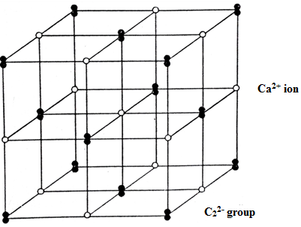
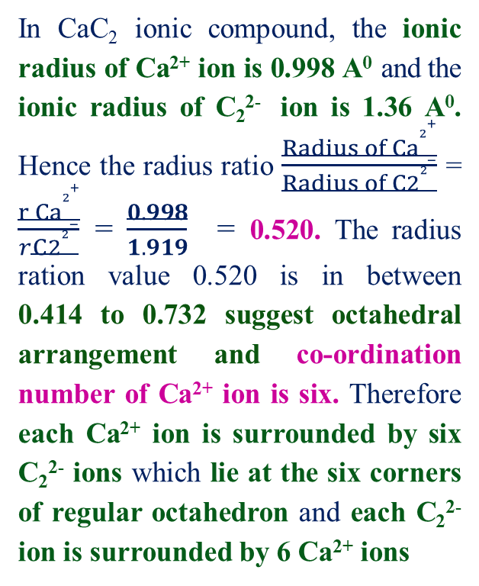
Structure of calcium carbide- The structure of calcium carbide is similar to that of sodium chloride as shown in the following figure.
In CaC₂ ionic compound, the ionic radius of Ca²⁺ ion is 0.998 A⁰ and the ionic radius of C₂²⁻ ion is 1.36 A⁰. Hence the radius ratio $\frac{{Radius of Ca}^{2+}}{{Radius of C2}^{2−}}$ = $\frac{{r Ca}^{2+}}{r{C2}^{2−}}$ = $\frac{0.998}{1.919}$ = 0.520. The radius ration value 0.520 is in between 0.414 to 0.732 suggest octahedral arrangement and co-ordination number of Ca²⁺ ion is six. Therefore each Ca²⁺ ion is surrounded by six C₂²⁻ ions which lie at the six corners of regular octahedron and each C₂²⁻ ion is surrounded by 6 Ca²⁺ ions
which indicate that co-ordination number of Ca²⁺ and C₂²⁻ ions is 6. Hence CaC₂ shows 6:6 arrangement or structure.

Slide 42
Similar to NaCl structure, sodium ions are replaced by calcium ions and chloride ions by C₂ groups.
The carbon atoms are associated in pairs forming the C₂ groups. These groups are aligned in parallels direction along one of the unit cell axis.
The sodium chloride cubic symmetry but calcium carbide shows distorted cubic structure considerably due to presence of elongated (parallel) C₂²⁻ groups.
The presence of non-spherical group C₂²⁻ion distorts the cubic structure.
The structure of FeS₂ is similar to that of CaC₂. but the S₂ units are not aligned in parallels as in the case of CaC₂.

Slide 43
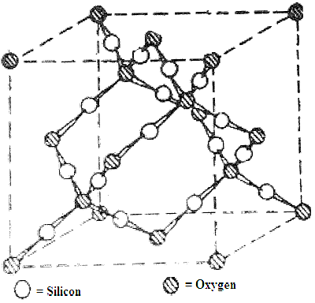
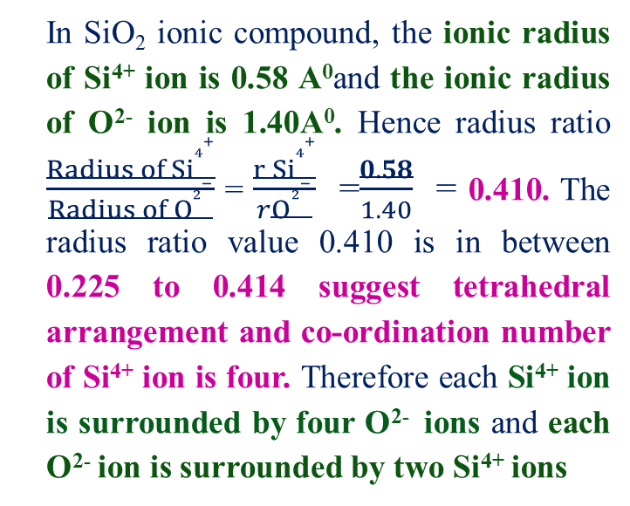
β-cristobalite (silicate) structure- Silica (SiO₂) exists in six different crystalline forms as α and β quartz, α and β cristobalite and α and β tridymite.
In the unit cell of β-cristobalite, the oxygen ions are represented by hollow circles and silicon ions are represented by solid circles.
In SiO₂ ionic compound, the ionic radius of Si⁴⁺ ion is 0.58 A⁰and the ionic radius of O²⁻ ion is 1.40A⁰. Hence radius ratio $\frac{{Radius of Si}^{4+}}{{Radius of O}^{2−}}$ = $\frac{{r Si}^{4+}}{rO^{2−}}$ =$\frac{0.58}{1.40}$ = 0.410. The radius ratio value 0.410 is in between 0.225 to 0.414 suggest tetrahedral arrangement and co-ordination number of Si⁴⁺ ion is four. Therefore each Si⁴⁺ ion is surrounded by four O²⁻ ions andeach O²⁻ ion is surrounded by two Si⁴⁺ ions
which indicate that co-ordination number of Si⁴⁺is 4 and co-ordination number of O²⁻ ions is 2. Therefore SiO₂ shows 4:2 arrangement or structure.

Slide 44
The β-cristobalite structure is similar to zinc blende structure, with two interpenetrating close-packed lattices,
one lattice arising from Si occupying the S²⁻ positions and the other lattice from Si occupying the Zn²⁺ positions (i.e. the tetrahedral holes in the first lattice).
The oxygen atoms lie midway between the Si atoms, but are shifted slightly off the line joining the Si atoms hence the bond angle Si-O-Si is not 180°.

Slide 45
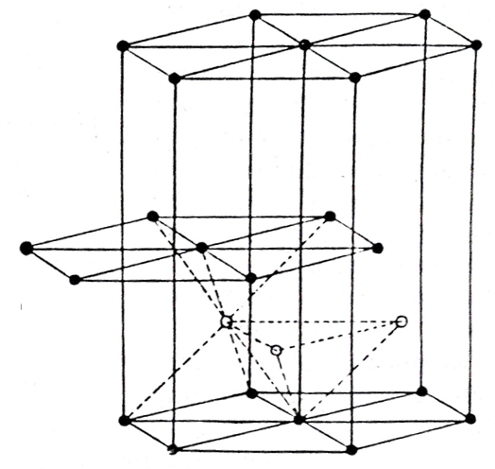
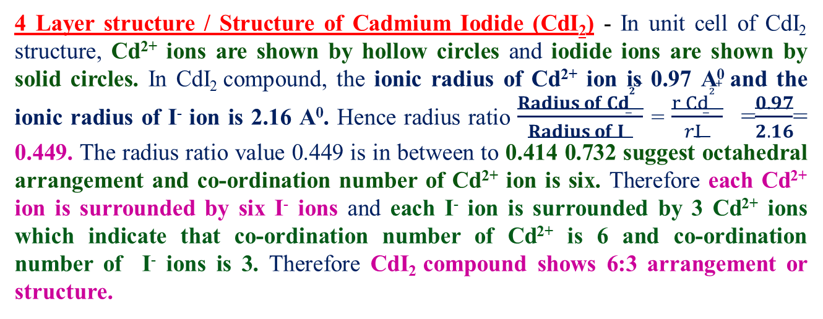
4 Layer structure / Structure of Cadmium Iodide (CdI₂)- In unit cell of CdI₂ structure, Cd²⁺ ions are shown by hollow circles and iodide ions are shown by solid circles. In CdI₂ compound, the ionic radius of Cd²⁺ ion is 0.97 A⁰ and the ionic radius of I⁻ ion is 2.16 A⁰. Hence radius ratio $\frac{{Radius of Cd}^{2+}}{{Radius of I}^{−}}$ = $\frac{{r Cd}^{2+}}{rI^{−}}$ =$\frac{0.97}{2.16}$= 0.449. The radius ratio value 0.449 is in between to 0.414 0.732 suggest octahedral arrangement and co-ordination number of Cd²⁺ ion is six. Therefore each Cd²⁺ ion is surrounded by six I⁻ ions andeach I⁻ ion is surrounded by 3 Cd²⁺ ions which indicate that co-ordination number of Cd²⁺ is 6 and co-ordination number of I⁻ ions is 3. Therefore CdI₂ compound shows 6:3 arrangement or structure.
The CdI₂ structure is made up of electrically neutral layers of Cd²⁺ ions with layers of I⁻ ions on both sides like sandwich. Where layers of Cd²⁺ ions is sandwiched (above and below) between two layers of I⁻ ions hence it is called as layer structure and it is not completely ionic.
In the CdI₂ layer structure, two layers of I⁻ ions are separated by layers of Cd²⁺ ions forms first layer and two adjacent layers of I⁻ ions are in contact with each other by weak Vander Wall forces between I⁻ ions forms second layer.

Slide 46
Therefore packing of layers in the crystal structure it not completely regular and it cleaves (break down) into two parallel sheets very easily. The third layer of I⁻ ions is directly above the first layer hence it gives repetitive pattern like ABABAB --------- indicate that I⁻ ions are hexagonally packed in the crystal lattice i.e. hexagonal close packed (hcp) arrangement.
The iodide ions are arranged in a hexagonal close packed (hcp) arrangement while cadmium ions lie in octahedral sites between every two layers of iodide ions.
Each Cd²⁺ ion is surrounded octahedrally by six I⁻ ions and each I⁻ ion has three Cd²⁺ ion as nearest neighbours. The three Cd²⁺ ion ions surround the I⁻ ion in an arrangement in which Cd²⁺ ions form the base of a trigonal pyramid whose apex is the I⁻ ion.
The arrangement of three layers, I - Cd - I, corresponds to the composition CdI₂ . This arrangement is continued is referred as a layer lattice. The forces present in between the I - Cd - I layers to hold together are weak (Vander Wall forces) . Hence CdI₂ compound is flaky and can be easily cleaved.

Slide 47
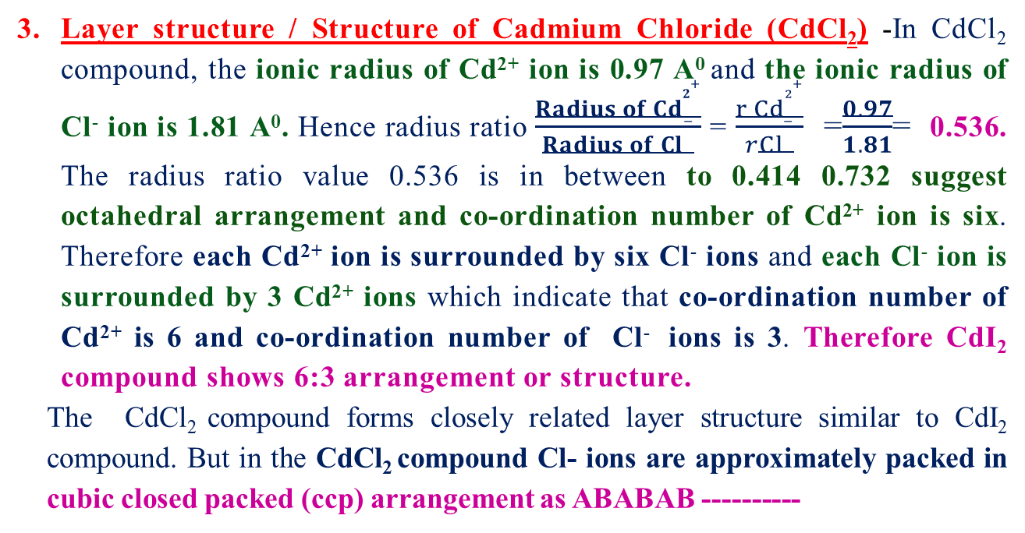
Layer structure / Structure of Cadmium Chloride (CdCl₂)-In CdCl₂ compound, the ionic radius of Cd²⁺ ion is 0.97 A⁰ and the ionic radius of Cl⁻ ion is 1.81 A⁰. Hence radius ratio $\frac{{Radius of Cd}^{2+}}{{Radius of Cl}^{−}}$ = $\frac{{r Cd}^{2+}}{r{Cl}^{−}}$ =$\frac{0.97}{1.81}$= 0.536. The radius ratio value 0.536 is in between to 0.414 0.732 suggest octahedral arrangement and co-ordination number of Cd²⁺ ion is six. Therefore each Cd²⁺ ion is surrounded by six Cl⁻ ions and each Cl⁻ ion is surrounded by 3 Cd²⁺ ions which indicate that co-ordination number of Cd²⁺ is 6 and co-ordination number of Cl⁻ ions is 3. Therefore CdI₂ compound shows 6:3 arrangement or structure.
The CdCl₂ compound forms closely related layer structure similar to CdI₂ compound. But in the CdCl₂ compound Cl- ions are approximately packed in cubic closed packed (ccp) arrangement as ABABAB ----------

Slide 48
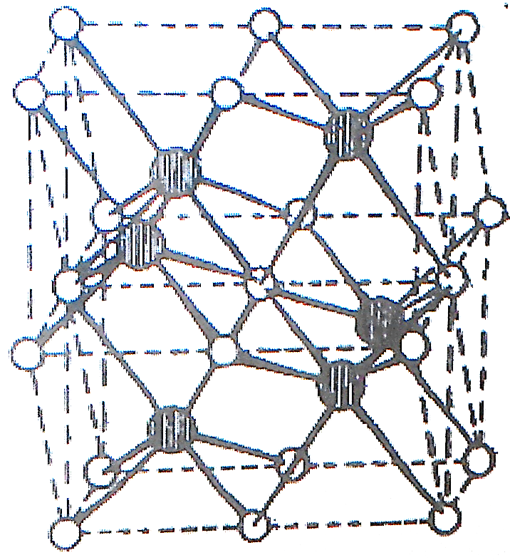
Layer structure / Structure of Nickel Arsenide (Ni-As)– In the unit cell of Ni-As, the nickel ions are represented by hollow circles and arsenic ions are represented by solid circles.
In Ni-as compound, the radius ratio is in between to 0.414 0.732 suggest octahedral arrangement and co-ordination number of Ni atom is six. Therefore each Ni atom is surrounded by six Arsenic atoms and each Arsenic atoms are surrounded by six Ni atoms which indicate that co-ordination number of Nickel is 6 and co-ordination number of Arsenic atoms is 6. Therefore Ni-As compound shows 6:6 arrangement or structure.
The important characteristics properties of Nickel arsenide structure are as
The structure of nickel arsenide Ni-As is related to the structure of CdI₂.
In Ni-As structure, the arsenic atoms form a hexagonal close-packed type of lattice with nickel atoms occupying all of the octahedral sites between all of the layers of arsenic atoms.

Slide 49
In CdI₂ compound, all of the octahedral sites between two layers of I⁻ ions half of the layers are filled, while in the Ni-As all of the octahedral sites between all of the layers of Arsenic are filled.
In the nickel arsenide structure each atom has six nearest neighbours of the other type of atom.
Each arsenic atom is surrounded by six nickel atoms at the corners of a trigonal prism.
Each nickel atom is surrounded octahedrally by six arsenic atoms, but with two more nickel atoms sufficiently close to be bonded to the original nickel atom.
The Ni-As structure is adopted by many transition elements combined with one of the heavier elements from the p-block (Sn, As, Sb, Bi, S, Se, Te) in various alloys. These are referred as inter-metallic phases rather than true compounds.
They are opaque, have metallic luster, and sometimes have available composition.
Layer structures are intermediate in type between the extreme cases of:
A totally ionic crystal with a regular arrangement of ions and strong electrostatic forces in all the directions.
A crystal in which small discrete molecules are held together by weak residual forces such as Van der Waals forces and hydrogen bonds.

Slide 50
C] Structures containing polyatomic ions-
There are many ionic compounds of types AX and AX₂ where A or X, or both ions are replaced by complex ions.
When the complex ion is roughly spherical, the ions often adopt one of the more symmetrical structures described above.
The ions such as SO₄²⁻, ClO₄⁻ and NH₄⁺ are almost spherical.
The transition metal complex [Co(NH₃)₆]I₂ adopts the CaF₂ (fluorite) structure.
While K₂[PtCl₆] adopts anti-fluorite structure, which is the same as a fluorite structure except that the sites occupied by positive and negative ions are interchanged.
If both ions may be complex ions such as [(Ni(H₂O)₆)]²⁺ [SnCl₆]²⁻ forms a slightly distorted CsCl structure.
Other ions such as CN⁻ and SH⁻ sometimes attain effective spherical symmetry by free rotation. or by random orientation forms CsCN, TlCN and CsSH etc.

Slide 51
Lattice Energy (U) of Ionic Solids- The lattice energy U of an ionic solid is defined as “ the amount of energy released when cations and anions in their gaseous states are brought from infinity to their respective lattice sites in a crystal to form one mole of the ionic solid.” It is denoted by the symbol. U.
The positive and negative coming together causes decrease in potential energy (heat) of the system. Hence lattice energy (U) is negative. It is obvious that the greater the magnitude of lattice energy of an ionic solid, (absolute value without negative sign) the greater would be its stability. The Lattice energies of a few ionic solids are given in the following table
Ionic compound | Lattice energy KJmol-¹
 | Experimental (Born Haber cycle) | Theoretical (Born-Lande equation)
MgF₂ | -2882 | -2920
CaF₂ | -2581 | -2585
Cad2 | -2410 | -1966
AgCl | -895 | -849
AgBr | -883 | -824
AgI | -870 | -795
Li Cl | -817 | -825
NaCl | -764 | -764
KCI | -679 | -686
KI | -606 | -617
The lattice energies of ionic solids are quite high due to strong electrostatic attraction between the oppositely charged ions in the solid. The coulombic forces of attraction changes directly with the product of the charges hence higher the valency (charge) of the ions, the greater would be the lattice energy of the ionic solid.

Slide 52


Calculation of Lattice Energies of Ionic Solids-The lattice energy of ionic solids can be calculated theoretically on the basis of coulombic interactions between the ions present in the crystals.
There are two types of interactions
Attractive Interactions between Oppositely Charged Ions-
Repulsive Interactions due to Interpenetration of Electron Charge Clouds-
The lattice energy ( U) of a crystal is the energy evolved when one gram molecule of the crystal is formed from gaseous ions:
Na⁺+ Cl⁻ NaCl_{(Solid crystal)}U= -782 KJmol⁻¹
The lattice energies cannot be measured directly.
The experimental values of lattice energy for ionic crystals are determined from thermodynamic data using the Born-Haber cycle.
while theoretical values of lattice energy for ionic crystals may be calculated by using Born- Lande’s expression. The ions are treated as point charges and the ·electrostatic (coulombic) energy E between two ions of oppositely charge is calculated by using the following expression
E=
Where, Z⁺ and Z⁻ are the charges on the positive and negative ions
e is the charge on an electron, r is the inter-ionic distance
For more than two ions the electrostatic energy depends on the number of ions and also on Madelung constant (A)their arrangement in space. For one mole the attractive energy is given by following expression
E=
N_{o} is the Avogadro constant - the number of molecules in one mole i.e. the value of Avogadro’s number is 6.023 x 10²³ mol⁻¹.
A is the Madelung constant which depends on the geometry of the crystal

Slide 53

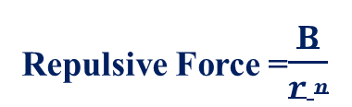
M = $−\frac{A(Z+Z−)}{rn}$
Type of structure | C. N. of Ions |  | Value of A | Value of M
 | Cation | Anion
Zinc blende ZnS | Zn⁺² = 4 | S²⁻ = 4 | 1.63806 | 1.63806
Wurtzite ZnS | Zn⁺² = 4 | S²⁻ = 4 | 1.64132 | 1.64132
Sodium chloride NaCl | Na⁺ = 6 | Cl⁻ = 6 | 1.74756 | 1.74756
Caesium chloride CsCl | Cs⁺ = 8 | Cl⁻ = 8 | 1.76267 | 1.76267
Rutile TiO₂ | Ti⁺⁴ = 6 | O²⁻ = 3 | 2.40800 | 4.816
Fluorite CaF₂ | Ca⁺² = 8 | F⁻ = 4 | 2.51939 | 5.03878
Corundum Al₂O₃ | Al⁺³ = 6 | O²⁻ = 6 | 4.17186 | 25 .03116
Cadmium iodide CdI₂ | Cd²⁺ = 3 | I⁻ = 3 | 4.7100 | -
Repulsive Force =$\frac{B}{r n}$
Where: B is constant depends on the structure. n is a constant called the Born exponent.
The average values for the Born exponent (n) are represented in the following table
Electronic structure of ion | Value of n | Examples
He | 5 | Li⁺, Be²⁺
Ne | 7 | Na⁺, Mg²⁺, O²⁻, F⁻
Ar | 9 | K⁺, Ca²⁺, S²⁻, C1⁻, Cu⁺
Kr | 10 | Rb⁺, Br⁻, Ag⁺
Xe | 12 | Cs⁺, I⁻, Au⁺

Slide 54
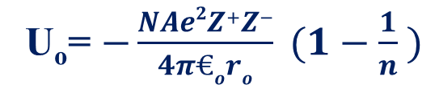
The total energy holding the crystal together is the lattice energy (U). This is the sum of the attractive and the repulsive forces.
U = Attractive forces + Repulsive forces
U_{o}= $−\frac{NAe2Z+Z−}{4π€oro} (1−\frac{1}{n} )$
Where,
N is the Avogadro’s constant (6.023 x 10²³ per mole). Number of molecules in a one mole of substance.
A is the Madelung constant which depends on the geometry of crystal. The values of Madelung constant (A) for MX₂ structures are 50% higher than those for MX structures.
Z⁺ and Z⁻ are the charges on the positive ions (cations) and negative ions (anions) respectively.
e is charge on the electron (4.8030 x 10⁻¹⁰esu).
r_{o} is the inert-ionic distance = (r⁺ + r⁻). It is the equilibrium distance between cation and anion.
€_{o} is permittivity of vacuum i.e. €_{o} is the permittivity of free space = 8.854 x 10⁻¹² Fm⁻¹.
n is Born exponent. It is associated with repulsion between ions. the value of n depends upon the type of electronic configuration for the ions of crystals. It has values between 9 and 12. Generally its value is taken 9 as error of 1 or 2 in n makes only a small difference in (1-1/n).

Slide 55
The calculated value of lattice energy (U) for NaCl = -778 kJ mo1⁻¹ by using the Born-Lande equation.
The experimental value of lattice energy (U) for NaCl = -770 kJmol⁻¹ at 25°C obtained by using the Born-Haber cycle.
The calculated value and the experimental value of lattice energy is close.
The experimental and theoretical values for the alkali metal halides and the oxides and halides of the alkaline earths (excluding Be) all agree within 3%.
Importance of Born-Lande’s expression-
1) The lattice becomes stronger i.e. lattice energy becomes more negative as inert-ionic distances (r_{o}) decreases. Hence U is inversely proportional to r_{o} i.e. (U α 1/r_{o})
Ionic compound | Inter-ionic distances (r_{o}) A⁰ | Lattice energy (U) K J mol-¹
LiF | 2.01 | -1004
CsI | 3.95 | -527
2) The lattice energy is depend upon (Z⁺and Z⁻). Hence U is directly proportional to (Z⁺and Z⁻) i.e. (U α (Z⁺and Z⁻)
Ionic compound | Product of ionic charges (Z⁺and Z⁻) | Lattice energy (U) K J mol-¹
LiF | 2.01 | -1004
CsI | 3.95 | -527

Slide 56
There is close agreement between experimentally determined lattice energies and theoretically calculated lattice energies for alkali metal halides prove that the assumptions made by Born-lande’s expression are correct.
The crystal with high lattice energies usually melt at high temperature and are very hard i.e. lattice energy is favoured by a small inter-ionic distance (r_{o}) and higher charge on the positive and negative ions (Z⁺ and Z⁻).
There are two opposing factors in the equation. As the inter-ionic distance (r) increases the lattice energy decreases. It is almost impossible to change inter-ionic distance (r) without changing the structure and therefore changing the Madelung constant (A).
As Madelung constant (A) increases the lattice energy also increases. Hence the effects of changing (r) and (A) may largely cancel each other.
Explaination- Consider constant value of n = 9, we may compare the inter-ionic distances for six-coordination : For a change of coordination number from 6 (NaCl structure) to 8(CsCl structure) the inter-ionic distance (r) increases by 3.7%, and the Madelung constants-A (for NaCl = 1.74756 and for CsCl = 1.76267) change by only 0. 9%. Hence the change in co-ordination number from 6 to 8 would result decreases in the lattice energy. But according to radius ratio assumptions the NaCl structure more stable than the CsCl structure. If the co-ordination number decreases from 6 to 4 decreases

Slide 57
inter-ionic distance (r) by 4.9%. The decrease in Madelung constants (A) from 6.1% or 6.3% indicate that whether a zinc blende or Wurtzite structure is formed but in either case it more than compensates for the change in inter-ionic distance (r)and in theory co-ordination number 6 ismore stable than 4 which indicate that four and eight coordinate structures cannot exist therefore six coordinateNaCl structure is more stable. Since ZnS have coordination number 4 while CsCl, CsBr and CsI have a co-ordination number of 8 this prediction is plainly incorrect. Therefore the mistakes observed in the theoretical assumptions are as
The value of n was assumed to be 9 but value of n may change from 5 to 12.
The calculation of electrostatic attraction assumes that the ions are point charges.
There is no reduction in charge because of the interaction (i.e. the bonds are 100% ionic).
An ionic crystal having higher lattice energy usually melts at high temperatures i.e. they have higher melting point. Ionic crystals having higher lattice energy are very hard and their hardness is measured on Mohs scale. The lattice energy of ionic crystals is higher due to small inter-ionic distance (r) and a higher charge on the ions(Z⁺ and Z⁻).

Slide 58
On the basis of radius ratio considerations, CsCl structures in fact adopt a NaCl structure because the Madelung constant (A) for CsCl is greater than NaCl structure shows that CsCl would gives increased lattice energy than NaCl. However the inter-ionic distances (r_{o}) will be larger in CsCl than in NaCl which will decreases the lattice energy. These two factors work in opposite direction and partly cancel each other. Therefore lattice energy for NaCl type structure is greater in some ionic crystals while CsCl type structure is geometrically possible.
Eg. In case of RbBr the radius ratio is close the borderline between co-ordination number = 6 (hence predicts NaCl structure) and co-ordination number = 8 (hence predicts CsCl structure). If CsCl structure is adopted by RbBr then Madelung constant is greater than NaCl which causes increase in lattice energy by 0.86%. At the same time the inter-ionic distances (r_{o}) in CsCl structure is increased by 3% which causes decrease in the lattice energy by 3%. Therefore RbBr must adopt NaCl type structure.

Slide 59
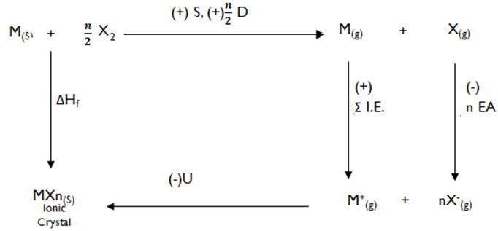
The Born-Haber cycle- The lattice energies of ionic solids can be determined by Born-Haber cycle. This cycle devised by Born and Haber (1919) relates the lattice energy of a crystal to other thermo- chemical data. The lattice energy of ionic salts may be related to several other thermo-chemical quantities by using Born-Haber thermo-chemical cycle.
Consider Born-Haber thermo-chemical cycle for MXn (where n = 1 for NaCl, n=2 for MgCl₂ and n=3 for AlCl₃ etc.)
The positive sign indicate that energy is supplied to the system (Energy absorbed by the system).
The negative sign indicate that energy is liberated by the system (Energy liberated by the system).

Slide 60
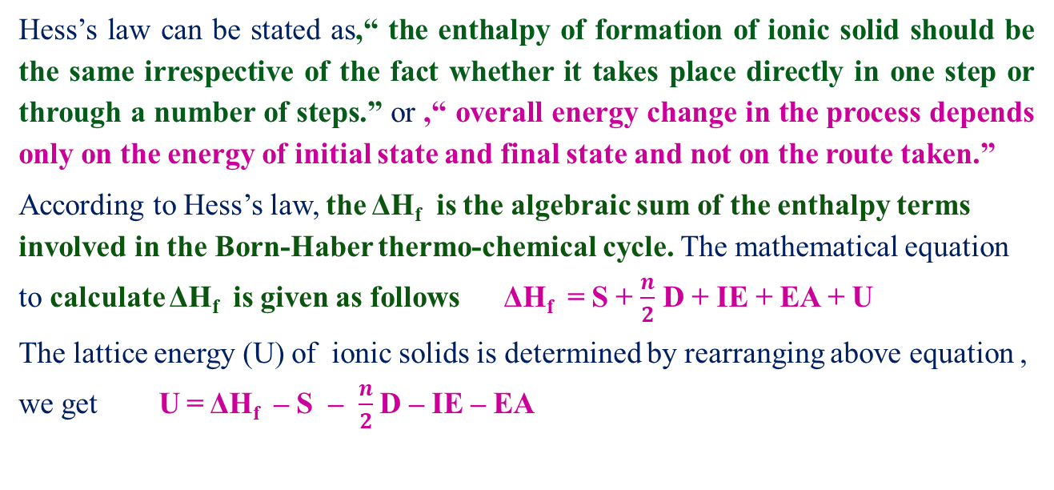
S is the energy required for the conversion of one mole of metallic sodium into gaseous sodium atoms is called sublimation energy.
D is the amount of energy required to dissociate one mole of gaseous chlorine molecules into gaseous atoms is called dissociation energy.
I.E. is the amount of energy required to convert one mole of gaseous sodium atoms into sodium ions in the gaseous state is called ionization energy.
E is the amount of energy released when one mole of gaseous chlorine atoms are converted into chloride ions in the gaseous state is called electron affinity.
U is the amount of energy released when one mole of solid crystalline compound is formed from gaseous ions of opposite charges is called lattice energy.
ΔH_{f} standard enthalpy of formation of metal halide MXn_{(S)} ionic Crystal NACl.
Hess’s law can be stated as,“ the enthalpy of formation of ionic solid should be the same irrespective of the fact whether it takes place directly in one step or through a number of steps.” or ,“ overall energy change in the process depends only on the energy of initial state and final state and not on the route taken.”
According to Hess’s law, the ΔH_{f} is the algebraic sum of the enthalpy terms involved in the Born-Haber thermo-chemical cycle. The mathematical equation to calculate ΔH_{f} is given as follows ΔH_{f} = S + $\frac{n}{2}$ D + IE + EA + U
The lattice energy (U) of ionic solids is determined by rearranging above equation , we get U = ΔH_{f} – S – $\frac{n}{2}$ D – IE – EA

Slide 61
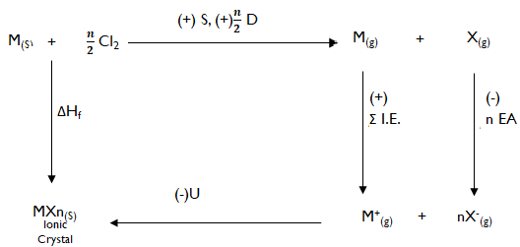
The Born-Haber cycle for NaCl ionic compound (Experimental Determination of Lattice ·Energy for NaCl)- The direct experimental determination of lattice energies is difficult but lattice energies are determined indirectly with the help of a thermo-chemical cyclic process known as Born-Haber cycle.
The various steps involved in the formation of NaCl (s) in crystalline state are as follows
Conversion of Metallic Sodium into Gaseous Sodium Atoms- The energy required for the conversion of one mole of metallic sodium into gaseous sodium atoms is called sublimation energy. It is represented by S.
Na_{(s)} + S Na_{(g)} | S = Sublimation energy

Slide 62
Dissociation of Gaseous Chlorine Molecules into Gaseous Chlorine Atoms- This step involves the dissociation of gaseous chlorine molecules into gaseous chlorine atoms. The amount of energy required to dissociate one mole of gaseous chlorine molecules into gaseous atoms is called dissociation energy. It is represented by D.
Evidently, the energy required to produce one mole of gaseous chlorine atoms would be D/2.
Cl_{2(g)} + D 2 Cl _{(g)} | D = Dissociation energy
Conversion of Gaseous Sodium Atoms into Sodium Ions- The amount of energy required to convert one mole of gaseous sodium atoms into sodium ions in the gaseous state is called ionization energy. This may be represented by IE.
Conversion of Gaseous Chlorine Atoms into Chloride Ions- The amount of energy released when one mole of gaseous chlorine atoms are converted into chloride ions in the gaseous state is called electron affinity. It is represented by EA.
Combination of Gaseous Ions to form a Solid Crystal- This step involves the combination of gaseous Na⁺ and Cl⁻ ions to give one mole of sodium chloride crystal. The amount of energy released when one mole of solid crystalline compound is formed from gaseous ions of opposite charges is called lattice energy. It is denoted by U.
The overall change may be represented as
The enthalpy change for this reaction is called enthalpy of formation of sodium chloride and may be denoted as ΔH_{f}.
These various steps may be represented in the form of Bern-Haber cycle as shown in following figure
Consider Born-Haber thermo-chemical cycle for NaCl (where n = 1)
Na_{(s)} + IE Na⁺_{(g)} + e⁻ | IE = Ionization energy
Cl_{(g)} + e⁻ Cl⁻_{(g)} + EA | EA = Electron affinity
Na⁺_{(g)}+ Cl⁻_{(g)} NaCl_{(s)} + U | U = Lattice energy
Na_{(g)}+ ½ Cl⁻_{(g)} NaCl_{(s)}

Slide 63
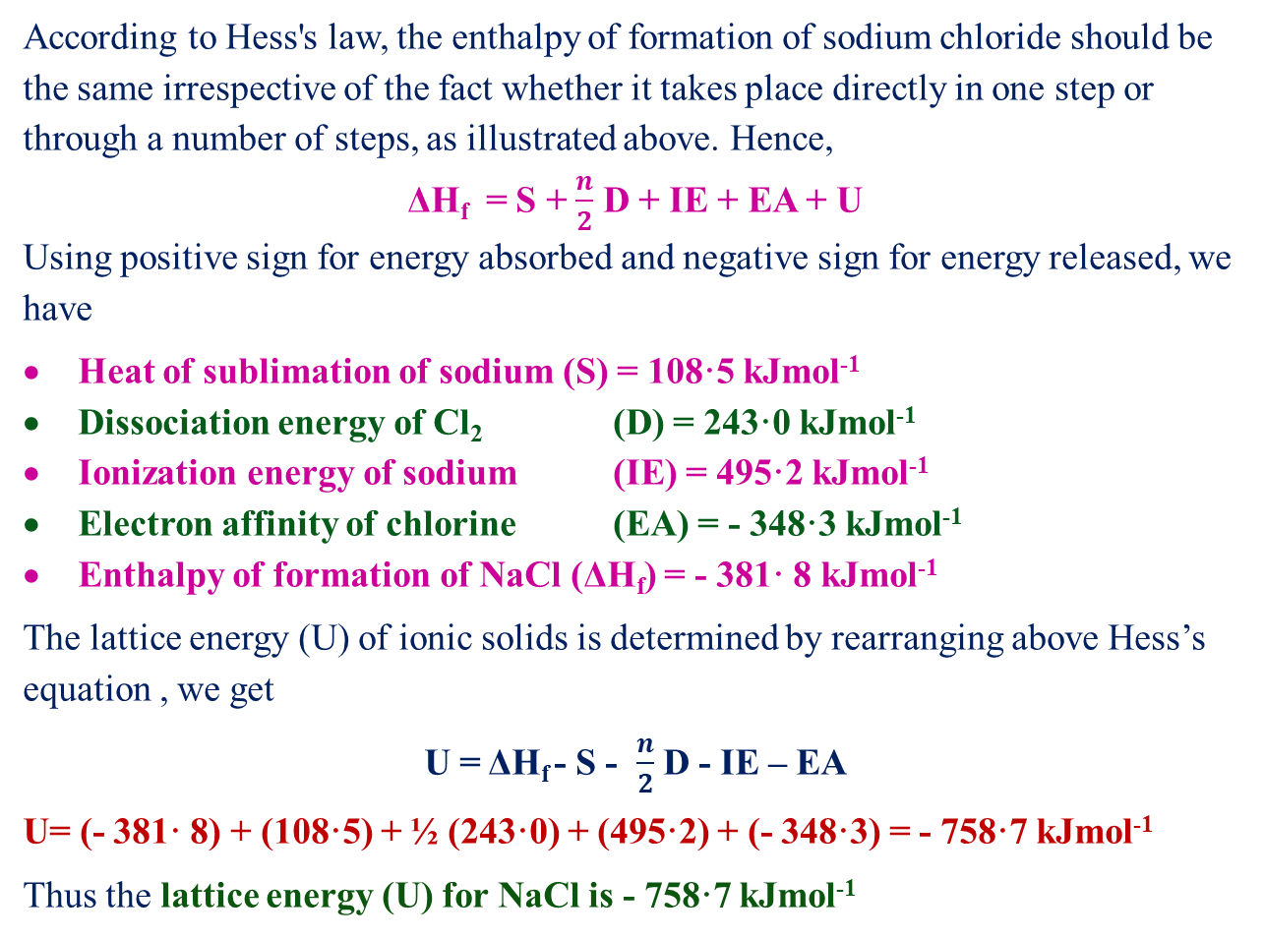
According to Hess's law, the enthalpy of formation of sodium chloride should be the same irrespective of the fact whether it takes place directly in one step or through a number of steps, as illustrated above. Hence,
ΔH_{f} = S + $\frac{n}{2}$ D + IE + EA + U
Using positive sign for energy absorbed and negative sign for energy released, we have
Heat of sublimation of sodium (S) = 108·5 kJmol⁻¹
Dissociation energy of Cl₂ (D) = 243·0 kJmol⁻¹
Ionization energy of sodium (IE) = 495·2 kJmol⁻¹
Electron affinity of chlorine (EA) = - 348·3 kJmol⁻¹
Enthalpy of formation of NaCl (ΔH_{f}) = - 381· 8 kJmol⁻¹
The lattice energy (U) of ionic solids is determined by rearranging above Hess’s equation , we get
U = ΔH_{f} - S - $\frac{n}{2}$ D - IE – EA
U= (- 381· 8) + (108·5) + ½ (243·0) + (495·2) + (- 348·3) = - 758·7 kJmol⁻¹
Thus the lattice energy (U) for NaCl is - 758·7 kJmol⁻¹

Slide 64
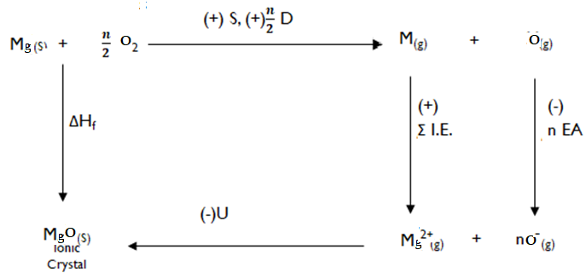
Applications of Lattice energies-
Estimation of electron affinities (EA) by using lattice energies (Born-Haber Thermo-chemical cycle)- The electron affinity can be measured directly only for the conversion of isolated gaseous atom into its singly charged anion.
F_{(g)} + e⁻ F⁻_{(g)} + EA | EA = Electron affinity
O_{(g)} + e⁻ O⁻_{(g)} + EA | EA = Electron affinity
However in order to find the sum of the first and second electron affinities of oxygen
atom and ΔH_{f} for the following reaction
must be known
O_{(g)} + 2e⁻ O²⁻_{(g)} + EA | EA = Electron affinity
Consider the Born-Haber thermo-chemical cycle for metal oxide such as MgO (n=1) to determine the lattice energy of MgO represented as follows

Slide 65
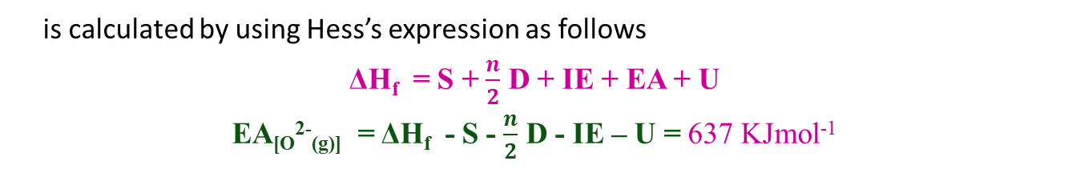
The theoretical lattice energy calculated by using Born-Lande’s expression is about -3800 KJmol⁻¹. MgO has NaCl type structure.
Therefore 6:6 arrangement , Z⁺ = Z⁻ = 2, ΔH_{f} = 630 KJmol⁻¹
Except EA all other enthalpy terms are known hence electron affinity (EA) for the reaction
O_{(g)} + 2e⁻ O²⁻_{(g)} + EA | EA = Electron affinity
is calculated by using Hess’s expression as follows
ΔH_{f} = S + $\frac{n}{2}$ D + IE + EA + U
EA_{[O}²⁻_{(g)]} = ΔH_{f} - S - $\frac{n}{2}$ D - IE – U = 637 KJmol⁻¹
The first electron affinity of oxygen is -118 KJmol⁻¹ but addition of second electron absorbs the energy (637 +118 = 755 KJmol⁻¹) which indicate that the formation of oxide ion (O²⁻) is not favoured but only reason why an oxide ion is stable and exist is its high lattice energy in contact with metal ion for Mg²⁺ ion in MgO compound.

Slide 66
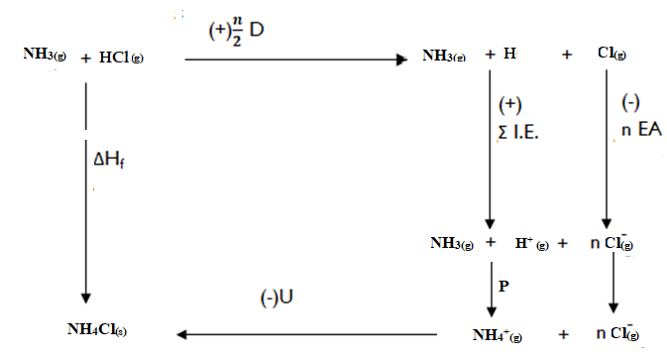
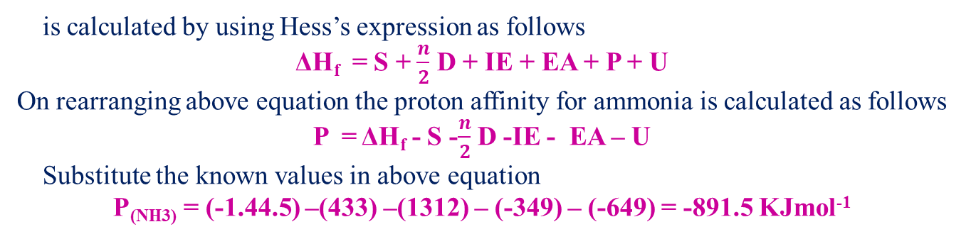
Estimation of proton affinities (P) by using lattice energies (Born-Haber Thermo-chemical cycle)- Consider the estimation of proton affinity (P) of base such as ammonia by using gas phase reaction represented as follows
NH_{3(g)} + H⁺_{(g)} NH₄⁺_{(g)} + P | P = Proton affinity
e.g NH_{3(g)} + HCl_{(g)} NH₄Cl_{(s)}
The proton affinity (P) of ammonia for the following reaction
NH_{3(g)} + H⁺_{(g)} NH₄⁺_{(g)} + P
is calculated by using Hess’s expression as follows
ΔH_{f} = S + $\frac{n}{2}$ D + IE + EA + P + U
On rearranging above equation the proton affinity for ammonia is calculated as follows
P = ΔH_{f} - S -$\frac{n}{2}$ D -IE - EA – U
Substitute the known values in above equation
P_{(NH3)} = (-1.44.5) –(433) –(1312) – (-349) – (-649) = -891.5 KJmol⁻¹

Slide 67
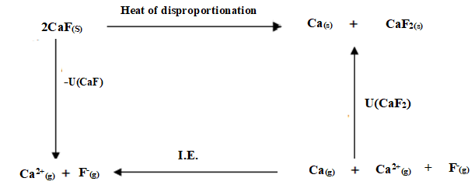
Estimation of enthalpies of formation and the disproportionation by using lattice energies (Born-Haber Thermo-chemical cycle)- Consider calcium monofluoride (CaF), theCaF is not unstable with respect to decomposition into calcium and calcium difluoride (CaF₂) represented as in the following reaction
2CaF_{(s)} Ca(s) + CaF_{2 (s)}
The above reaction is represented in the form of Born-Haber thermo-chemical cycle as follows
The enthalpy quantities (terms) involved are enthalpy of sublimation of Calcium which is very small, first ionization energy (590KJmol⁻¹) and second (1146KJmol⁻¹) ionization energy of calcium. Hence the ΔH_{f} for the reaction,
2Ca⁺_{(g)} Ca(g) + Ca²⁺_{(g)}
will be 556 KJmol⁻¹ (1146-590 =556 KJmol⁻¹ )

Slide 68
The gaseous Ca²⁺ion therefore will not disproportionate and possibility of obtaining Ca²⁺ion in solid calcium fluoride is depend upon relative magnitudes of lattice energies of CaF and CaF₂ compounds.
The magnitude of CaF₂ compound is greater than CaF compound due to following reasons
Z⁺ is twice large as in the CaF₂ as compared to CaF.
(For CaF Z⁺= 1) and For (CaF₂ Z²⁺ = 2)
The size of Ca²⁺ion is smaller than Ca⁺ion.
Madelung constants for MX₂ structures about one and half times more than those for MX structures. Therefore lattice energy of CaF would be less than that of one third lattice energy of CaF₂ compound. Which is about 2610 KJmol⁻¹. The extra lattice energy of CaF₂ compound over that of CaF compound overweighs the effect of the values of ionization energies and CaF₂ is formed.

