Slide 1
JET's Z.B.Patil College, Dhule.
Internal Quality Assurance Cell And Department of Chemistry - Chemistry Association
Welcomes You all for the National Science Day Celebration
Date: 28/2/2022 Monday
Time: 3:30 pm to 4:30 pm.
Subject: Online lecture on "Chemistry and Career"
Speaker: Dr. Dinesh Sawant ( MRSC) Scientist at CSIR - NCL and Assistant Professor at AcSIR, Pune
President of the Function: Hon'ble Principal Dr. P.H.Pawar
Hon'ble Vice-Principal Prof. V. S. Pawar, Dr. D. K. Patil, Dr. Varsha Patil Dr. V. B. Jadhav (HOD), Dr. P. S. Girase (Secretory, Chemistry Association), All Professors & Staff of the department will be present at this programme. All students of M.Sc.-I, M.Sc.-II, T.Y.BSc, S.Y.BSc & F.Y.BSc should be present at this time.
https://teams.microsoft.com/l/meetup-join/19%3ameeting_NmViMDg2ZTAtYWEzNi00NjM3LWE2NWYtZDJmOTkwNjNmNDYw%40thread.v2/0?context=%7b%22Tid%22%3a%2245b60a23-6e1f-4650-9944-1701c44009a8%22%2c%22Oid%22%3a%2254dac2fe-ef46-4b04-820e-481bf26683b7%22%7d
Tap on the link or paste it in a browser to join.

Slide 2
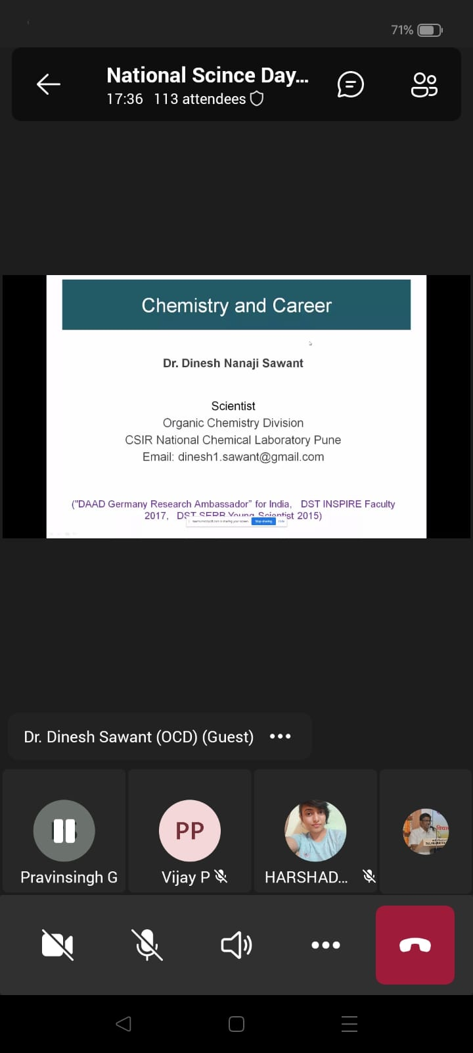

Slide 3
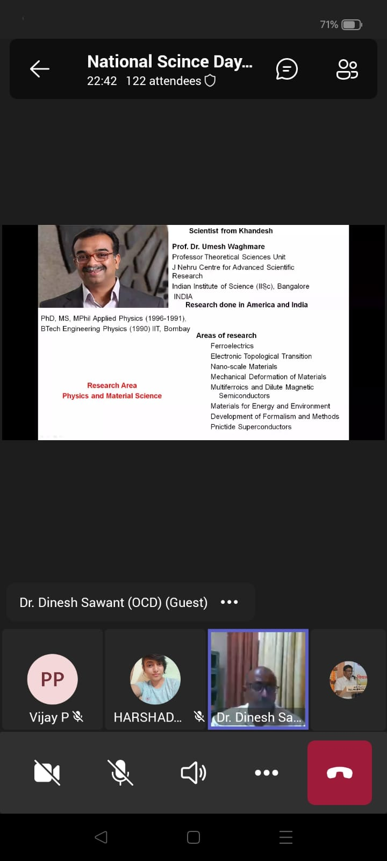
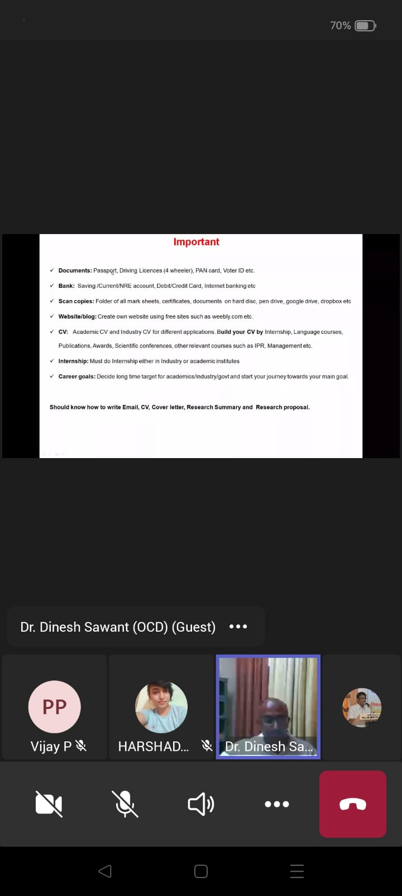
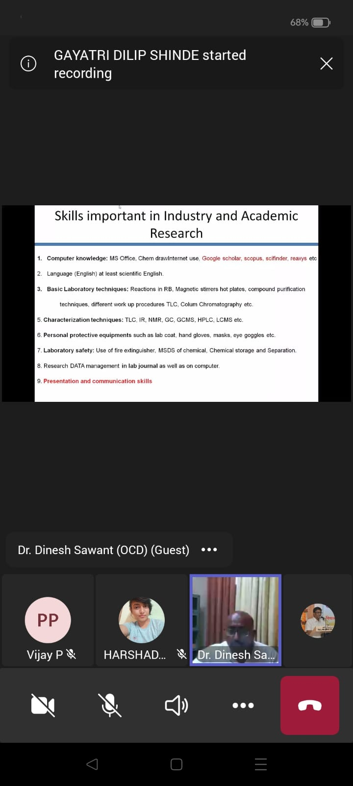

Slide 4
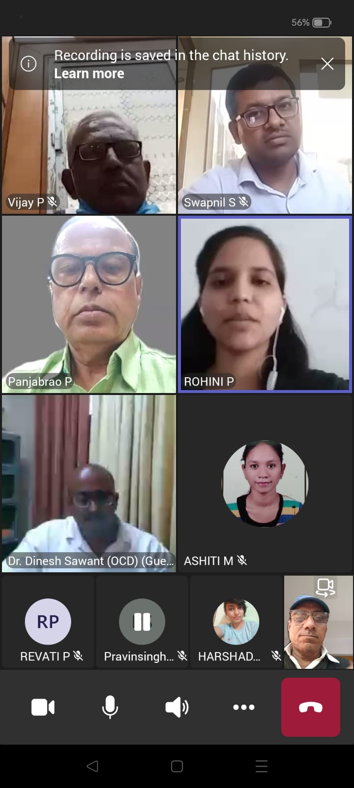
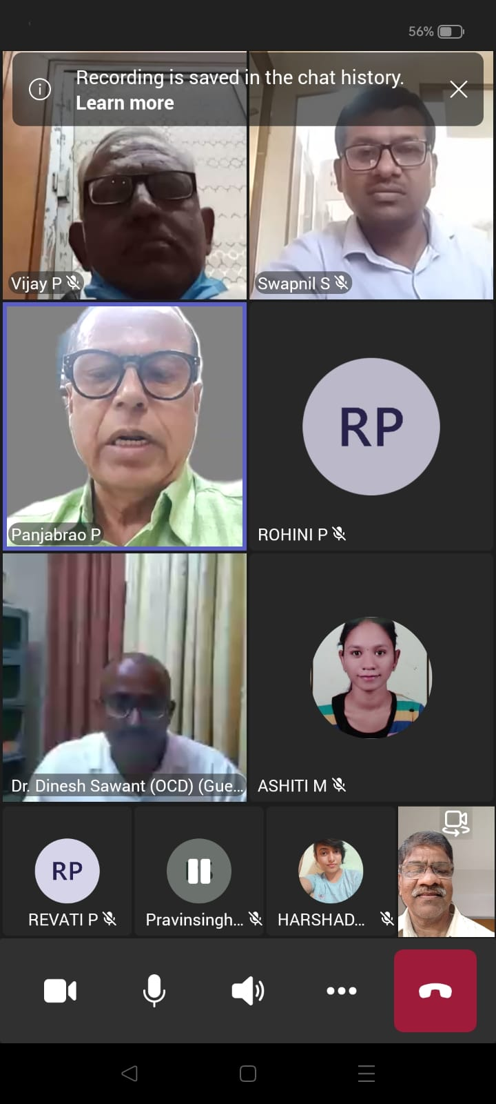
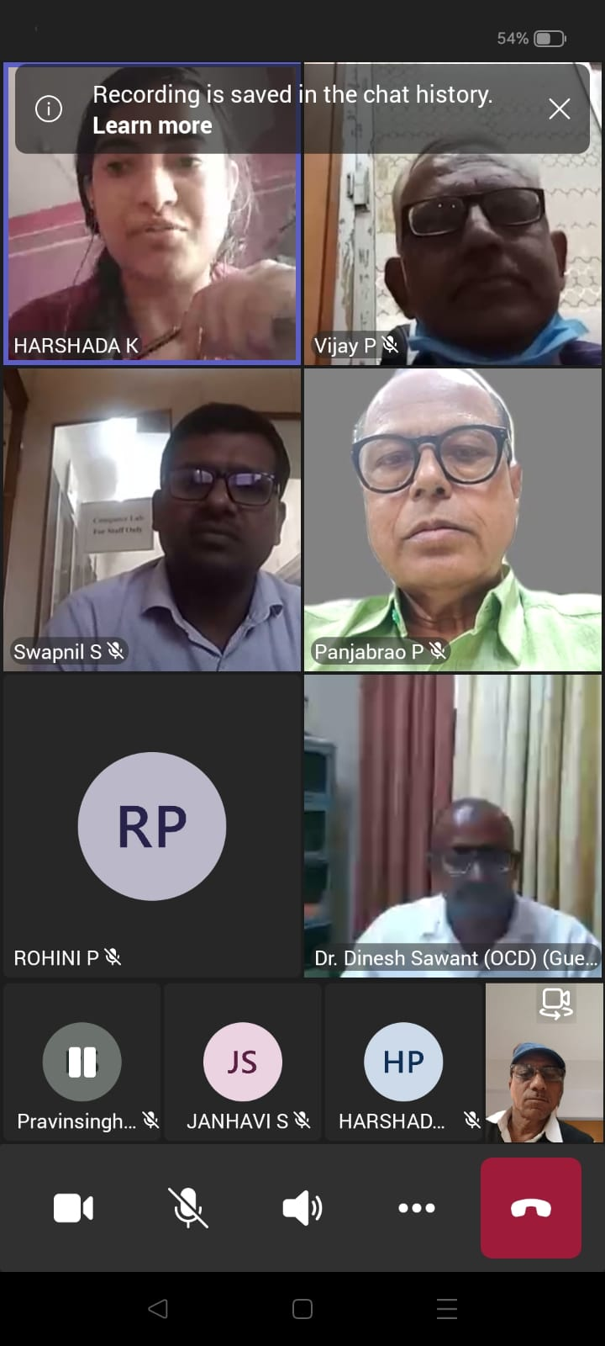

Slide 5
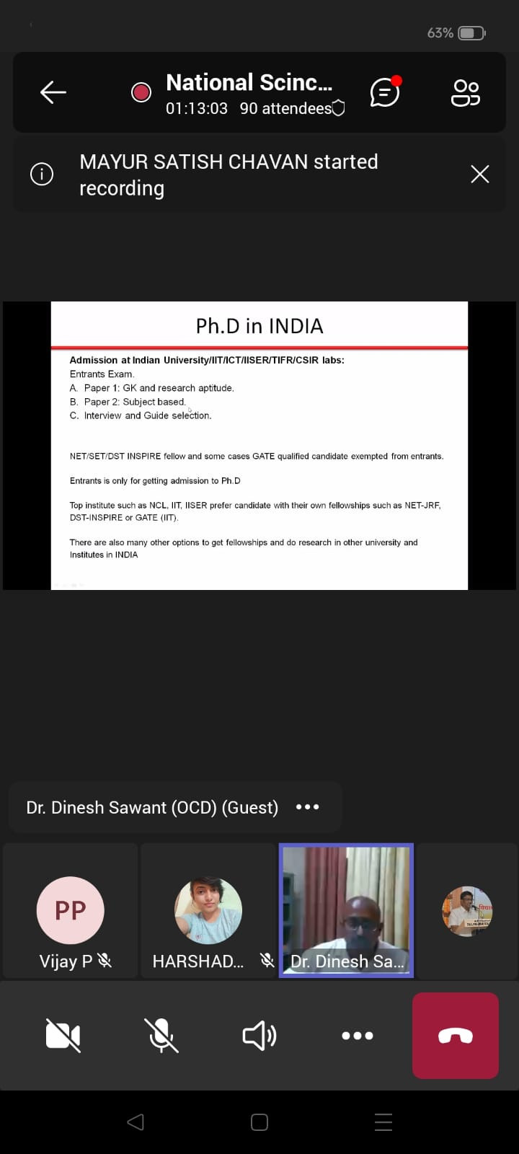
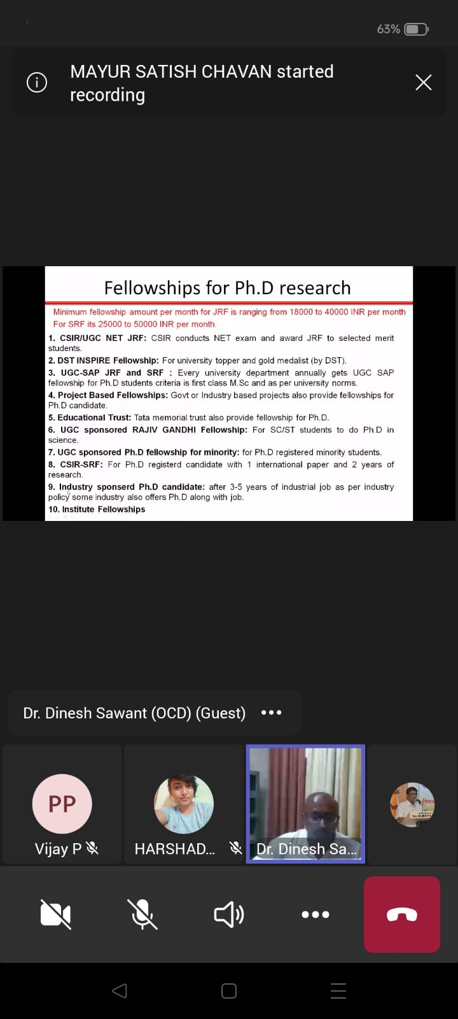
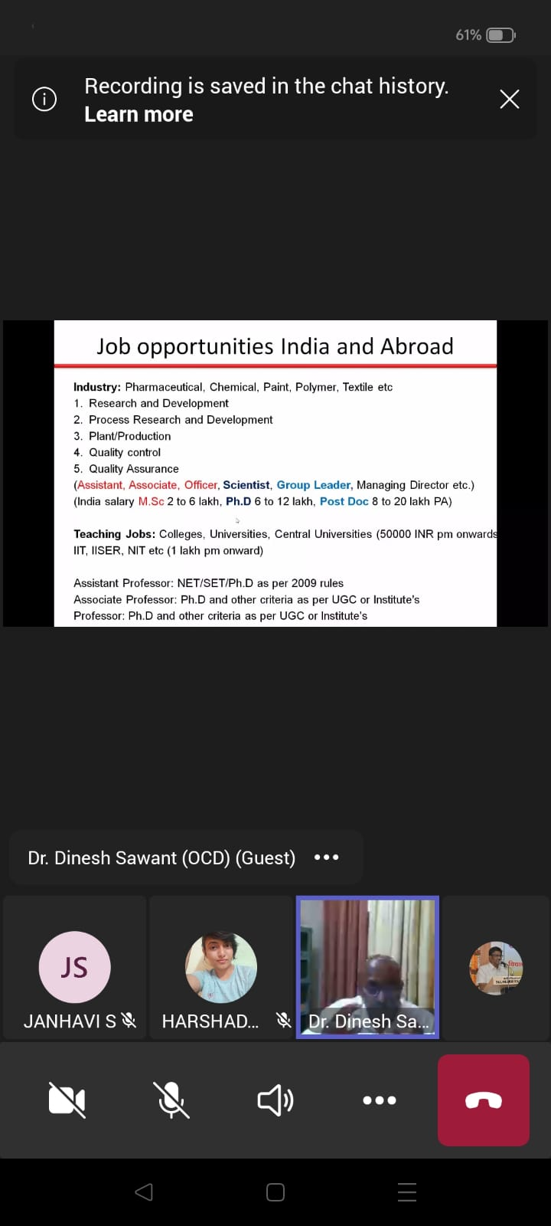

Slide 6
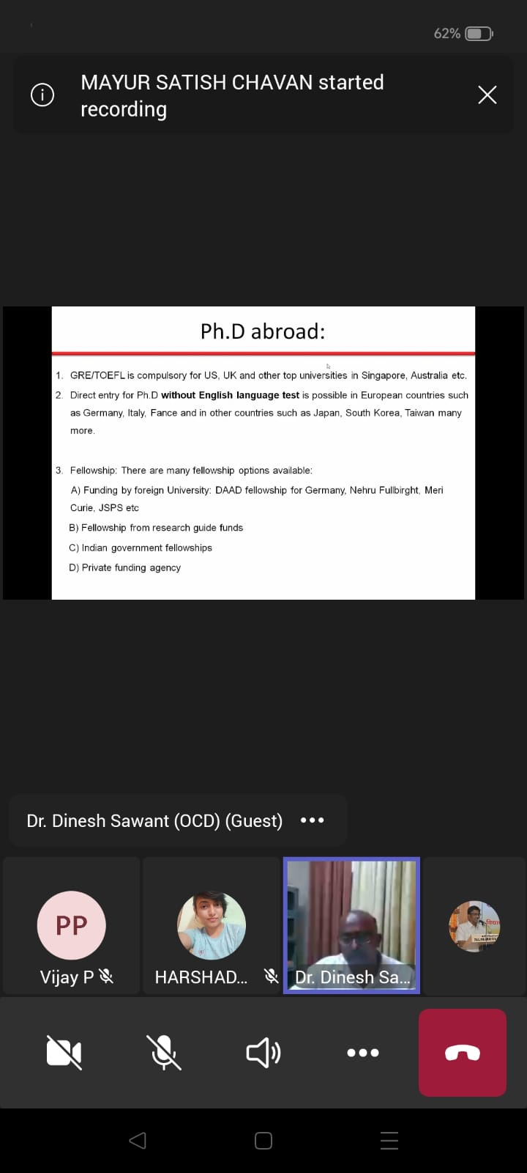
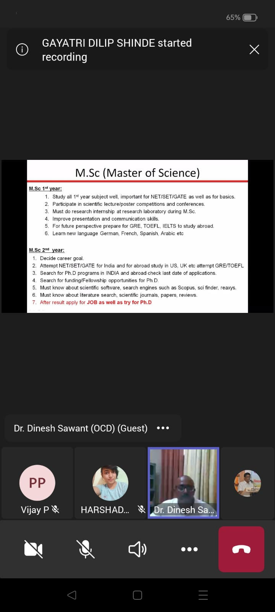
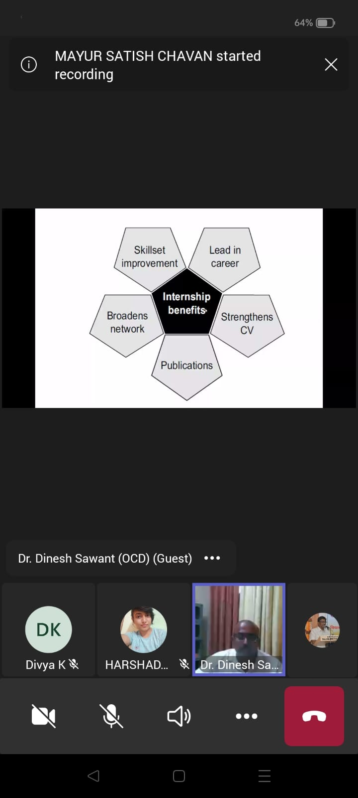

Slide 7
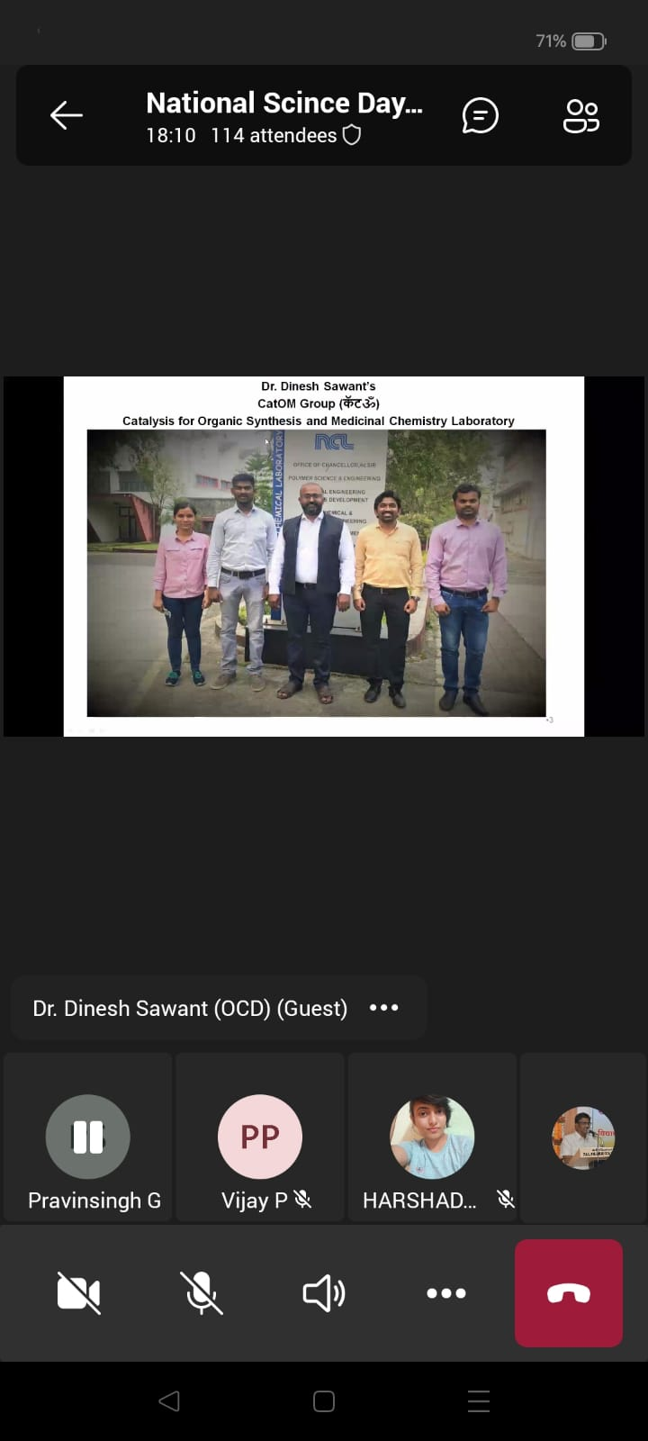
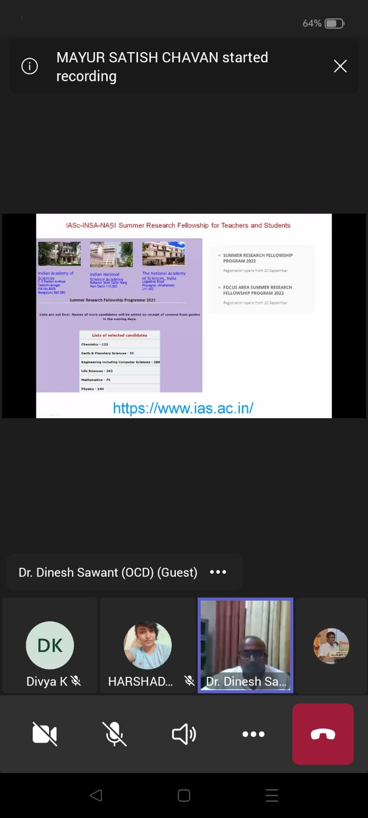
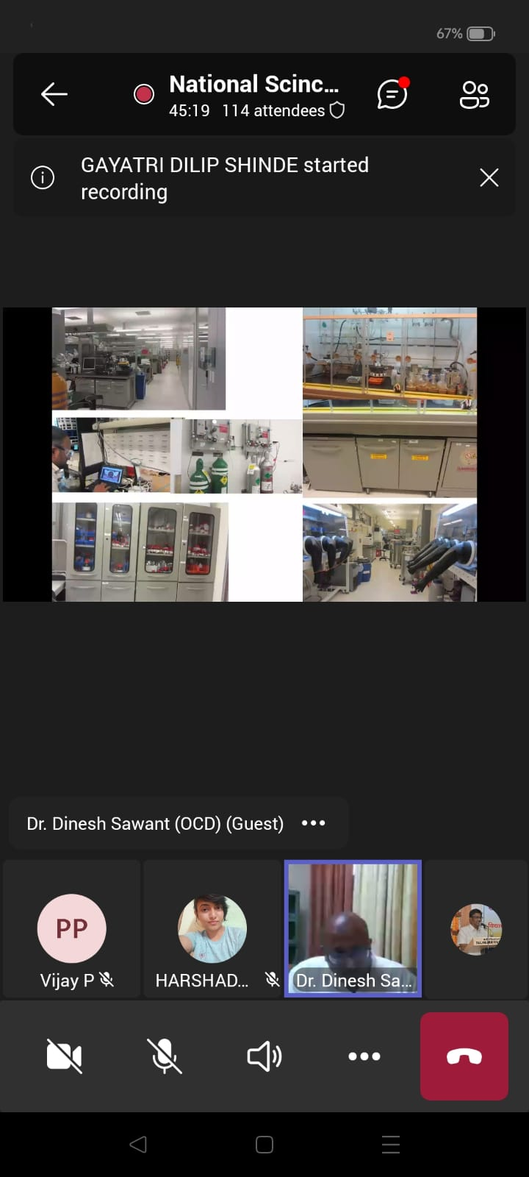

Slide 8

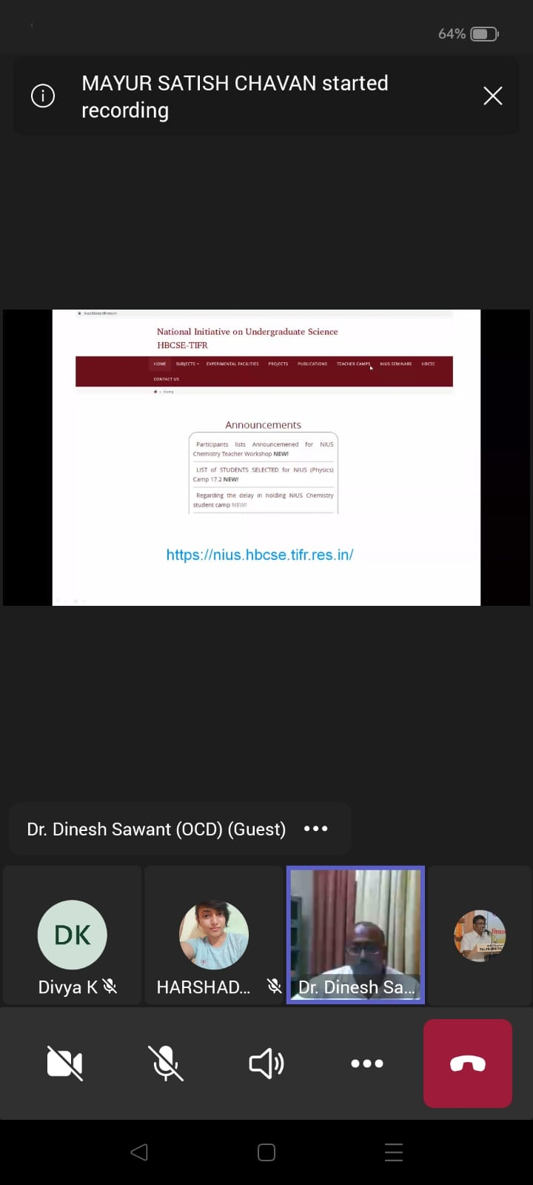
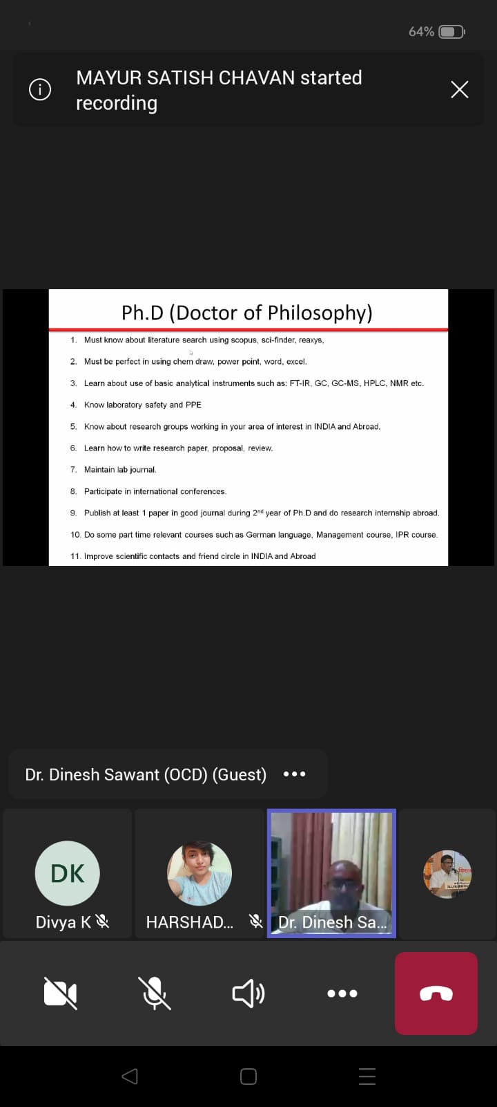

Slide 9
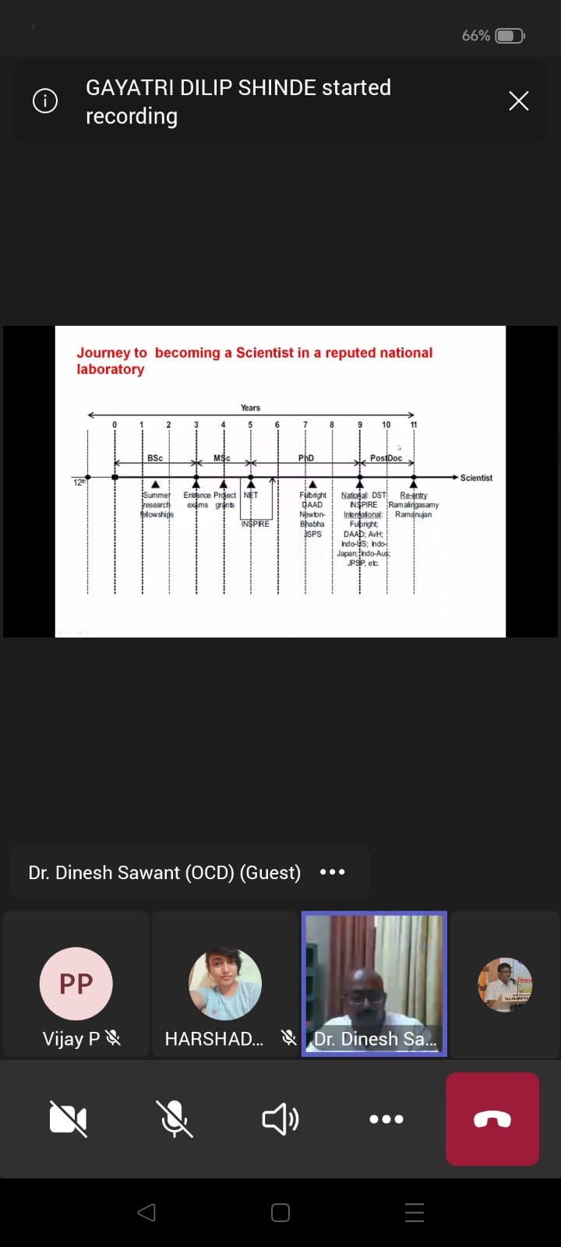
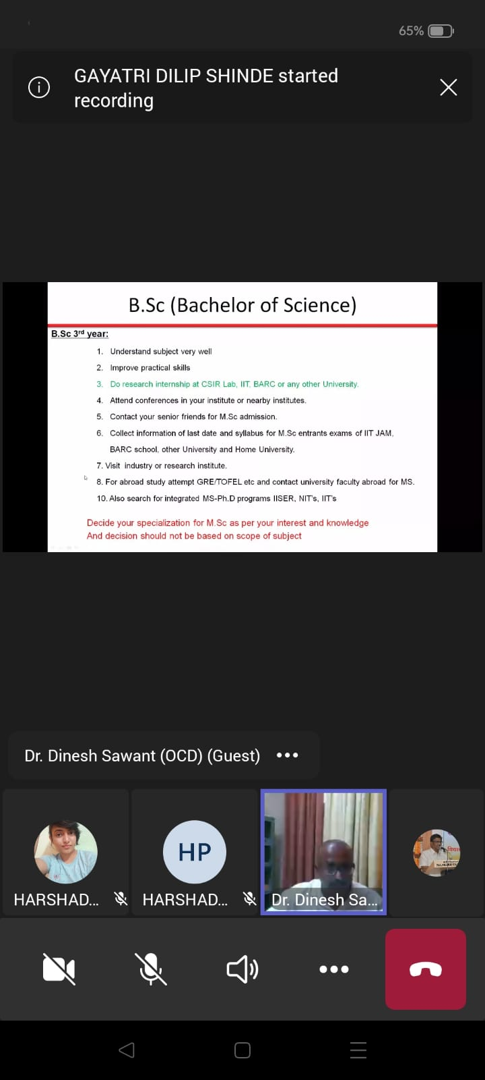
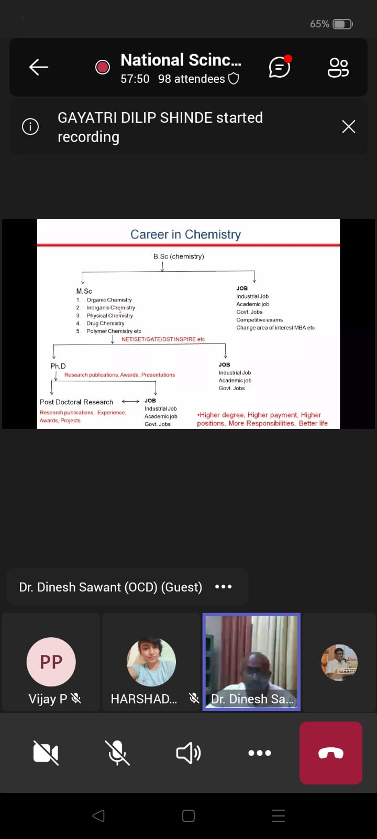

Slide 10
