Slide 1


Name: Dr. Jadhav Vilas Bhaskar
Designation: Associate Professor
Department: Chemistry
Jai Hind Educational Trust’s
Zulal Bhilajirao Patil College, Dhule

Slide 2
Core II
Inorganic Chemistry (CH – 502)
Credits : 3
Hours per week: 3
Teaching Hours : 45
Marks: 60

Slide 3
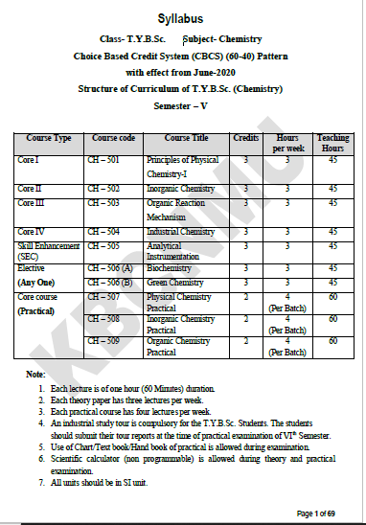

Slide 4
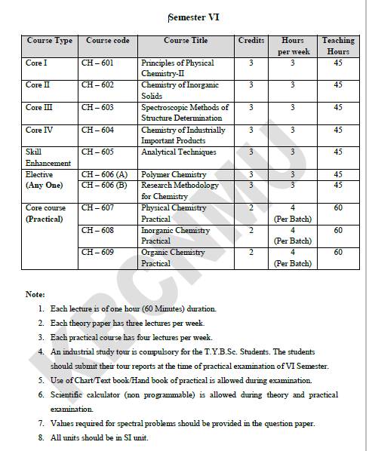

Slide 5
Atoms consists of proton, neutrons and electrons
Electrons are present in atomic orbitals
[Kr] 4d¹⁰, 5s², 5p⁵ is the electronic configuration of Iodine.
Fifth shell is valence shell in above electronic configuration.
Seven electrons are present in valence shell of Iodine.
Due to presence of Seven electrons in valence shell Iodine belongs to VII group of p block

Slide 6
[Ne] 3s¹ is the electronic configuration of ------------.
------------ is valence shell in above electronic configuration.
---------- electrons are present in valence shell.
Due to presence of --------- electrons in valence shell --------- belongs to ---------- group of ----- block
[Ar] 3d¹⁰,4s¹ is the electronic configuration of ------------.
------------ is valence shell in above electronic configuration.
---------- electrons are present in valence shell.
Due to presence of --------- electrons in valence shell --------- belongs to ------- group of ----- block

Slide 7
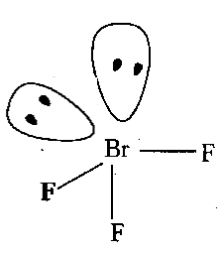
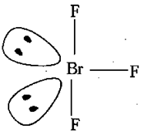
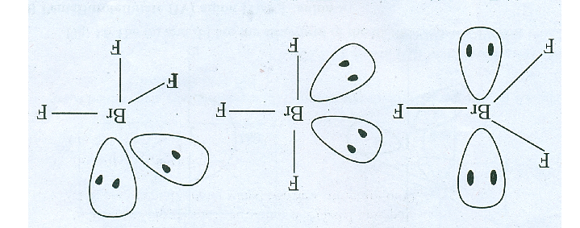
Name:
Central atom:
Electron configuration of central atom:
Valence shell:
Bond pairs:
Lone pairs:
Geometry:
Theory: VSEPR/VBT
Name:
Central atom:
Electron configuration of central atom:
Hybridization:
No. of hybrid orbitals:
Lone pairs:
Geometry:
Theory: VSEPR/VBT

Slide 8

Thank
You

