Slide 1


Name: Dr. Jadhav Vilas Bhaskar
Designation: Associate Professor
Department: Chemistry
Jai Hind Educational Trust’s
Zulal Bhilajirao Patil College, Dhule

Slide 2
Core II
Inorganic Chemistry (CH – 502)
Credits : 3
Hours per week: 3
Teaching Hours : 45
Marks: 60

Slide 3
UNIT 2 : Modern Theories of Coordination Compound Part –A (L-09, M-12)
Assumptions,
Werner theory and isomerism,
EAN,
Stability of complex ion,
Factors affecting stability of complex ion,
Irving William series,
Stabilization of unstable oxidation state,
Stereochemistry of coordination compound with C.N. 4 and 6,
Isomerism in coordination compounds.
Ref. - 1: 735-737, 742-745, 748--757.
Principle of Inorganic Chemistry, B. R. Puri, L. R. Sharma, K. C. Kalia, Milestone Publisher and distributor.
Ref. - 2: Relevant Pages.
Concise Inorganic Chemistry, 5th Edition, J. D. Lee.

Slide 4
Introduction
Werner's co-ordination theory was made the first attempt to explain the bonding in co-ordination complex compounds for their properties. Such as CoCl₃.6NH₃, CoCl₃.5NH₃, CoCl₃.4NH₃, CoCl₃.3NH₃ complexes which are obtained by combination of stable salt like CoCl₃ with various numbers of stable molecules like NH₃.
Before the discovery of electron by J. J. Thompson (1896) and before the discovery of electronic theory of valency by G. N. Lewis (1916), Werner was putforth theory of Co-ordination compounds (Werner’s theory-1893).
Alfred Werner honoured with the Nobel prize in Chemistry (1913) for his 20 years work on the study of co-ordination compound.

Slide 5
Fundamental postulates of Werner’s theory
The metal atom/ion in co-ordination complex compound possesses two types of valencies
a) Primary or principle or ionizable valency
b) Secondary or auxiliary or non-ionizable valency.
Every metal atom/ion has a fixed number of secondary valencies (co-ordination number).
The central metal atom/ion try to satisfy both its primary as well as secondary valencies. The primary valencies are satisfied by negative ions whereas secondary valencies are satisfied either by negative ions (groups) or by neutral molecules.
The fulfilment (satisfaction) of secondary valencies is essential hence sometimes negative ion may satisfy primary as well as secondary valencies.

Slide 6
Fundamental postulates of Werner’s theory
The secondary valencies (ligands) are always directed towards fixed position in a space around the central metal atom and this gives definite geometry (such as square planar, octahedral) to the co-ordination compound. Therefore secondary valency determines the stereochemistry of co-ordination compounds. Such co-ordination complex compounds are capable of showing the phenomenon of isomerism.

Slide 7
Experimental Evidence to support Werner’s theory / Werner’s work / Determination of structure of co-ordination complex
Werner did the experiment for identification, presence and confirmation of primary and secondary valencies in co-ordination compounds.
Werner treated cold aqueous solution of various co-ordination compounds/complexes with excess of AgNO₃ solution. The AgCl precipitated was weighed and from the weights of precipitate he confirmed the primary and secondary valencies in various co-ordination compounds as shown

Slide 8
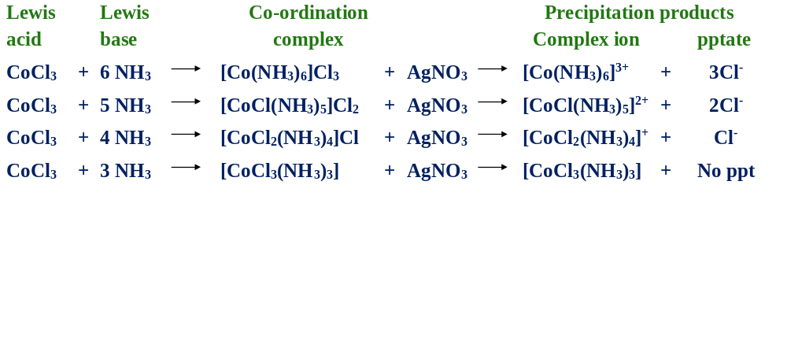
Experimental Evidence to support Werner’s theory / Werner’s work / Determination of structure of co-ordination complex

Slide 9
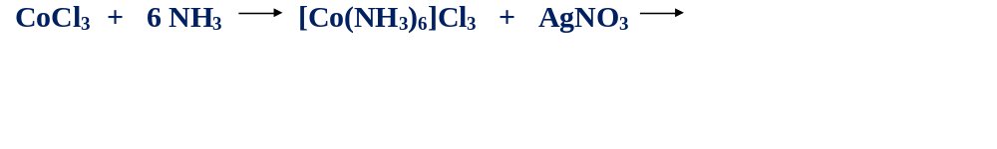
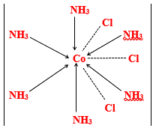
Conclusions
1.
In the reaction of CoCl₃ and 6NH₃, three Cl- ions acts as primary valencies and six NH₃ acts as secondary valencies. These three Cl- ions are ionic hence precipitated 3AgCl. While six NH₃ acts as secondary valencies. Therefore structure of co-ordinate complex is [Co(NH₃)₆]Cl₃
Primary valencies represented by dotted line.
Secondary valencies represented by solid line with arrow.

Slide 10

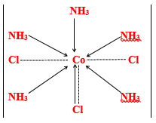
Conclusions
2.
In the reaction of CoCl₃ and 5 NH₃, two Cl- ions acts as primary valencies. These two Cl⁻ ions are ionic hence precipitated 2AgCl. While five NH₃ and one Cl⁻ ion acts as secondary valencies. Therefore structure of co-ordinate complex is [CoCl(NH₃)₅]Cl₂
Primary valencies represented by dotted line.
Secondary valencies represented by solid line with arrow.

Slide 11

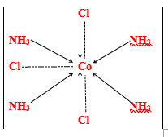
Conclusions
3.
In the reaction of CoCl₃ and 4 NH₃ , one Cl⁻ ions acts as primary valency. This one Cl⁻ ion is ionic hence precipitated AgCl. While four NH₃ and two Cl⁻ ion acts as secondary valencies. Therefore structure of co-ordinate complex is [CoCl₂(NH₃)₄]Cl
Primary valencies represented by dotted line.
Secondary valencies represented by solid line with arrow.

Slide 12

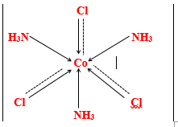
Conclusions
4.
In the reaction of CoCl₃ and 3 NH₃ , three Cl⁻ ions do not acts as primary valency. Due to absence of Cl⁻ ion as primary valency Cl⁻ is not ionic hence AgCl precipitate is not obtained. So that three NH₃ and three Cl⁻ ion acts as secondary valencies. Therefore structure of co-ordinate complex is [CoCl₃ (NH₃)₃]
Primary valencies represented by dotted line.
Secondary valencies represented by solid line with arrow.

Slide 13
Explain: [CoCl₃(NH₃)₃] is non-electrolyte while [CoCl₂(NH₃)₄]Cl is electrolyte-
Answer: [CoCl₃(NH₃)₃] is non-electrolyte because [CoCl₃(NH₃)₃] co-ordinate complex/compound is non-ionic (neutral) complex which will not ionize in solution hence it is non-electrolyte.
While [CoCl₂(NH₃)₄]Cl is electrolyte because it ionize in water gives cationic complex ion [CoCl₂(NH₃)₄]⁺ and one Cl⁻ anion hence it is electrolyte. The ionization reaction is represented as
[CoCl₂(NH₃)₄]Cl ======= [CoCl₂(NH₃)₄]⁺ + Cl⁻
Explain: [Pt(NH₃)₂Cl₄] is non-electrolyte while [Pt(NH₃)₅Cl]Cl₃ is electrolyte-
Answer: [Pt(NH₃)₂Cl₄] is non-electrolyte because [Pt(NH₃)₂Cl₄] compound is non-ionic (neutral) complex which will not ionize in solution hence it is non-electrolyte.
while [Pt(NH₃)₅Cl]Cl₃ is electrolyte because it ionize in water gives cationic complex ion [Pt(NH₃)₅Cl]³⁺ and three Cl⁻ anions hence it is electrolyte. The ionization reaction is represented as
[Pt(NH₃)₅Cl]Cl₃ ======= [Pt(NH₃)₅Cl] ³⁺ + 3Cl ⁻

Slide 14
Difference between primary valency and primary valency
Primary valency | Secondary valency
The primary valencies of central metal atom/ion are satisfied by negative ions (ligands such as Cl⁻ Br⁻ , CN⁻, SCN⁻, NO₂⁻, NH₂⁻ etc.) | Secondary valencies of central metal atom/ion are satisfied either by negative ions /groups (ligands such as Cl⁻ , Br⁻ , CN⁻, SCN⁻, NO₂⁻, NH₂⁻ etc.) or by neutral molecules (ligands such as H₂O, NH₃, Pyridine etc.)
It represent second co-ordination sphere. | It represent first co-ordination sphere.
It involves formation of ionic bond in the co-ordination complex compounds. | It involves formation of co-ordinate bond in the co-ordination complex compounds.
It is non-directional. | It is directional.
It is ionizable. | It is non-ionizable.
It gives idea about oxidation state of central metal atom/ion | It gives idea about co-ordination number of central metal atom/ion
Its magnitude is charge on complex ion in the co-ordination complex compounds. | Its magnitude is number of co-ordinate bonds formed in the co-ordination compounds.

Slide 15
Werner theory and isomerism
Werner further attempted to find out and predict the shapes (geometrical arrangement) of the co-ordination complex compounds. The geometrical arrangement of coordinated ligands around the central metal atom/ion causes optical and geometrical isomerism of the co-ordination complex compounds.

Slide 16
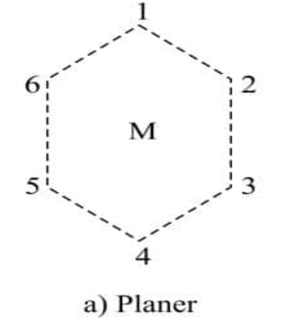
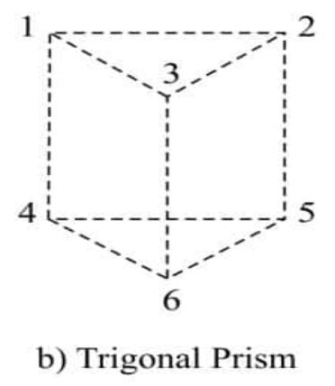
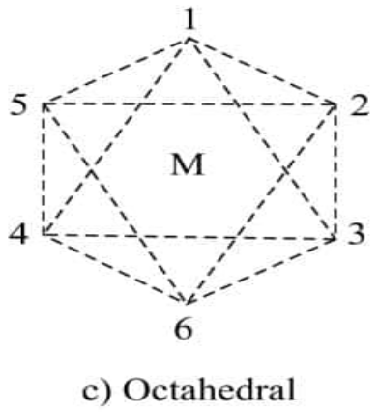
A] Complexes with co-ordination number Six (CN=6)
According to Werner’s co-ordination theory, the co-ordination complex compounds with co-ordination number six shows three possible structures such as
1) Planar hexagonal
2) Trigonal Prism
3) Octahedral
The number of predicted and actually found structures for co-ordination complexes having CN= 6 is
given in the following table

Slide 17
Complex | Observed structures | Expected structures
 |  | Planar Hexagonal | Trigonal prism | Octahedral
[MX₆] | 1 | 1 | 1 | 1
[MX₅Y] | 1 | 1 | 1 | 1
[MX₄Y₂] | 2 | 3 | 3 | 2
[MX₃Y₃] | 2 | 3 | 3 | 2
Example of [MX₄Y₂] type complex [CoCl₂(NH₃)₄]⁺

Slide 18
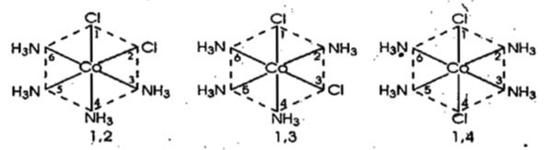
The complex [CoCl₂(NH₃)₄]⁺ is [MX₄Y₂] type complex.
From above table it is clear that, [MX₄Y₂] type complex
gives
1) Three Planar hexagonal isomers- It has three possible isomers represented as follows
The possible number of isomers for the [MX₄Y₂] i.e[CoCl₂(NH₃)₄]⁺ will be 3 with planar hexagonal such as 1,2 (ortho), 1,3 (meta), 1,4 (para) positions.
Three Planar Hexagonal isomers

Slide 19
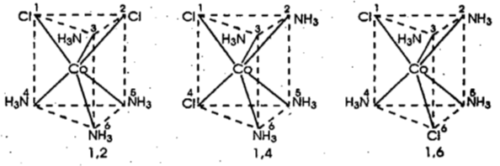
2) Three Trigonal Prism isomers- It has three possible isomers represented as follows
The possible number of isomers for the [MX₄Y₂] i. e. [CoCl₂(NH₃)₄]⁺ will be 3 with trigonal prism such as such as (1,2), (1,4), (1,6) positions of co-ordinated groups (ligands).
Three Trigonal prism isomers

Slide 20
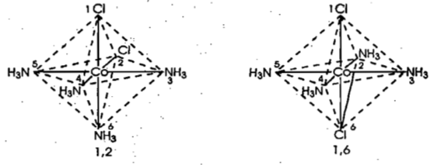
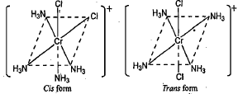
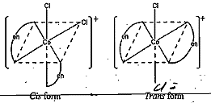
Two Octahedral isomers
3) Two Octahedral isomers- In octahedral arrangements, only 2 isomers are possible such as 1,2 (cis) and 1,6 (trans). Thus only 2 isomers have been isolated experimentally. These complexes with CN =6 have an octahedral shape.
Hence Werner concluded that, the arrangement of ligands around central metal atom/ion is 6 (six coordinated) and is always octahedral.

Slide 21
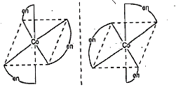
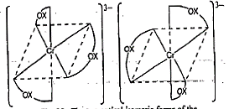
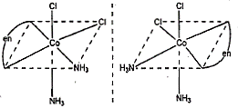
Two Octahedral optical isomers- Werner Also prepared the complexes of the type [M(AA)₃] which are optically active.
Only octahedral geometry will show optical isomerism
while planar hexagonal and trigonal prismatic geometry cannot form optically active complexes.
Therefore [M(AA)₃] complex is octahedral. E.g. [Cr(en)₃]³⁺, [Ni(en)₃]²⁺, [Fe(C₂O₄)₃]³⁻ and [M(AA)B₂C₂] E.g. [CoCl₂(en)(NH₃)₂]⁺ can form optically active complexes. (Where AA is symmetrical bidentate ligand like ethylenediamine (en)
The octahedral complexes (octahedral geometry) will show two optical isomers
dextro (d) or (+) rotatory optical isomer
laevo (l) or (-) rotatory optical isomer
Two Octahedral optical isomers

Slide 22
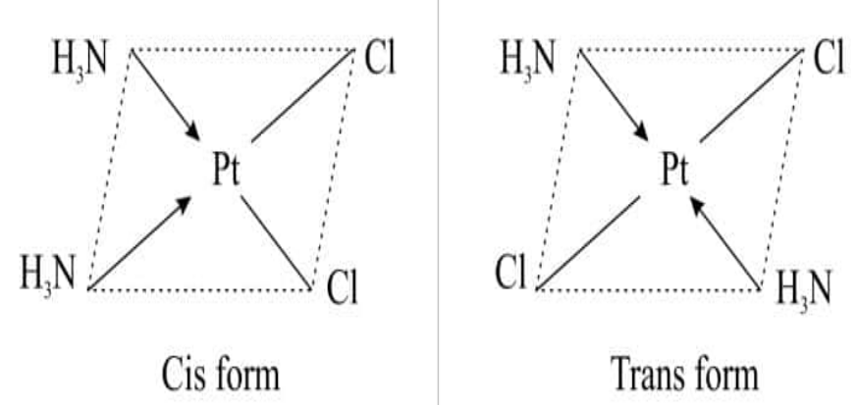
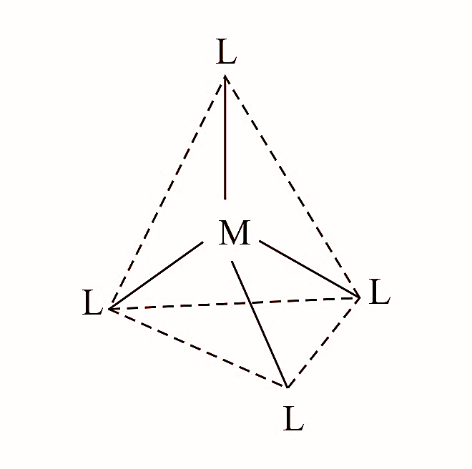
B] Complexes with co-ordination number Four-
According to Werner’s co-ordination theory, The complexes [Pt^{II}(NH₃)₂Cl₂] and [Pd^{II}(NH₃)₂Cl₂] shows either tetrahedral or square planar geometry.
Werner was prepared and study 2 different isomers of [Pt^{II}(NH₃)₂Cl₂] and [Pd^{II}(NH₃)₂Cl₂] complexes.
Therefore above square planar complex can exist in 2 isomeric forms such as Cis and Trans isomers. Therefore the complexes [Pt^{II}(NH₃)₂Cl₂] and [Pd^{II}(NH₃)₂Cl₂] are square planar and not tetrahedral.
The tetrahedral complex can exist in one form - If molecule is tetrahedral only one geometrical isomer would have been possible.
For [Pd^{II}(NH₃)₂Cl₂] the similar Cis and Trans structures can be represented
Tetrahedral only one geometrical isomer

Slide 23
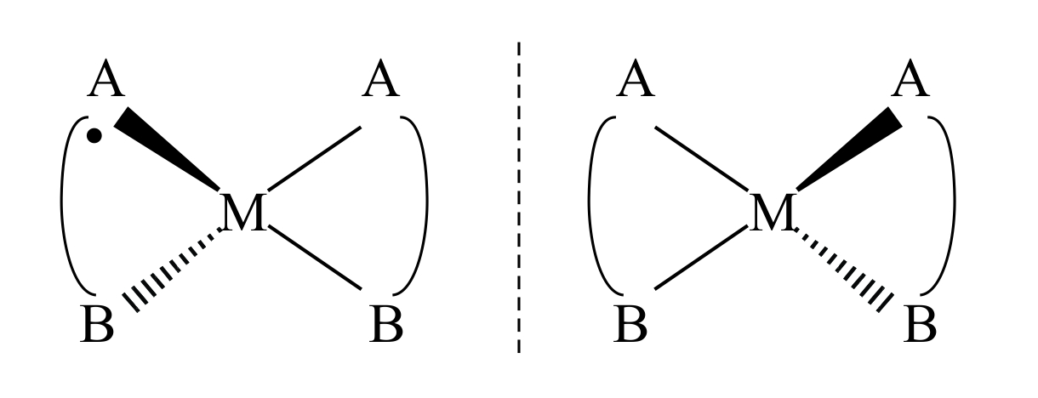
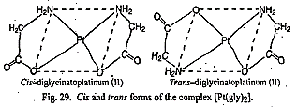
B] Complexes with co-ordination number Four- Optical isomers
If the structure is asymmetric then it gives rise to optical isomerism.
For the complex of the type [M(A-B)₂], two optical isomers are possible
A-B is unsymmetrical bidentate ligand.
For [Pt^{II}(gly)₂] the similar d and l structures can be represented

Slide 24
Examples of Effective Atomic Number (E.A.N.)
During the formation of co-ordination compound the ligands donate electron pair/s to the central metal atom/ion. So that number of electrons around the central metal atom/ion increased in the coordination compound.
To calculate the number of e- around the central metal atom/ion in the coordination compound and to determine the stability of the coordination compound,
Sidgwick introduced the concept of EAN.
The total number of electrons associated with central metal atom/ion in the complex is called EAN of the central metal atom/ion.
The EAN of central metal atom/ion in the complex can be calculated as –
EAN of Central Metal Atom/Ion = [(Atomic Number of metal) – (Number electrons lost during
ion formation)] + [Number electrons gained from ligands in complex)]
EAN of CMA/I = [ (Z - Ne⁻ lost) + (Ne⁻ gained)] = [ (Z - Ne⁻ lost) + 2(CN of metal ion in complex)]
According to Sidgwick, the complexes are stable when the central atom acquires the effective atomic number equal to atomic number of next inert gas element.
Accordingly, the EAN in a complex should be equal to 36 (electrons in Krypton). 54 (electrons in Xenon) or 86 (electrons in Radon).
The complex is said to obey EAN if the EAN of metal atom/ion in the complex is either 36, 54 or 86.

Slide 25
Examples of Effective Atomic Number (E.A.N.)
a) [Co(NH₃)₆]³⁺ Given- At. No. of Co (Z) = 27, For Co³⁺ ion, n= 3 EAN_{(Central Metal Ion)} = [(Z – n) + 2CN] = [(27-3) + (2x6)]= 24+12=36 The atomic number of next inert gas is 36 (krypton). The EAN for Co³⁺ ion is 36 which is equal to 36 (krypton). Therefore complex ion obeys EAN rule | b) [Cr(CO)₆] Given- At. No. of Cr (Z) = 24, For Cr⁰, n = 0 EAN_{(Central Metal Ion)} = [(Z – n) + 2CN] = [(24-0) + (2x6)]= 24+12=36 The atomic number of next inert gas is 36 (krypton). The EAN for Cr³⁺ ion is 36 which is equal to 36 (krypton). Therefore complex ion obeys EAN rule
c) [Cu(CN)₄]³⁻ Given- At. No. of Cu (Z) = 29, For Cu⁺ ion, n = 1 EAN_{(Central Metal Ion)} = [(Z – n) + 2CN] = [(29-1) + (2x4)]= 28+8=36 The atomic number of next inert gas is 36 (krypton). The EAN for Cu⁺ ion is 36 which is equal to 36 (krypton). Therefore complex ion obeys EAN rule | d) [Cr(NH₃)₆]³⁺ Given- At. No. of Cr (Z) = 24, For Cr³⁺ ion, n = 3 EAN_{(Central Metal Ion)} = [(Z – n) + 2CN] = [(24-3) + (2x6)]= 21+12=33 The atomic number of next inert gas is 36 (krypton). The EAN for Cr³⁺ ion is 33 which is not equal to 36 (krypton). Therefore complex ion not obeyed EAN rule
e) [Fe(CN)₆]³⁻ Given- At. No. of Fe (Z) = 26, For Fe³⁺ion, n = 3 EAN_{(Central Metal Ion)} = [(Z – n) + 2CN] = [(26-3) + (2x6)]= 23+12=35 The atomic number of next inert gas is 36 (krypton). The EAN for Fe³⁺ ion is 35 which is not equal to 36 (krypton). Therefore complex ion not obeyed EAN rule | e) [Fe(CN)₆]⁴⁻ Given- At. No. of Fe (Z) = 26, For Fe²⁺ion, n = 2 EAN_{(Central Metal Ion)} = [(Z – n) + 2CN] = [(26-2) + (2x6)]= 24+12=36 The atomic number of next inert gas is 36 (krypton). The EAN for Fe²⁺ ion is 36 which is equal to 36 (krypton). Therefore complex ion obeyed EAN rule
e) [Cu(NH₃)₄]²⁺ Given- At. No. of Cu (Z) = 29, For Cu²⁺ ion, n = 2 EAN_{(Central Metal Ion)} = [(Z – n) + 2CN] = [(29-2) + (2x4)]= 27+8=35 The atomic number of next inert gas is 36 (Krypton). The EAN for Cu²⁺ ion is 35 which is not equal to is 36 (Krypton). Therefore complex ion not obeyed EAN rule | f) [Ag(NH₃)₂]⁺ Given- At. No. of Ag (Z) = 47, For Ag⁺ ion, n = 1 EAN_{(Central Metal Ion)} = [(Z – n) + 2CN] = [(47-1) + (2x2)]= 46+4=50 The atomic number of next inert gas is 54 (Xenon). The EAN for Ag⁺ ion is 50 which is not equal to 54 (Xenon). Therefore complex ion not obeyed EAN rule

Slide 26
Complexes which obeys EAN rule are given in the following table
Complex | Central metal atom and its At. No. (Z) | Central metal ion in complex | Number Electron lost in the formation of metal ion (n) | Co-ordination N of central metal ion (CN) | Number electrons gained by metal ion from ligands (2xCN) | EAN of central metal ion
[Cu(NH₃)₄]⁺ | Cu (29) | Cu⁺ | 1 | 4 | 8 | 36
[Cu(CN)₄]³⁻ | Cu (29) | Cu⁺ | 1 | 4 | 8 | 36
[Fe(CN)₆]⁴⁻ | Fe (26) | Fe²⁺ | 2 | 6 | 12 | 36
[Ni(CO)₄] | Ni (28) | Ni⁰ | 0 | 4 | 8 | 36
[Cr(CO)₆] | Cr (24) | Cr⁰ | 0 | 6 | 12 | 36
[Co(NH₃)₆]³⁺ | Co (27) | Co³⁺ | 3 | 6 | 12 | 36
[Pd(NH₃)₆]⁴⁺ | Pd (46) | Pd⁴⁺ | 4 | 6 | 12 | 54
[Ag(NH₃)₄]⁺ | Ag (47) | Ag⁺ | 1 | 4 | 8 | 54
[Pt(NH₃)₆]⁴⁺ | Pt (78) | Pt⁴⁺ | 4 | 6 | 12 | 86
[Pt(NH₃)₃Cl₃]⁺ | Pt (78) | Pt⁴⁺ | 4 | 6 | 12 | 86

Slide 27
Complexes which donot obeys EAN rule are given in the following table
Complex | Central metal atom and its At. No. (Z) | Central metal ion in complex | Number Electron lost in the formation of metal ion (n) | Co-ordination N of central metal ion (CN) | Number electrons gained by metal ion from ligands (2xCN) | EAN of central metal ion
[Cr(NH₃)₆]³⁺ | Cu (29) | Cu⁺ | 1 | 4 | 8 | 36
[Fe(CN)₆]³⁻ | Cu (29) | Cu⁺ | 1 | 4 | 8 | 36
[CoCl₄]²⁻ | Fe (26) | Fe²⁺ | 2 | 6 | 12 | 36
[Ni(NH₃)₆]²⁺ | Ni (28) | Ni⁰ | 0 | 4 | 8 | 36
[Cu(NH₃)₄]²⁺ | Cr (24) | Cr⁰ | 0 | 6 | 12 | 36
[PdCl₄]²⁻ | Co (27) | Co³⁺ | 3 | 6 | 12 | 36
[Ag(NH₃)₄]⁺ | Pd (46) | Pd⁴⁺ | 4 | 6 | 12 | 54
[Pt(NH₃)₄]²⁺ | Pt (78) | Pt²⁺ | 2 | 4 | 8 | 84

Slide 28
Limitation of Sidgwick’s interpretation
The concept of donation of electron pairs to central metal ion is defective due to involvement of accumulation of excessive negative charge by acceptance electron density from ligands on normally electropositive metal.
The electron lone pairs donated by water or ammonia are 2S2 electrons which have no bonding characteristics and excite them to higher energy level would require more energy than is usually available in bond formation.
EAN is no longer useful as there are many stable complexes which do not obey EAN rule.
The tendency to obtain noble gas configuration is significant factor but not necessary condition for complex formation. Some Cr and Pt complexes are equally stable even though EAN is not achieved by central metal ion.
For complex formation, it is necessary to produce a symmetrical structure like tetrahedral, square planar, octahedral irrespective of number of electrons involved according to Sidgwick model.

Slide 29
Stability of complex ions
Most of the complexes are quite stable however they do dissociate in aqueous solution to little extent in order to established equilibrium between central metal ion and the ligands from the complex is formed.
Ex. The aqueous solution of containing complex ion [Ag(NH₃)₂]⁺ makes the equilibrium with Ag⁺ ion and two NH₃ molecules.
[Ag(NH₃)₂]⁺ Ag⁺ + 2NH₃
The dissociation constant (K_{Dissociation}) for above equilibrium is given as
[Ag⁺][ NH₃]²
K_{Dissociation} = -------------------- = 6 x10⁻⁸
[Ag(NH₃)₂]⁺
The K_{Dissociation} is very small about 6 x10⁻⁸ hence the complex ion [Ag(NH₃)₂]⁺ is stable.
In general, if the K_{Dissociation} is very small then the complex ion is very stable.

Slide 30
Stability of complex ions
Ex. The Ag⁺ ion and two NH₃ molecules combine to give complex ion [Ag(NH₃)₂]⁺is represented by the equilibrium as follows
Ag⁺ + 2NH₃ [Ag(NH₃)₂]⁺
The stability constant (K_{Stability}) for above equilibrium is given as
[Ag(NH₃)₂]⁺
K_{Stability} = -------------------- =1.67 x10⁷
[Ag⁺][ NH₃]²
The K_{Dissociation} is very greater about 1.67 x10⁷ hence the complex ion [Ag(NH₃)₂]⁺ is stable.
In general, if the K_{Stability} is very greater then the complex ion is very stable.
Thus relation between K_{Dissociation} and K_{Stability} is given as follows
1 1
K_{Stability} = --------------- or K_{Dissociation} = --------------
K_{Dissociation} K_{stability}
The reciprocal of dissociation constant is called stability constant of the complex ion.

Slide 31
Factors affecting the Stability of complex ions
The Stability of complex ions is depend mainly on the following three factors
Nature of central metal ion
Nature of ligand
Chelate effect
1) Nature of central metal ion- In general, if greater is the positive charge density or ionic potential or charge density on central metal ion greater is the stability of its complexes.
The charge density is determined using the relation,
charge on metal ion
Charge density = -----------------------------
size of metal ion
In other words, if greater is the charge on metal ion and smaller is the size of metal ion then the ratio of charge on metal ion to size of metal ion is greater hence greater is stability of its complexes.
Different charge and different Size on metal ion – E.g. Fe³⁺ ion carries greater positive charge and smaller size than Fe²⁺ ion which indicate that charge density on Fe³⁺ ion is greater than Fe²⁺ ion.

Slide 32
The stability constant of Fe³⁺ ion complex [Fe(CN)₆]³⁻ is 10³¹ and the stability constant of Fe²⁺ ion complex [Fe(CN)₆]⁴⁻ is 10⁶.
Therefore the complex formed by Fe³⁺ ion is more stable than Fe²⁺ ion.
Same charge and different Size on metal ion – Some metal ions having same charge but having different ionic radius then metal ion having smaller ionic radius shows greater stability for that complex due to greater charge density on central metal ion.
Central metal ion | Mn²⁺ | Fe²⁺ | Co²⁺ | Ni²⁺ | Cu²⁺
Ionic radius (A⁰) | 0.91 | 0.98 | 0.82 | 0.78 | 0.69
Charge density | 2.20 | 2.04 | 2.44 | 2.56 | 2.90
Stability of complex formed by above metal ions increase from Mn²⁺ ion to Cu²⁺ ion.

Slide 33
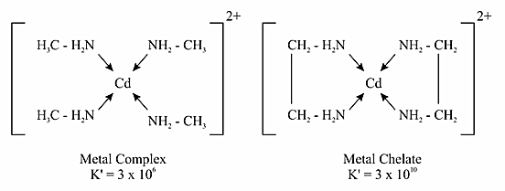
2) Electronegativity of Central ion : Greater the electronegativity of the central ion, greater is the stability of its complexes. Hence strongly electron attracting central ion will give more stable complex.
3) Nature of Ligand : Strongly basic ligands (electron donating ligands) form more stable complexes than weakly basic ligands. e.g. CN–, F–, NH₃ are strong bases and form stable complexes.
The anionic ligand with higher charge and smaller size forms more stable complex. e.g. F- forms more sable complex than Cl–.
4) The Chelate effect: The complexes containing chelate rings are more stable than those containing similar but unidentate ligands. This effect is known as Chelate effect.
For example: The complex ion [Cd(en)₂]²⁺ is 10,000 times more stable that [Cd(CH₃NH₂)₄]²⁺

Slide 34
The chelating ligands (bidentate or polydentate ligands) form more stable complexes (containing chelate ring) than those complexes containing Unidentate ligand. This effect is called as chelate effect.
For example [Cu(NH₃)₄]²⁺ is less stable complex because it is formed by Unidentate ligand and can-not form metal Chelate. While [Cu(en)₂]²⁺ is more stable complex because it is formed by bi-dentate ligand and can form chelate ring i.e. metal chelate.
5) Steric effect: The steric factors and size of the chelate ring are also important factors about the stability of metal chelate complexes. The larger and bulky ligands from less stable complexes than smaller ligands.

Slide 35
2.7 Stereochemistry of co-ordination complex compounds having Co-ordination number 4 and 6:
The secondary valencies (ligands) are always directed towards fixed position in a space around the central metal atom depending on the co-ordination number of central metal ion and this gives definite geometry to the co-ordination complex compound. The arrangement of co-ordinated ligands is such that the electrostatic repulsion between them is minimum.
A] Stereochemistry of co-ordination complex compounds having Co-ordination number 4: The possible geometries for co-ordination number 4 are
Tetrahedral
Square planar

Slide 36
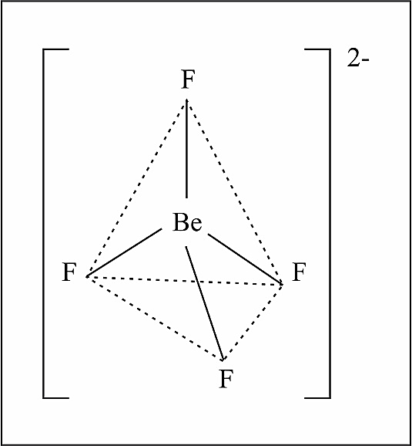
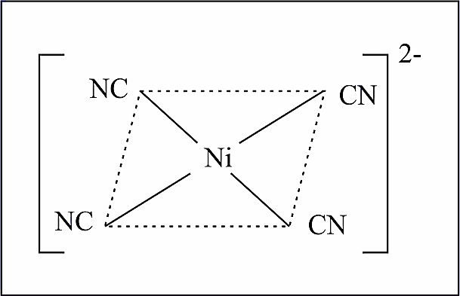
Tetrahedral structure of (BeF₄)^{2–}
1] Stereochemistry of co-ordination complex compounds having Co-ordination number 4 (Tetrahedral geometry):
This geometry is common amongst complexes of transition as well as non transition elements.
e.g. [BeF₄]^{2–}, [BF₄]^{2–}, [MnCl₄]^{2–} [ZnCl₄]^{2–} etc.
2] Stereochemistry of co-ordination complex compounds having Co-ordination number 4 (Tetrahedral geometry):
This geometry is common in transition metal complexes only.
e.g. [Ni(CN₄)]^{2–}, [Cu(NH₃)₄]²⁺, [PtCl₄]^{2–}, [PdCl₄]^{2–} etc.
Square planer geometry of [Ni(CN)₄]^{2–}

Slide 37
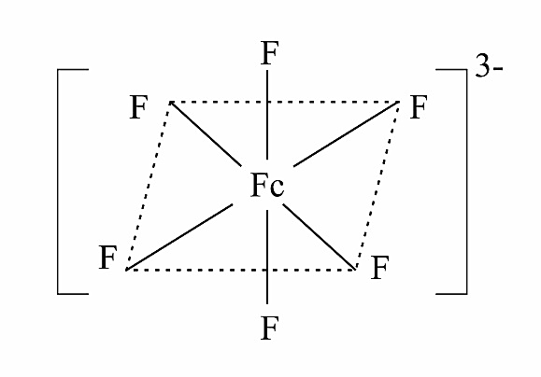
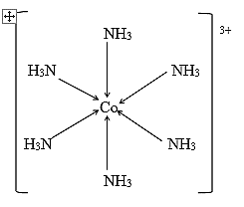
2] Stereochemistry of co-ordination complex compounds having Co-ordination number 6- Octahedral geometry:
Complex with C.N. 6 have octahedral structures. Large number of complexes show octahedral geometry.
e.g. [Co(NH₃)₆]²⁺ , [FeF₆]³, [TiF₆]^{2–}, [PtF₆], [SbF₆] etc. However some complexes with C.N.6 show tetragonally distorted octahedral structures.
e.g. [Co(NH₃)₆]³⁺, [CoCl₂(NH₃)₄]²⁺
Octahedral structure of [FeF₆]^{3–}
Octahedral structure of [Co(NH₃)₆]³⁺

Slide 38
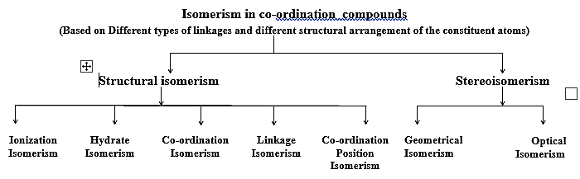
2.8 Isomerism in co-ordination compounds
Compound having same molecular formula but different structures and hence different physical and chemical properties are called isomers.
The phenomenon of existence/formation of such isomer compounds is known as isomerism.
Co-ordination compounds give wide variety of isomers due to different types of linkages and different structural arrangements.
Co-ordination compounds show following types of Isomerism.
A] Structural isomerism
B] Stereo isomerism

Slide 39
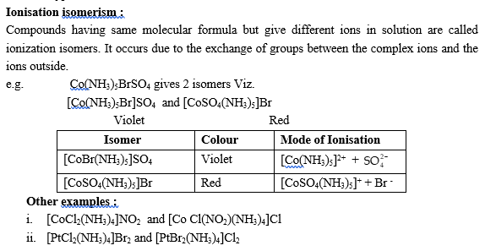
2.8 Isomerism in co-ordination compounds
A] Structural isomerism- It is shown by compounds having different ligands in their co-ordination spheres. These are of different types.

Slide 40
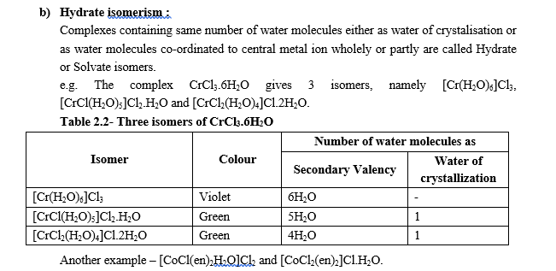
2.8 Isomerism in co-ordination compounds
A] Structural isomerism

Slide 41
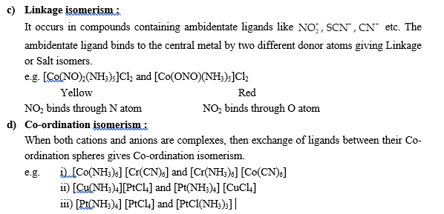
2.8 Isomerism in co-ordination compounds
A] Structural isomerism

Slide 42
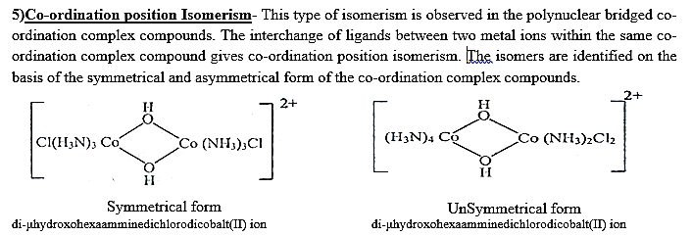
2.8 Isomerism in co-ordination compounds
A] Structural isomerism

Slide 43
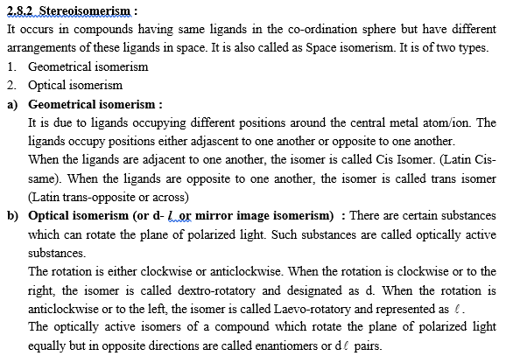
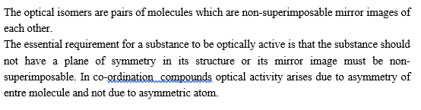
2.8 Isomerism in co-ordination compounds
B] Stereoisomerism-

Slide 44
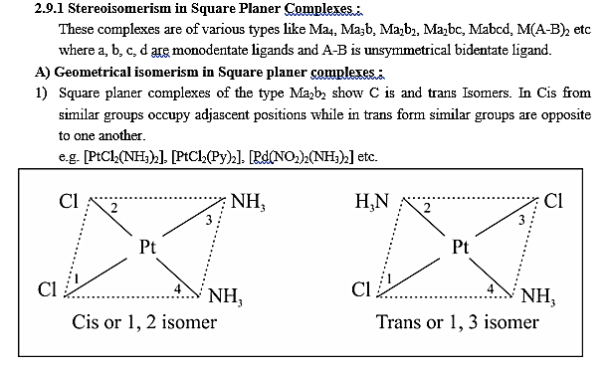
2.9 Stereoisomerism in Complexes with co-ordination number 4 :
Complexes with C.N. 4 have either square planer geometry.

Slide 45
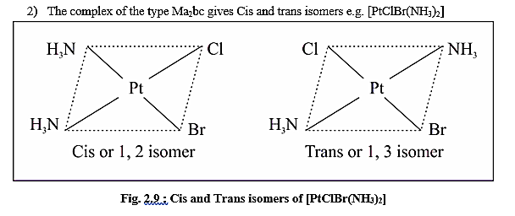
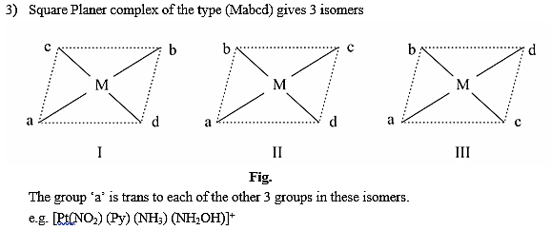
2.9 Stereoisomerism in Complexes with co-ordination number 4 :
Complexes with C.N. 4 have either square planer geometry.

Slide 46
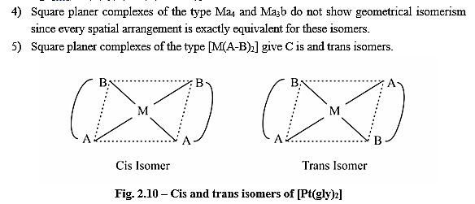
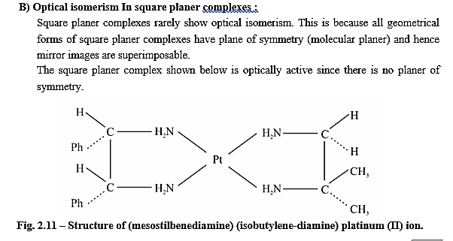
2.9 Stereoisomerism in Complexes with co-ordination number 4 :
Complexes with C.N. 4 have either square planer geometry

Slide 47
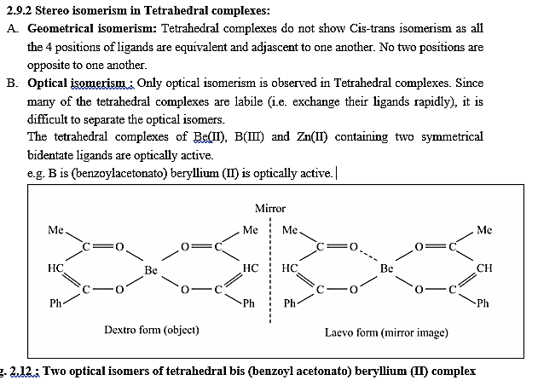
2.9 Stereoisomerism in Complexes with co-ordination number 4 :
Complexes with C.N. 4 have either Tetrahedral geometry.

Slide 48
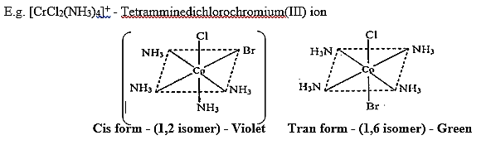
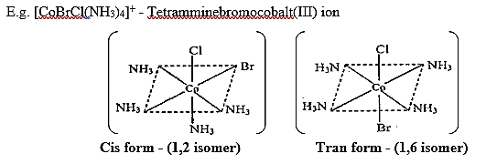
2.9 Stereoisomerism in Complexes with co-ordination number 6 :
The co-ordination complexes with co-ordination number 6 have octahedral geometry.
The octahedral complexes of the type [Ma₆] and [Ma₅b] do not show geometrical isomerism.
The octahedral complexes of the type [Ma₂b₄] or [Ma₄b₂], [Ma₃b₃] and [M(aa)₂b₂] can show geometrical (cis-trans) isomerism which are further divided into 4 types discussed as follows
[Ma₂b₄]or [Ma₄b₂] or [Ma₄bc] type complexes- The [Ma₂b₄] or [Ma₄b₂] or [Ma₄bc] complexes can give cis and trans form.

Slide 49
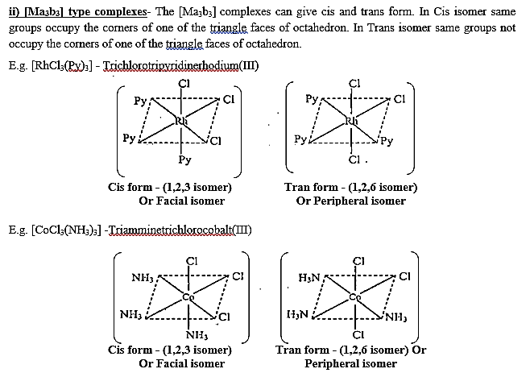
2.9 Stereoisomerism in Complexes with co-ordination number 6 :

Slide 50
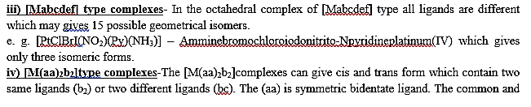
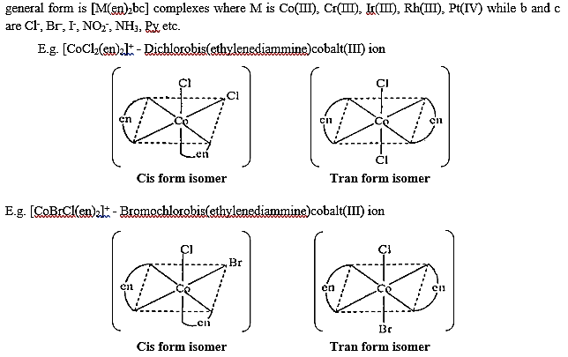
2.9 Stereoisomerism in Complexes with co-ordination number 6 :

Slide 51
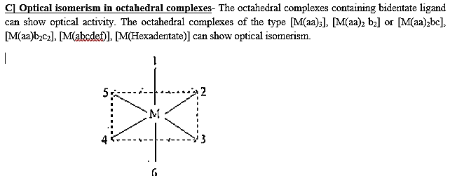
2.9 Stereoisomerism in Complexes with co-ordination number 6 :

Slide 52
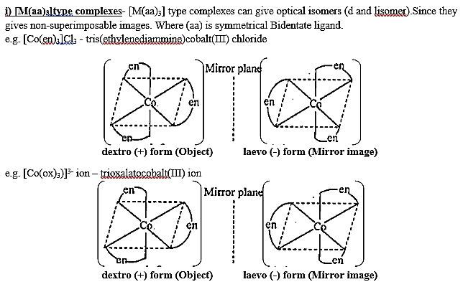
2.9 Stereoisomerism in Complexes with co-ordination number 6 :

Slide 53
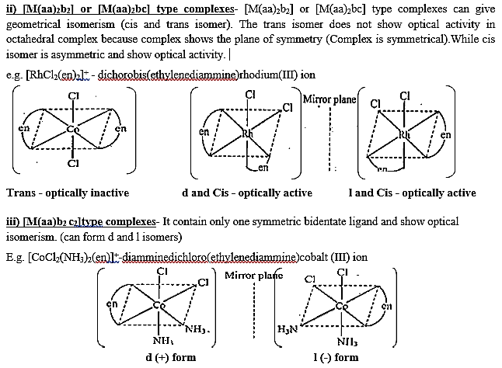
2.9 Stereoisomerism in Complexes with co-ordination number 6 :

Slide 54
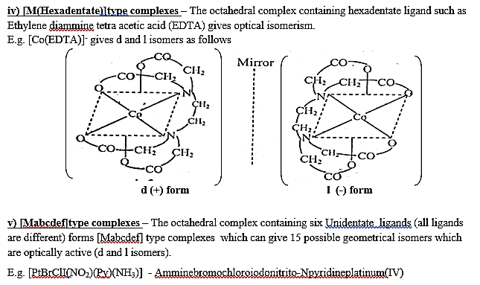
2.9 Stereoisomerism in Complexes with co-ordination number 6 :

Slide 55

Thank

