Slide 1


Name: Dr. Jadhav Vilas Bhaskar
Designation: Associate Professor
Department: Chemistry
Jai Hind Educational Trust’s
Zulal Bhilajirao Patil College, Dhule

Slide 2
Core II
Inorganic Chemistry (CH – 502)
Credits : 3
Hours per week: 3
Teaching Hours : 45
Marks: 60

Slide 3
UNIT 3 : Modern Theories of Coordination Compound Part –B (L-09, M-12)
Assumptions of V.B.T.,
V.B. Theory as applied to structural and bonding in complexes of 3d series elements,
Examples of square planar, Tetrahedral and Octahedral complexes, inner and outer orbital complexes,
Magnetic properties of complexes of 3d series elements,
limitations of V.B.T.,
Assumptions of CFT,
Degeneracy of ‘d’ orbital’s,
Application of CFT to octahedral complexes,
Weak and strong ligand field splitting,
spectrochemical series.
Ref. - 1: Ref. - 1: 759-766.
Principle of Inorganic Chemistry, B. R. Puri, L. R. Sharma, K. C. Kalia, Milestone Publisher and distributor.
Ref. - 2: Relevant Pages.
Concise Inorganic Chemistry, 5th Edition, J. D. Lee.

Slide 4
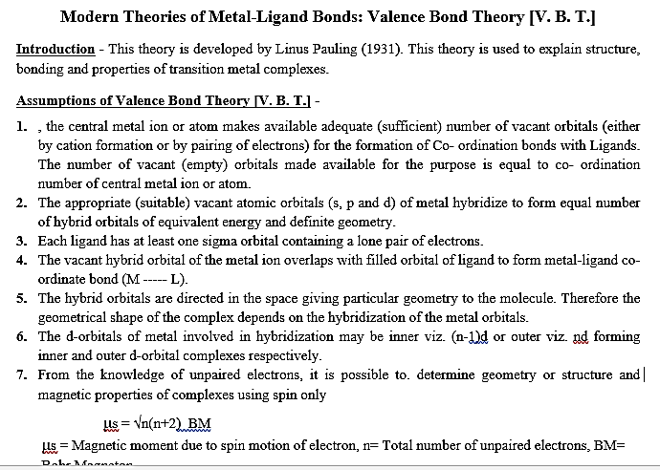
UNIT 3 : Modern Theories of Coordination Compound Part –B (L-09, M-12)

Slide 5
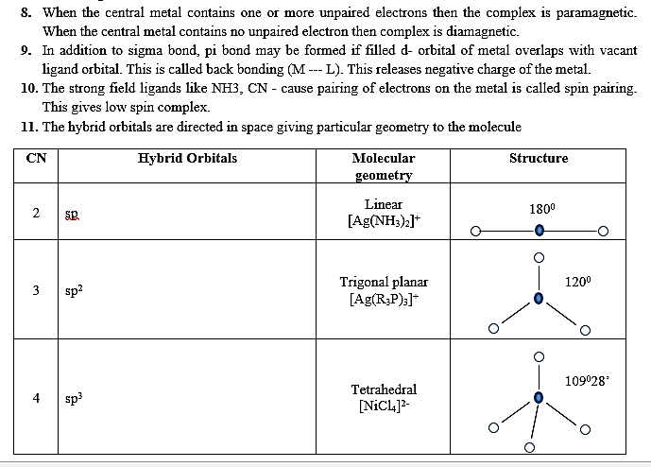

Slide 6
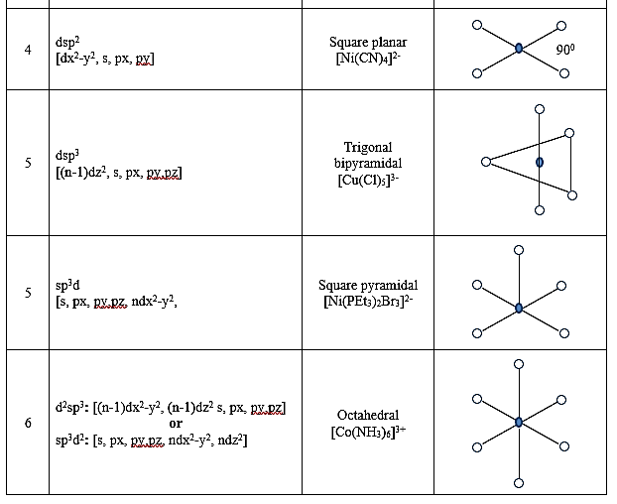

Slide 7
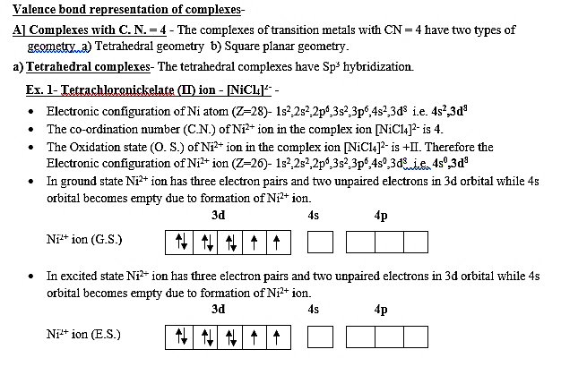
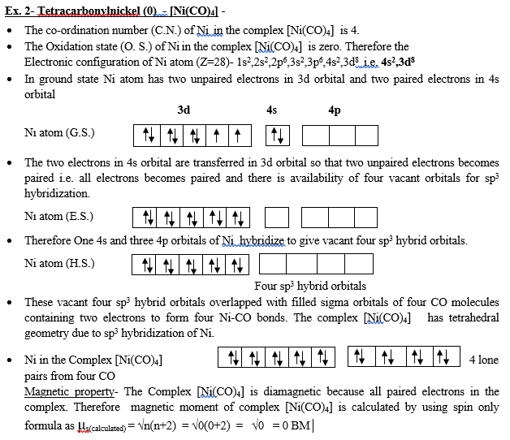
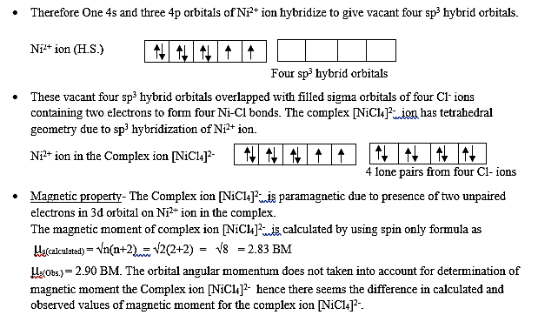

Slide 8
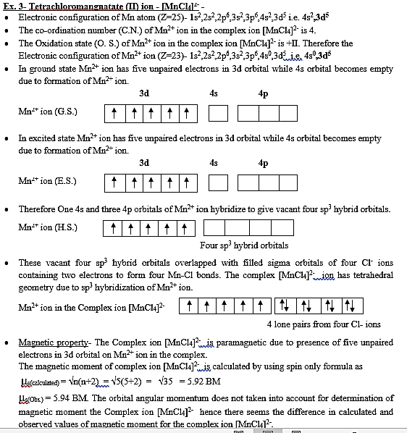

Slide 9
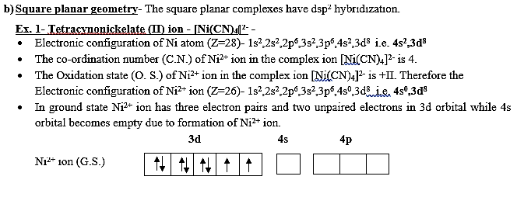
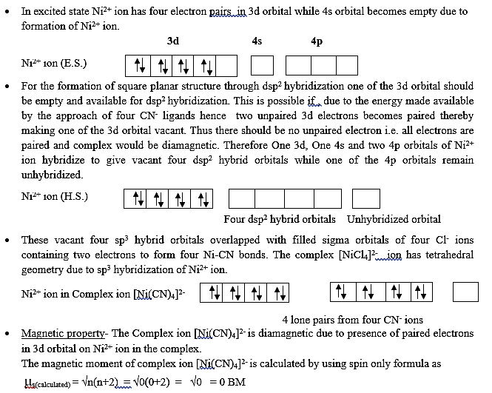

Slide 10
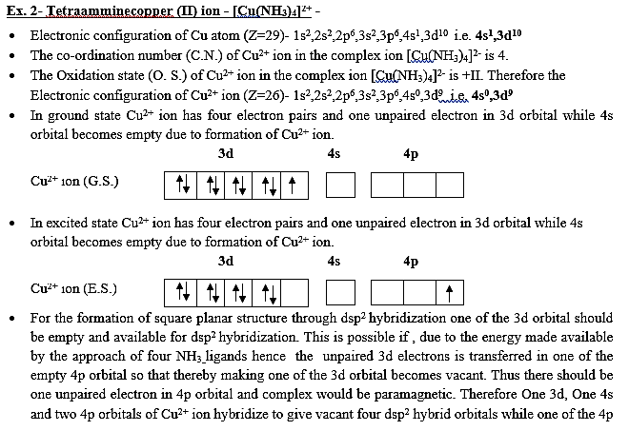
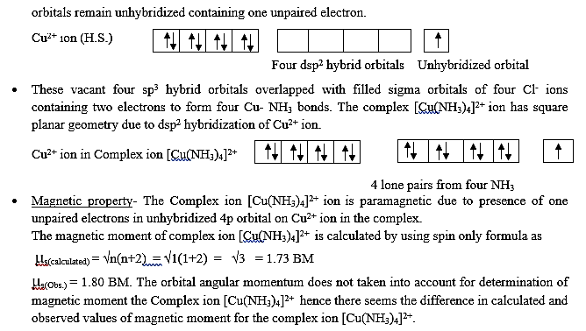

Slide 11
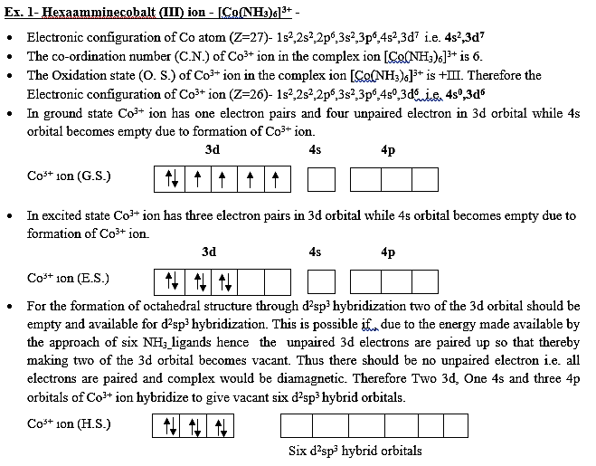
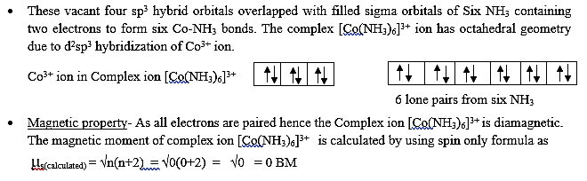

Slide 12
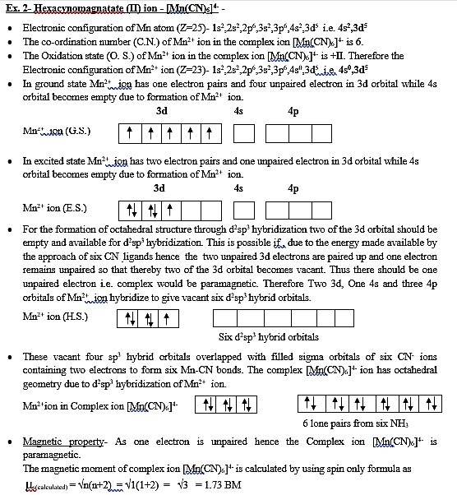

Slide 13
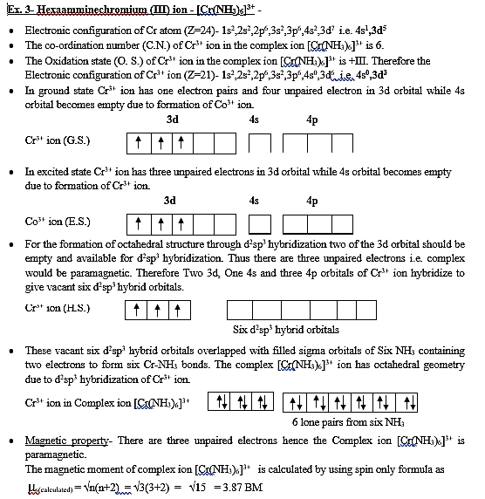

Slide 14
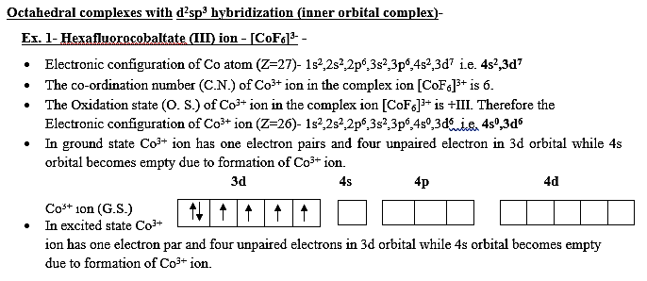
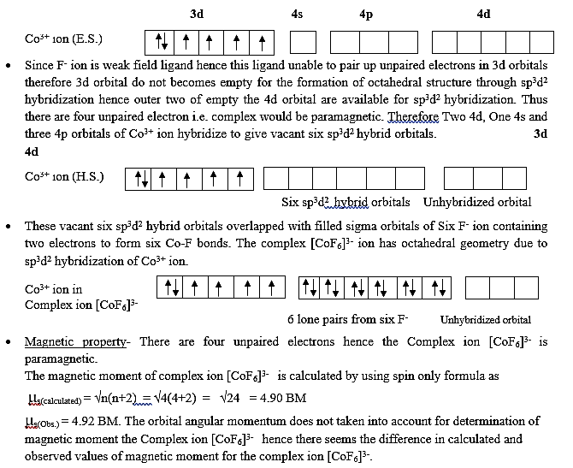

Slide 15
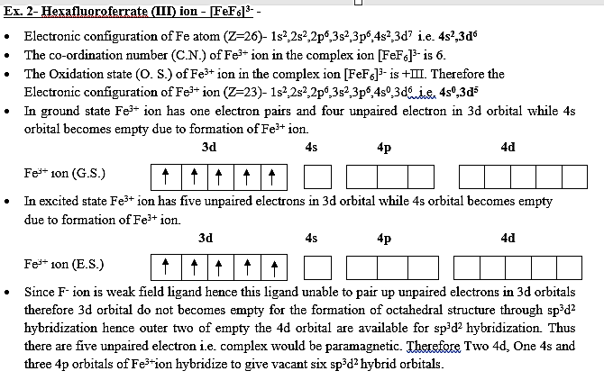
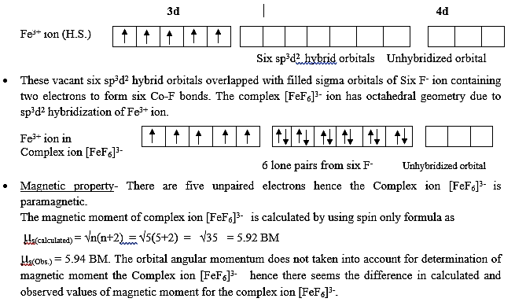

Slide 16
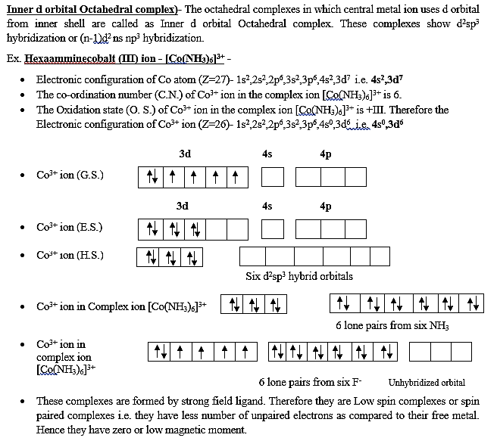

Slide 17
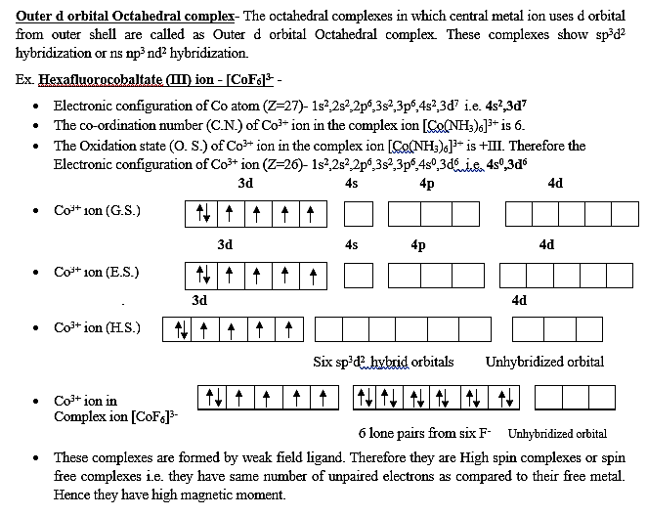

Slide 18
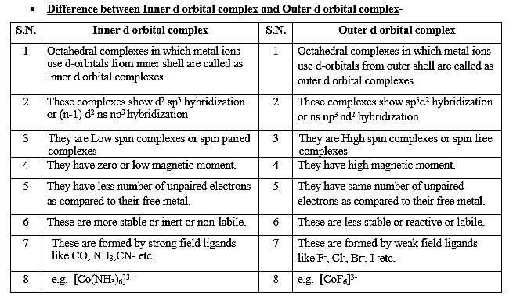

Slide 19
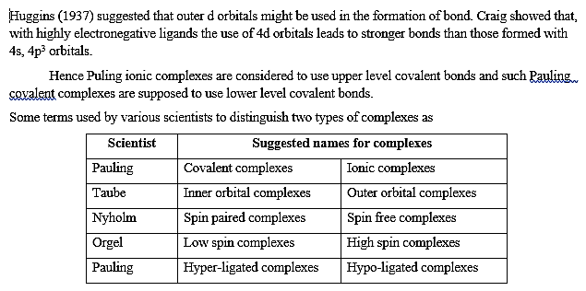

Slide 20
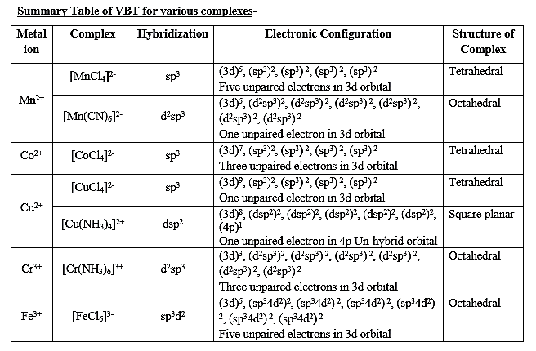

Slide 21
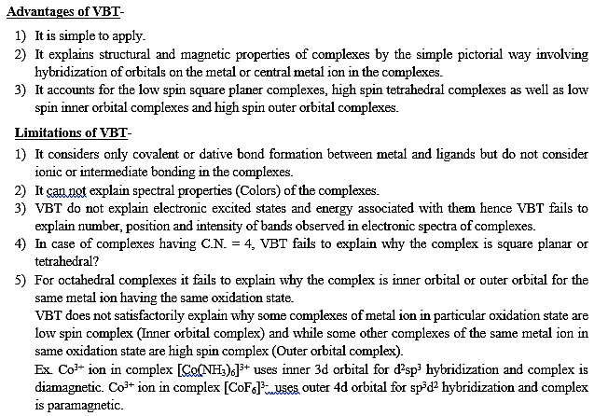

Slide 22
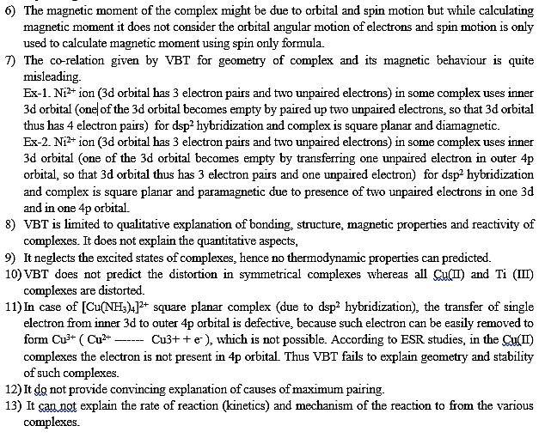

Slide 23
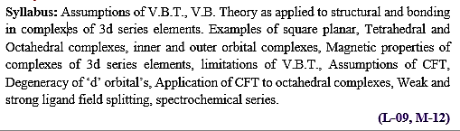
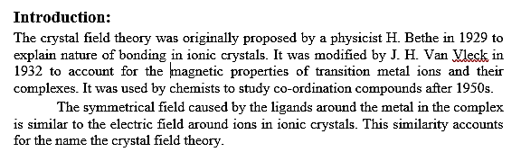
Crystal Field Theory

Slide 24
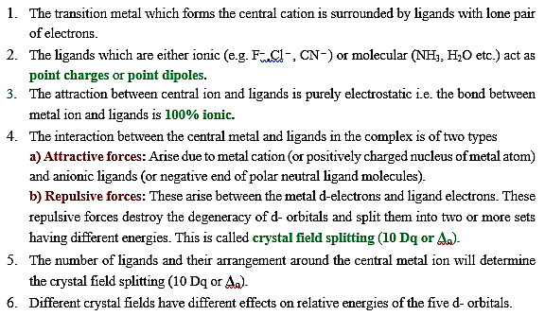
Assumptions of CFT

Slide 25
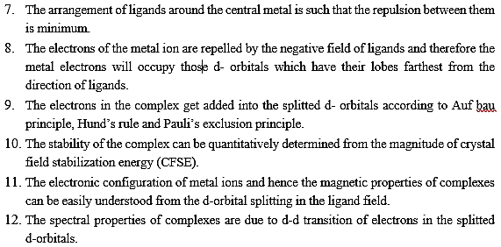

Slide 26
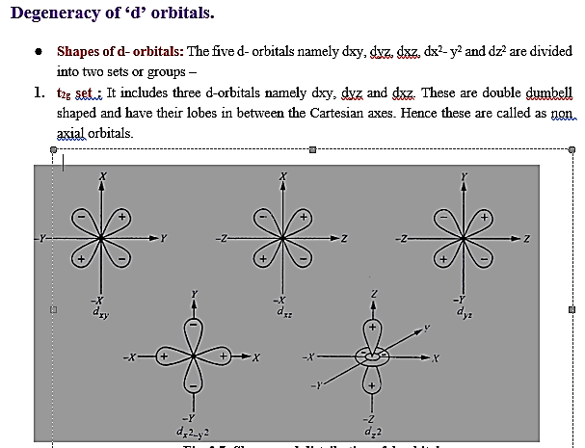
Degeneracy of ‘d’ orbital’s

Slide 27
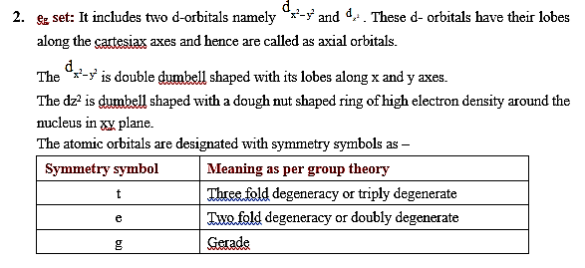

Slide 28
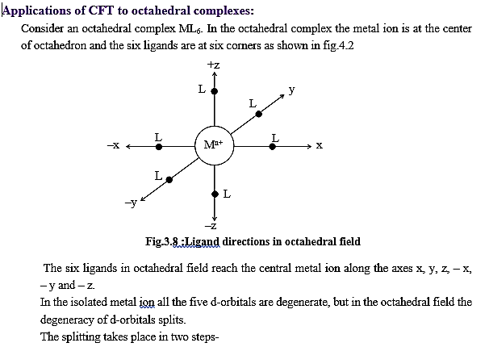
Application of CFT to octahedral complexes

Slide 29
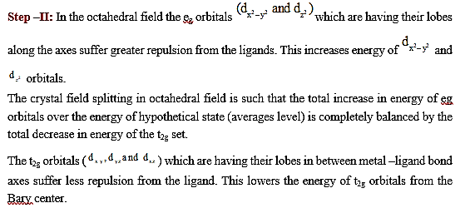

Slide 30
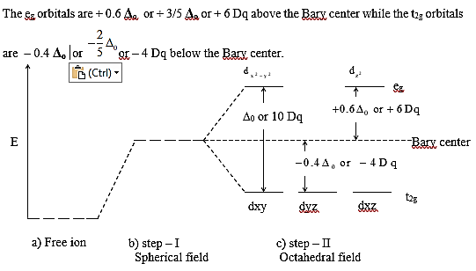

Slide 31
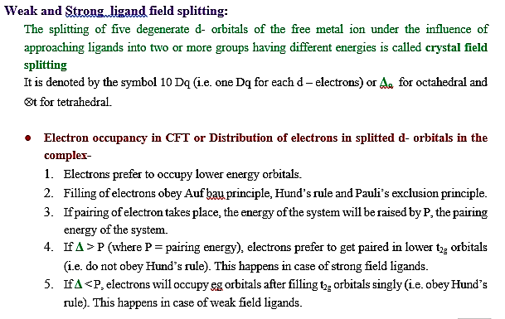
Weak and strong ligand field splitting

Slide 32
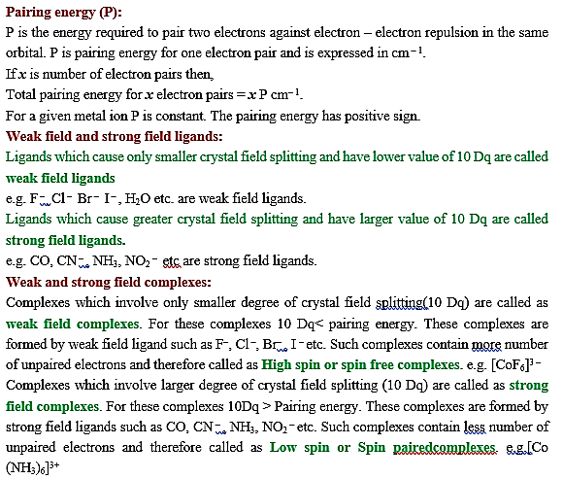

Slide 33
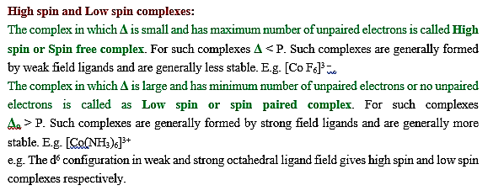

Slide 34
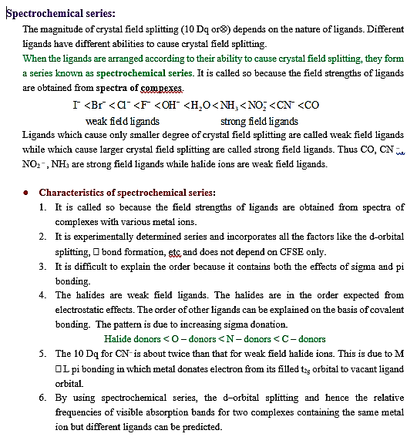
Spectrochemical series

Slide 35
Spectrochemical series

Slide 36

Thank

