Slide 1


Name: Dr. Jadhav Vilas Bhaskar
Designation: Associate Professor
Department: Chemistry
Jai Hind Educational Trust’s
Zulal Bhilajirao Patil College, Dhule

Slide 2
Core II
Inorganic Chemistry (CH – 502)
Credits : 3
Hours per week: 3
Teaching Hours : 45
Marks: 60

Slide 3
UNIT 4 : Modern Theories of Coordination Compound Part –C (L-09, M-12)
Definition of C.F.S.E.,
Calculation of C.F.S.E. in weak and strong field octahedral complexes,
Evidences of C.F.S.E., Factor’s affecting 10 Dq,
CFT and magnetic properties, spin only magnetic moment equation,
Electron occupancy in CFT,
Application of CFT to tetrahedral and Calculation of C.F.S.E. in tetrahedral complexes,
Tetragonal distortions from octahedral geometry,
Jahn-Teller theorem,
Application of CFT to square planer complexes,
Problems related to calculation of spin only magnetic moment for square planer, tetrahedral and octahedral complexes (for high spin and low spin complexes).
Ref. - 1: Ref. - 1: 766-772.
Principle of Inorganic Chemistry, B. R. Puri, L. R. Sharma, K. C. Kalia, Milestone Publisher and distributor.
Ref. - 2: Relevant Pages.
Concise Inorganic Chemistry, 5th Edition, J. D. Lee.

Slide 4
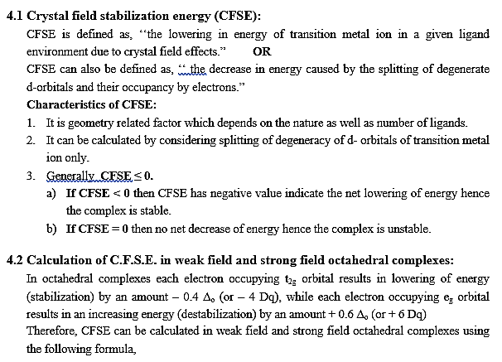

Slide 5
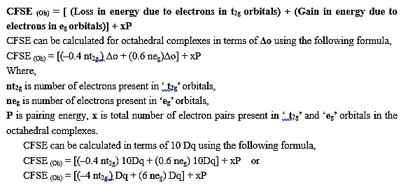

Slide 6
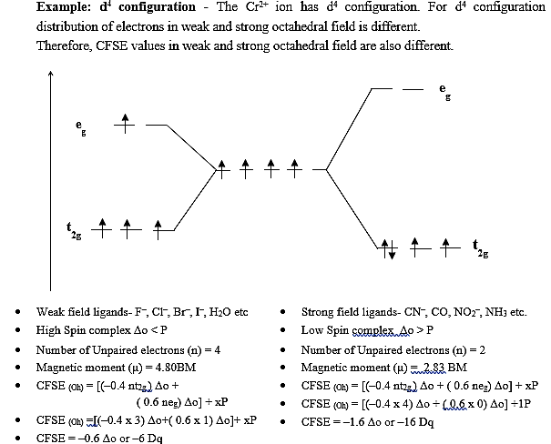

Slide 7
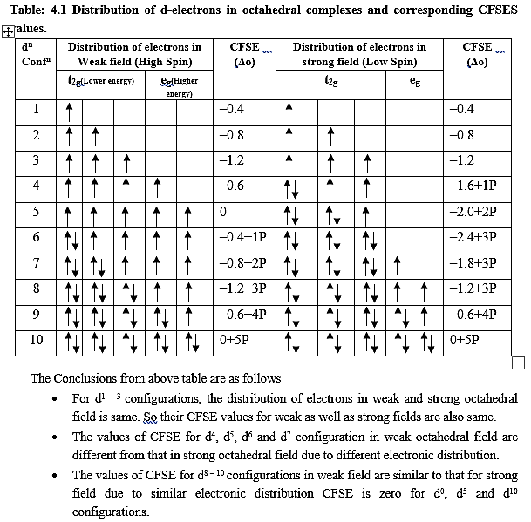

Slide 8
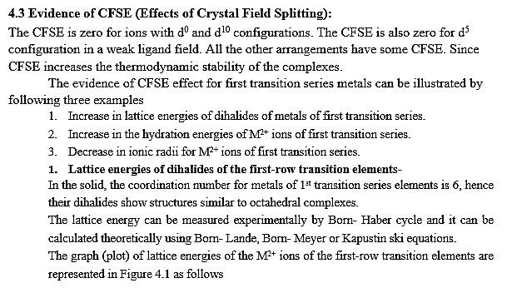

Slide 9
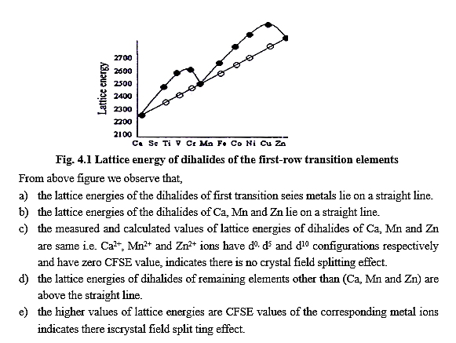

Slide 10
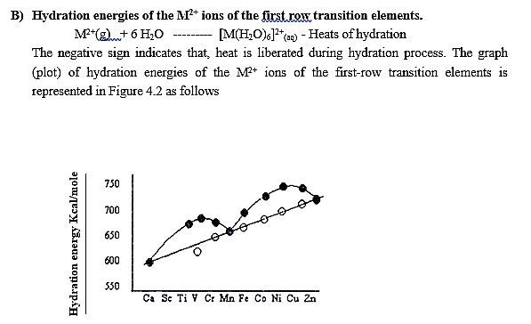

Slide 11
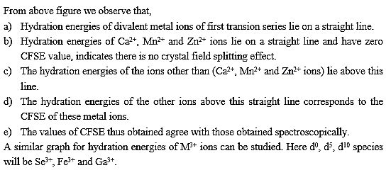

Slide 12
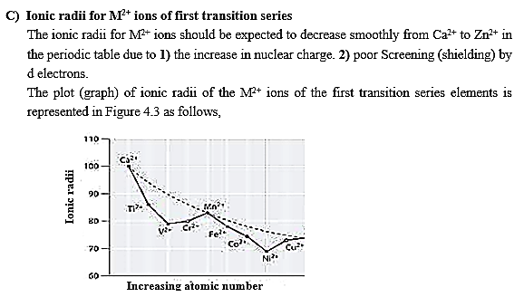

Slide 13
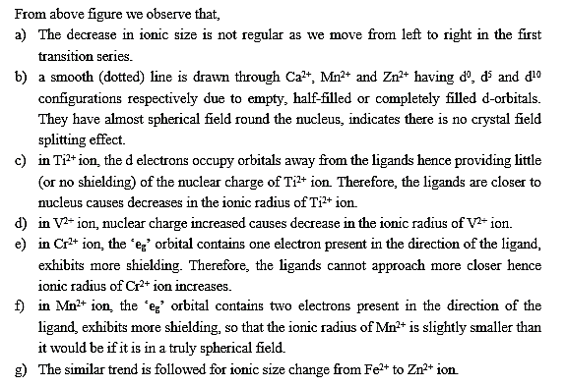

Slide 14
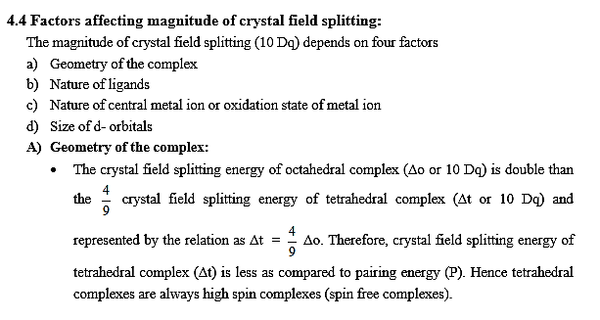

Slide 15
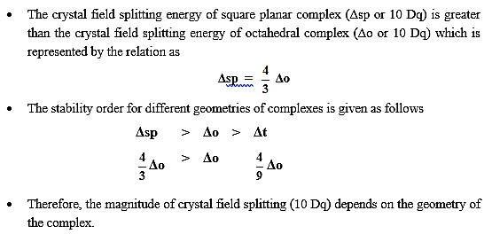

Slide 16
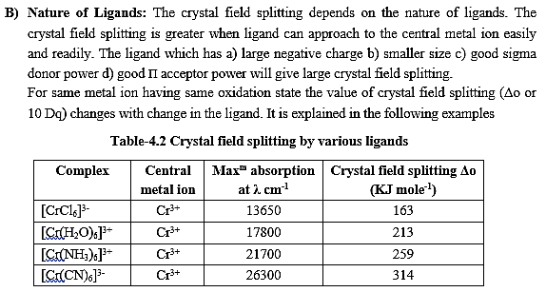

Slide 17
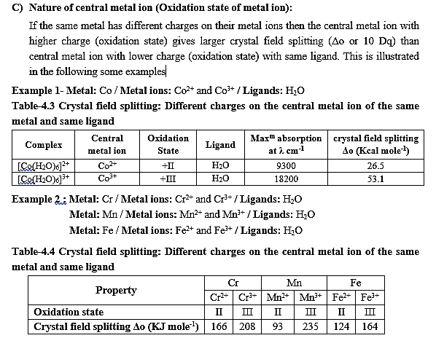

Slide 18
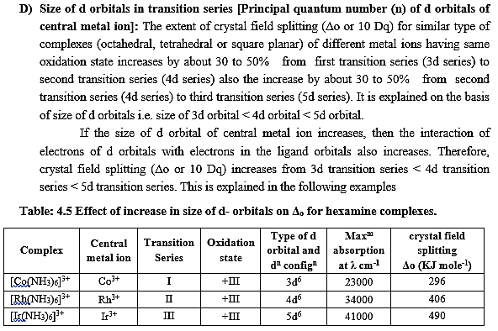

Slide 19
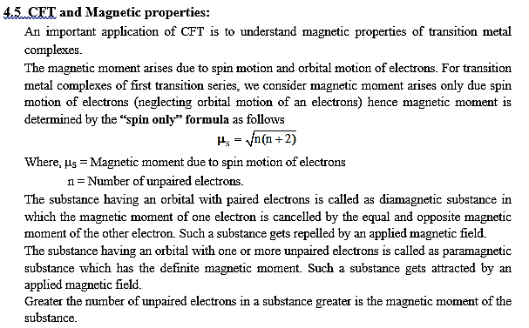

Slide 20
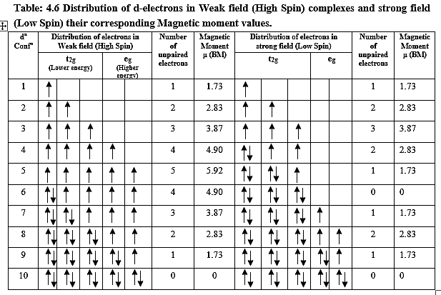

Slide 21
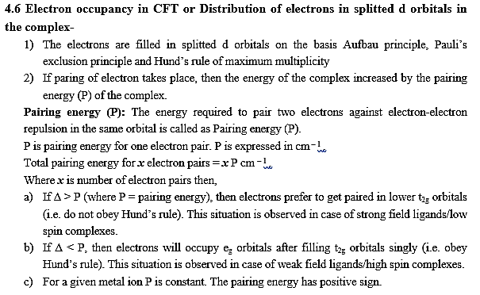

Slide 22
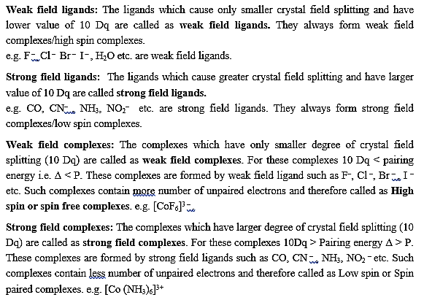

Slide 23
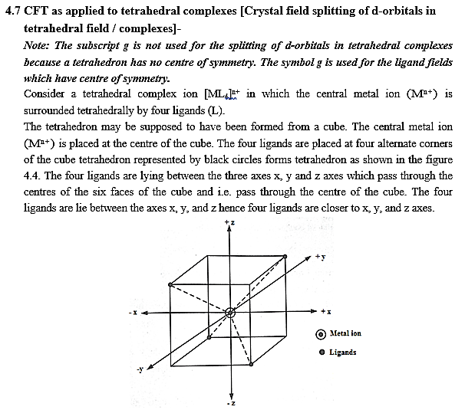

Slide 24
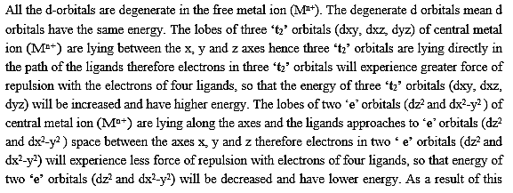


Slide 25
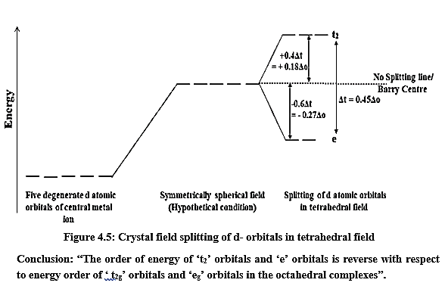

Slide 26
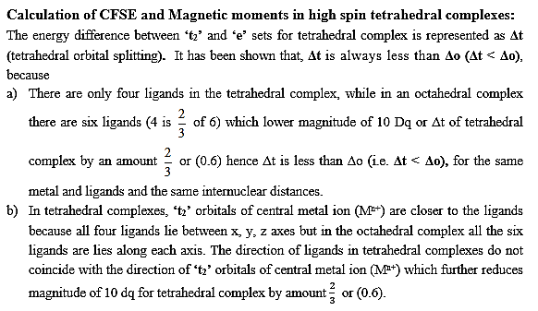

Slide 27
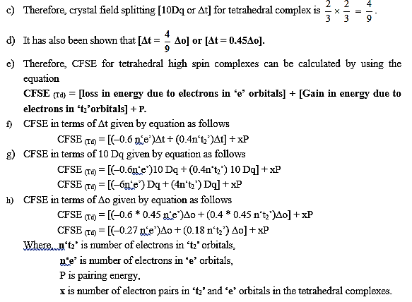

Slide 28
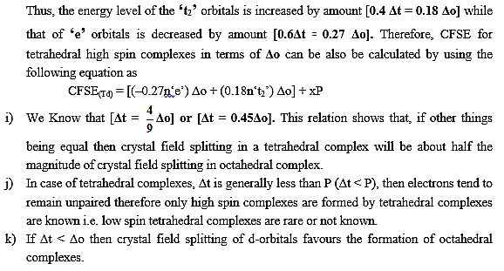

Slide 29
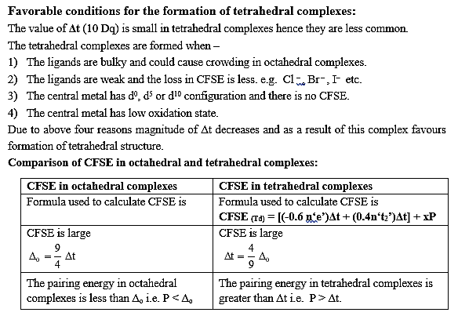

Slide 30
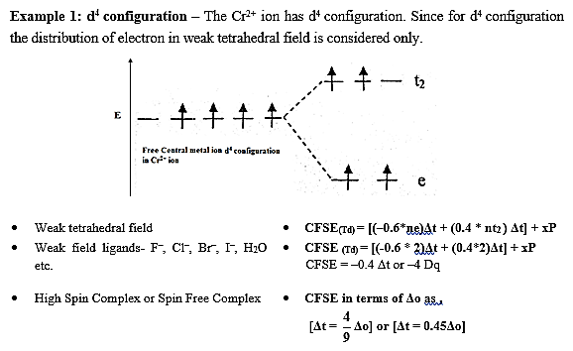
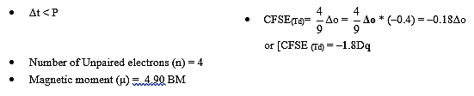

Slide 31
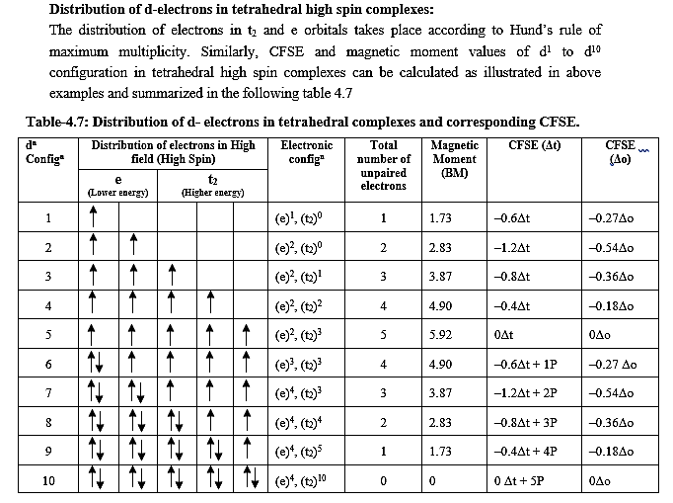

Slide 32
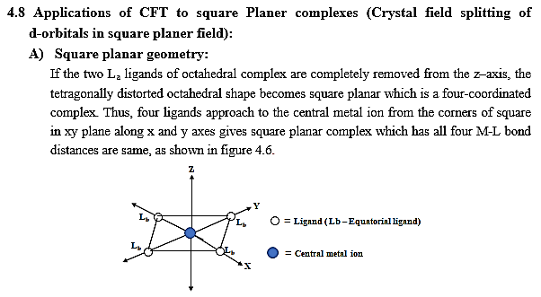

Slide 33
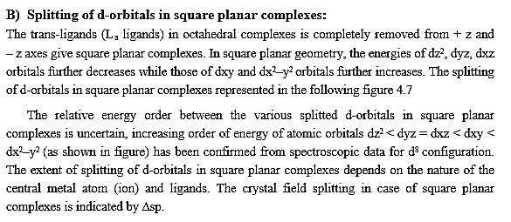
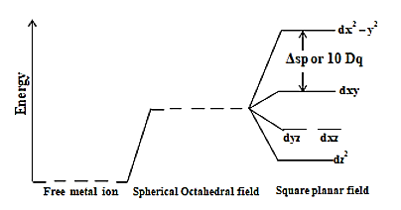

Slide 34
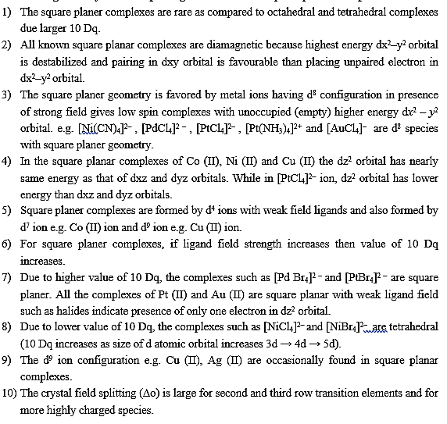

Slide 35
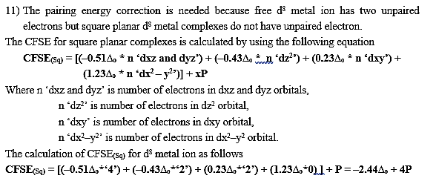
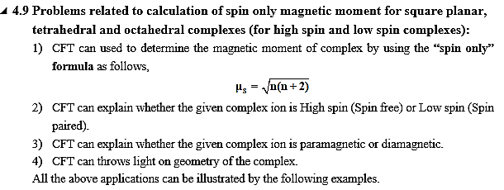

Slide 36
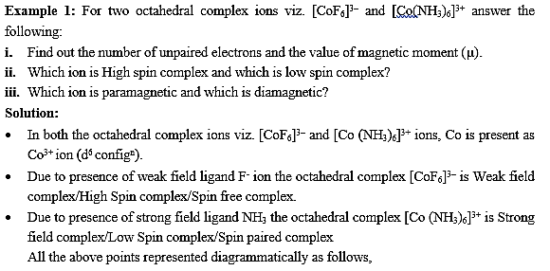
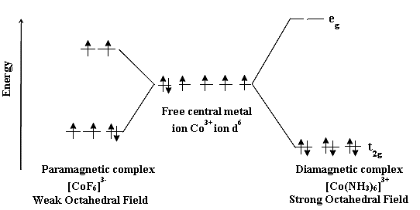

Slide 37
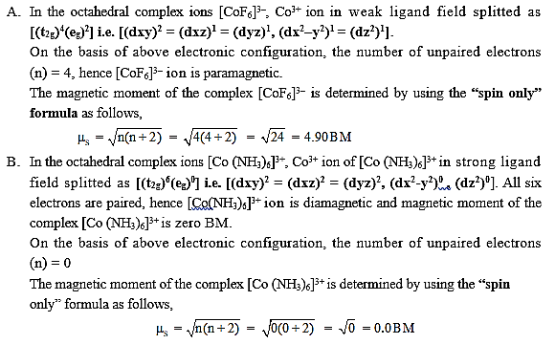

Slide 38
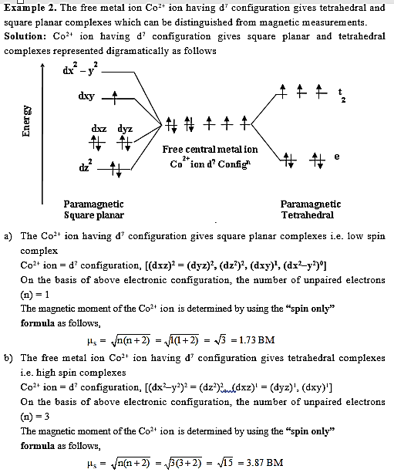

Slide 39
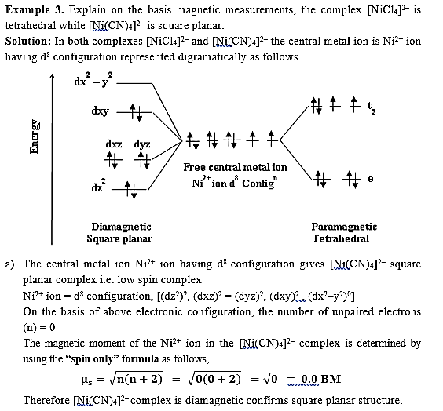

Slide 40
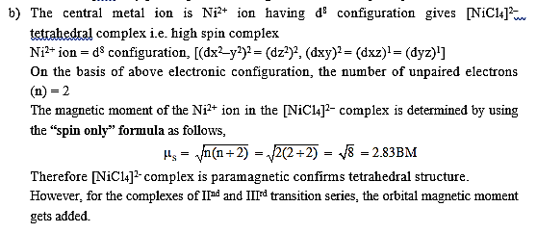

Slide 41

Thank

