Slide 1


Name: Dr. Jadhav Vilas Bhaskar
Designation: Associate Professor
Department: Chemistry
Jai Hind Educational Trust’s
Zulal Bhilajirao Patil College, Dhule

Slide 2
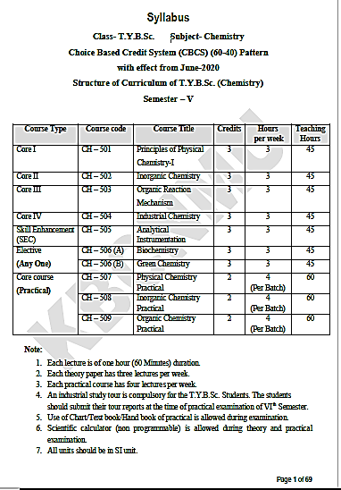

Slide 3
Core II
Inorganic Chemistry (CH – 502)
Credits : 3
Hours per week: 3
Teaching Hours : 45
Marks: 60

Slide 4
Unit-1: Structure and Reactivity of Molecules
(L-09, M-12)
Valence Shell Electron Pair Repulsion Theory (VSEPR),
Shapes of simple molecules and ions containing lone and bond pairs of electrons multiple bonding,
Prediction of shapes of irregular molecules and ions like - Sulphur tetra fluoride, Bromine trifluoride, Dichloroiodate (I) anion, Penta fluoro telluurate (IV) anion, Tetrachloroiodate (III) anion, Nitrogen dioxide, Phosphorus trihalides, Carbonyl fluoride,
Summary of VSEPR rules
Drawbacks of VSEPR theory.
Ref. - 1: 206-207.
Principle of Inorganic Chemistry, B. R. Puri, L. R. Sharma, K. C. Kalia, Milestone Publisher and distributor.
Ref. - 2: Relevant Pages.
Concise Inorganic Chemistry, 5th Edition, J. D. Lee.

Slide 5
Introduction
There are several different theories which explain the electronic structures and shapes of known molecules and attempt to predict the shape of molecules whose structures are so far unknown. Each theory has its own advantages and disadvantages. In many cases, all the theories give the correct and expected explanation.
Some important theories
Lewis Theory
Sidgwick-Powell Theory
Valence Shell Electron Pair Repulsion (VSEPR) Theory
Valence Bond Theory (VBT)

Slide 6
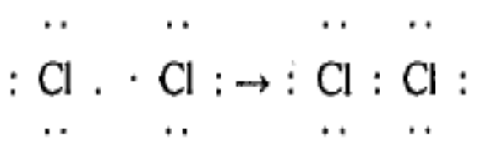
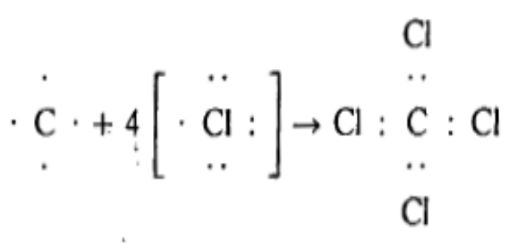

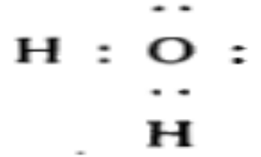
A) Lewis Theory
The Lewis theory was the first explanation of a covalent bond in terms of electrons that was generally accepted.
The Octet rule –
If two electrons are shared between two atoms then covalent bond is formed and binds the atoms together indicates formation of molecule.
For many light atoms (smaller atomic numbers) a stable arrangement is attained when the atom is surrounded by eight electrons.
This octet can be made up from some electrons which are 'totally owned' and some electrons which are 'shared'.
Cl₂ molecule
CCl₄ molecule
NH₃ molecule
H₂O molecule

Slide 7
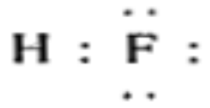
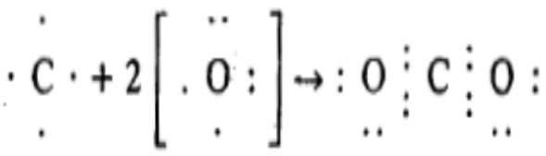
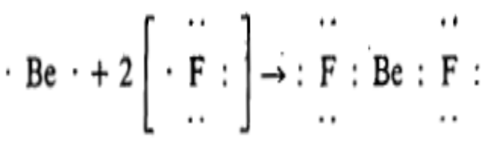
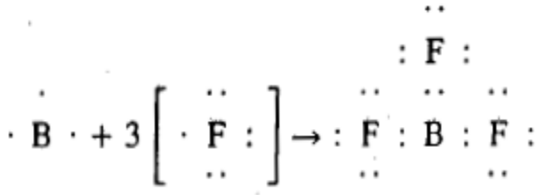
The Octet rule –
The atoms continue to form the bonds until they have attained octet of electrons. This is called the 'octet rule'. The octet rule explains the observed valencies in many molecules.
HF molecule
CO₂ molecule
Exceptions to the octet rule-
There are exceptions to the octet rule; for example
BeF₂ molecule
BF₃ molecule

Slide 8
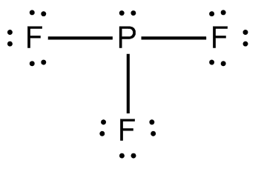
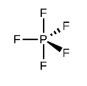
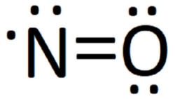

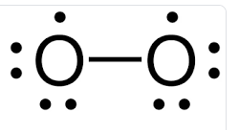
Exceptions to the octet rule-
Example: Phosphorous pentafluoride molecule PF₅ –
The octet rule is also not valid where atoms have an extra energy level which is close in energy of the p level and may accept electrons and be used for bonding. PF₃ obeys the octet rule, but PF₅ does not obeys octet rule. PF₅ has ten outer electrons (Phosphorus uses one 3s, three 3p and one 3d orbitals electrons while five Fluorine uses five unpaired electrons in 2p orbitals.
Any compound with more than four covalent bonds do not obeyed the octet rule, and these violations become increasingly common in the elements after the first two periods of eight elements in the periodic table.
PF₃ molecule
PF₅ molecule
Example for Odd number of electrons in some molecules-
The octet rule does not applicable in molecules which have an odd number of electrons, such as NO and ClO₂ also it does not explain why O₂ is paramagnetic and has two unpaired electrons.
NO molecule
ClO₂ molecule
Despite these exceptions, the octet rule is surprisingly reliable and explain the number of bonds formed in simple molecules.
But Octet rule do not gives information about the shape adopted by the molecule.
O₂ molecule

Slide 9
B) Sidgwick and Powell Theory
Sidgwick and Powell (1940) studied the structures of various molecules and suggested following assumption to predict structure, shape and bond angles for the molecules and ions
The molecules and ions contain only single bonds.
The approximate shape can be predicted from the number of electron pairs in the outer (valence) shell of the central atom.
The outer shell of central atom contains one or more bond pairs of electrons and may also contain unshared pairs of electrons (called as lone pairs).
The bond pairs and lone pairs were taken as equivalent.
Since all electron acquires some space and all electron pairs repel each other.
The repulsion is minimized if the electron pairs are orientated in space as far apart as from each other.

Slide 10
If there are two pairs of electrons in orbitals of the valence shell of the central atom then theses two pairs of electrons will be oriented at 180⁰ to each other. If these orbitals overlap with appropriate orbitals of other atoms to form bonds i.e. linear molecule will be formed.
If there are three electron pairs in the valence shell of the central atom then three electron pairs will be at 120⁰ to each other giving a planar triangular structure.
For four electron pairs the angle is 109⁰28’, and the shape of the molecule is tetrahedral.
For five electron pairs the angles are 120⁰ and 90⁰, and the shape of the molecule is a trigonal bipyramidal.
For six electron pairs the angles are 90° and the shape of the molecule is octahedral.

Slide 11
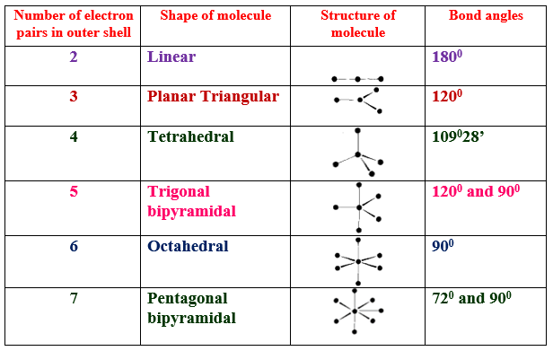
Molecular shapes predicted by Sidgwick-Powell theory given in the following Table

Slide 12
C) Valence Shell Electron Pair Repulsion (VSEPR) theory
Gillespie (1957) and Nyholm amended, improved and upgraded the Sidgwick-Powell theory to predict and explain the shapes, structures and bond angles of molecules and ions.
The theory was developed extensively by Gillespie as the Valence Shell Electron Pair Repulsion (VSEPR) theory.
This theory is based on repulsion of bond pair and lone pair electrons present in the valence shell of central atom of molecule or ion.

Slide 13
The main postulates are summarized as follows
The shape of the molecule is determined on the basis of repulsions between all of the electron pairs (bond pairs and lone pairs) present in the valence shell. (This is the same as the Sidgwick-Powell theory).
The lone pair of electrons occupied more space around the central atom than bonded pair of electrons.
The lone pair is attracted to one nucleus while the bond pair is shared by two nuclei. Therefore, repulsion between two lone pairs is greater than repulsion between a lone pair and a bond pair, which in turn is greater than the repulsion between two bond pairs. So that the presence of lone pairs on the central atom causes slight distortion in the bond angles with respect to ideal shape.

Slide 14

If the angle between a lone pair, the central atom and a bond pair is increased then actual bond angles between the atoms must be decreased.
The increasing order of repulsion between electron pairs is given as follows
(Bond pair – Bond pair) < (Lone pair – Bond pair) < (Lone pair – Lone pair)
or
(Lone pair – Lone pair) > (Lone pair – Bond pair) > (Bond pair – Bond pair)
Total number of electron pairs around the central atom in valence shell is determined by using following relation
The magnitude of repulsions between bonding pairs of electrons of ABn molecule depends on the electronegativity difference between the central atom (A) and the other atoms (B).

Slide 15
Double bonds cause more repulsion than single bonds, and triple bonds cause more repulsion than a double bond. The order of repulsion is given as follows
Triple bonds > Double bonds > Single bonds and
Triple bond - Single bond > Double bond - Single bond > Single bond - Single bond
The repelling power of electrons in the molecule is given as in following order
Lone pair > Multiple bonds > Bond pair > Single electron
The geometry of the molecule or ion depend on sum of bonding electron pairs (σ-bps) and non-bonding electron pairs or lone pairs (lps) in the central atom. These σ-bps and lps arranges around central atom in such a way that molecule has minimum energy (minimum repulsion) and maximum stability.

Slide 16
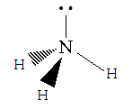
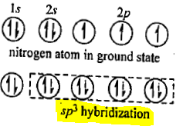
Shapes of simple molecules and ions containing lone and bond pairs of electrons
Geometry of molecules containing one lone pair electrons- e.g. Ammonia molecule
In NH₃ molecule, Nitrogen atom (Z=7) has electron configuration 1s², 2s², 2p³ hence four electron pairs are present in the outer valence shell of the Nitrogen atom i.e. three bond pairs and one lone pair (Nitrogen atom is sp³ hybridized).
Due to presence of one lone pair, the bond angle H-N-H is reduced from the theoretical (ideal) tetrahedral angle of 109⁰28’ to 107⁰48’.
Therefore, in NH₃ molecule, three bond pairs and one lone pair causes repulsion of (Lone pair – Bond pair) > (Bond pair – Bond pair) hence gives distorted tetrahedral structure (trigonal pyramidal structure)

Slide 17

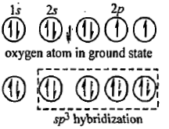
Shapes of simple molecules and ions containing lone and bond pairs of electrons
2) Geometry of molecules containing two lone pair electrons- e.g. Water molecule
In H₂O molecule, Oxygen atom (Z=8) has electron configuration 1s², 2s², 2p⁴ hence four electron pairs are present in the outer valence shell of the Oxygen atom i.e. two bond pairs and two lone pairs. (Oxygen atom is SP³ hybridized).
Due to presence of two lone pairs, the bond angle
H-O-H is reduced from the theoretical (ideal)
tetrahedral angle of 109⁰28’ to 104⁰27’.
Therefore, H₂O molecule has distorted tetrahedral structure called as bend or V shaped structure.
So that in H₂O molecule, two bond pairs and two lone pair causes (Lone pair – Bond pair) > (Lone pair – Bond pair) > (Bond pair – Bond pair) repulsion hence gives distorted tetrahedral structure (bend/V shaped structure)

Slide 18
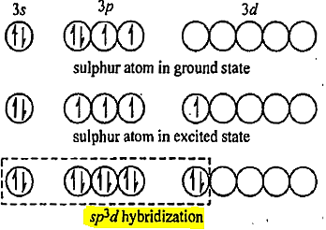
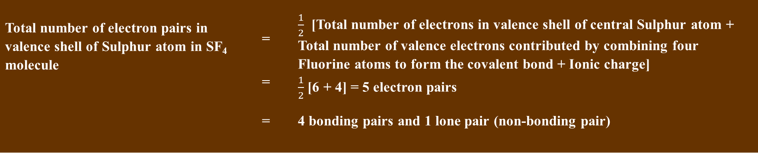
Prediction of Shapes of irregular molecules and ions
Geometry of molecules containing one lone pair electrons: e.g. SF₄ molecule
A) SF₄ molecule
In SF₄ molecule,
Sulphur atom (Z=16) electron configuration [Ne] 3s², 3p⁴ .
Sulphur atom has 6 valence electrons (sp³d hybridization)
Fluorine atom (Z=9) electron configuration 1s², 2s², 2p⁵
Each Fluorine atom has one unpaired valence electron in 2p atomic orbital.
Each Fluorine atom forms 4 sigma covalent bonds with central Sulphur atom.
Total number of electron pairs in valence shell of Sulphur atom in SF₄ molecule is determined by following relation
Total number of electron pairs in valence shell of Sulphur atom in SF₄ molecule | = | $\frac{1}{2}$ [Total number of electrons in valence shell of central Sulphur atom + Total number of valence electrons contributed by combining four Fluorine atoms to form the covalent bond + Ionic charge]
 | = | $\frac{1}{2}$ [6 + 4] = 5 electron pairs
 | = | 4 bonding pairs and 1 lone pair (non-bonding pair)

Slide 19
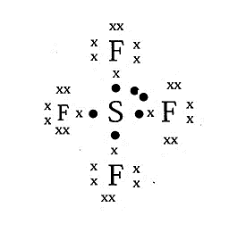
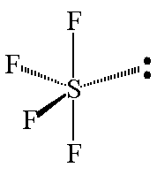
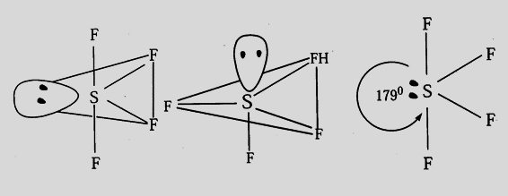
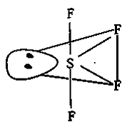
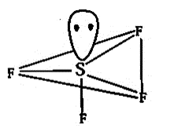
The lone pair at equatorial position is in contact with only two 90⁰ interactions i.e. with two axial bonding pairs cause minimum repulsion (Lone pair – Bond pair) and bond angle F-S-F reduced from 180⁰ to 179⁰ and equatorial F-S-F bond angle becomes 103⁰.
The equatorial position of the lone pair is suitable due to
a) The lone pair in the equatorial position is in contact with only two 90⁰ interactions (with the axial bonding pairs).
b) The lone pair in the axial position is in contact with the three 90⁰ interactions (with the equatorial bonding pairs).
The electron pairs at 90⁰ shows more repulsion to each other while electron pairs at 120⁰ shows minimum repulsion to each other. Hence in trigonal bipyramidal structure lone pair always occupy equatorial position and minimum repulsion (Lone pair – Bond pair) is observed. Therefore, SF₄ molecule shows distorted trigonal bipyramidal structure called as See-saw type structure.
=
=
Incorrect structure

Slide 20
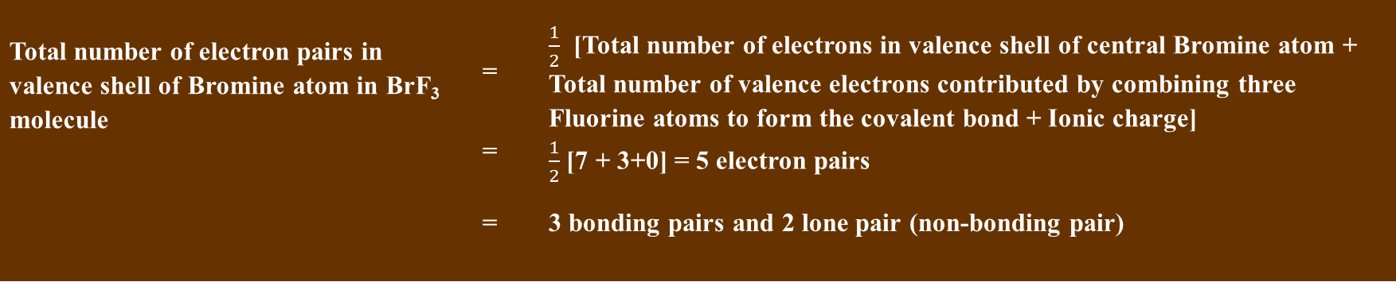
Prediction of Shapes of irregular molecules and ions
Geometry of molecules containing two lone pair electrons: e.g. SF₄ molecule
B) BrF₃ molecule
In BrF₃ molecule,
Bromine atom (Z=35) electron configuration [Ar] 3d¹⁰, 4s², 4p⁵ .
Bromine atom has 7 valence electrons (sp³d hybridization)
Fluorine atom (Z=9) electron configuration 1s², 2s², 2p⁵
Each Fluorine atom has one unpaired valence electron in 2p atomic orbital.
Each Fluorine atom forms 3 sigma covalent bonds with central Bromine atom.
Total number of electron pairs in valence shell of Bromine atom in BrF₃ molecule is determined by following relation
Total number of electron pairs in valence shell of Bromine atom in BrF₃ molecule | = | $\frac{1}{2}$ [Total number of electrons in valence shell of central Bromine atom + Total number of valence electrons contributed by combining three Fluorine atoms to form the covalent bond + Ionic charge]
 | = | $\frac{1}{2}$ [7 + 3+0] = 5 electron pairs
 | = | 3 bonding pairs and 2 lone pair (non-bonding pair)

Slide 21
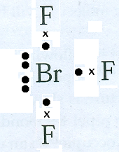
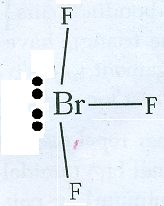
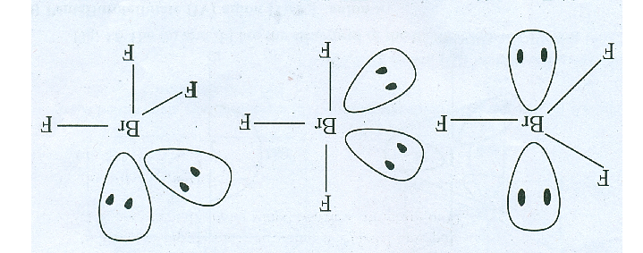
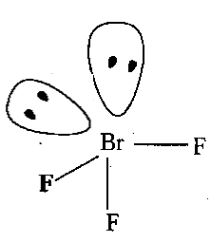
In trigonal bipyramidal structure lone pairs always occupy equatorial position and minimum repulsion (Lone pair – Bond pair) is observed.
The two lone pairs at equatorial position is in contact with two axial bonding pairs cause minimum repulsion (Lone pair – Bond pair) and equatorial bond angle F-Br-F reduced from 90⁰ to 86⁰ and axial bond angle F-Br-F slightly increased from 180⁰ to 181⁰. This structure is the most symmetrical, but has six 90⁰ repulsions between lone pairs and Fluorine atoms.
The lone pairs repel each other and distort the structure which causes the axial fluorine atoms to bent away from a linear (straight) arrangement. Therefore, BrF₃ molecule shows distorted trigonal bipyramidal structure called as T shaped structure.
=
Two lone pair at equatorial position
Incorrect structure
One lone pair at equatorial position and one lone pair at axial position
Two lone pair at axial position

Slide 22
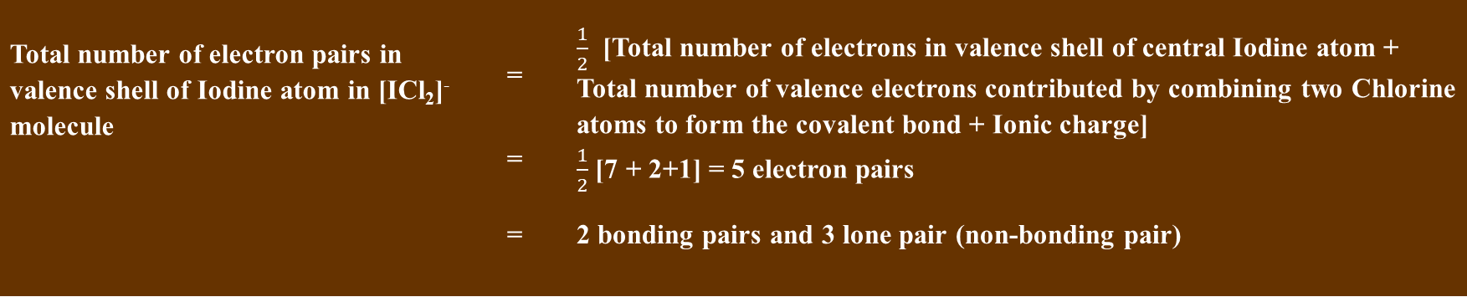
Prediction of Shapes of irregular molecules and ions
Geometry of molecule ion containing three lone pair electrons: e.g. SF₄ molecule
C) Dichloroiodate (I) anion [ICl₂]⁻
In Dichloroiodate (I) anion ,
Iodine atom (Z=53) electron configuration [Kr] 4d¹⁰, 5s², 5p⁵ . Iodine atom has 7 valence electrons (sp³d hybridization)
Chlorine atom (Z=17) electron configuration [Ne] 3s², 3p⁵
Each Chlorine atom has one unpaired valence electron in 3p atomic orbital.
Each Chlorine atom forms 2 sigma covalent bonds with central Iodine atom.
Total number of electron pairs in valence shell of Iodine atom in [ICl₂]⁻ ion is determined by following relation
Total number of electron pairs in valence shell of Iodine atom in [ICl₂]⁻ molecule | = | $\frac{1}{2}$ [Total number of electrons in valence shell of central Iodine atom + Total number of valence electrons contributed by combining two Chlorine atoms to form the covalent bond + Ionic charge]
 | = | $\frac{1}{2}$ [7 + 2+1] = 5 electron pairs
 | = | 2 bonding pairs and 3 lone pair (non-bonding pair)

Slide 23


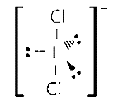
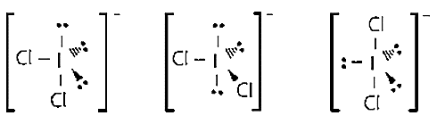
These five electron pairs can be arranged around central Iodine atom as away from each other as possible for minimum repulsion between them in [ICl₂]⁻ anion.
The approximate/predicted geometry of ICl₂⁻ anion will be trigonal bipyramidal due to 5 electron pairs.
In trigonal bipyramidal structure lone pairs always occupy equatorial position and minimum repulsion (Lone pair – Bond pair) is observed.
The Three lone pairs at equatorial position is in contact with two axial bonding pairs cause minimum (Lone pair – Bond pair) repulsion.
One Iodine atom at centre and two Chlorine atoms occupy axial position i.e. all three atoms observed in straight line so that bond angle Cl-I-Cl is 180⁰. Therefore [ICl₂]⁻ anion shows linear structure.
Three lone pair at equatorial position
Incorrect structure
Two lone pairs at equatorial position and one lone pair at axial position
Two lone pair at axial position and one lone pair at equatorial position

Slide 24

Prediction of Shapes of irregular molecules and ions
Geometry of molecule ion containing two lone pair electrons: e.g. SF₄ molecule
D) Tetrachloroiodate (III) anion [ICl₄]⁻
In Tetrachloroiodate (I) anion ,
Iodine atom (Z=53) electron configuration [Kr] 4d¹⁰, 5s², 5p⁵ . Iodine atom has 7 valence electrons (sp³d² hybridization)
Chlorine atom (Z=17) electron configuration [Ne] 3s², 3p⁵
Each Chlorine atom has one unpaired valence electron in 3p atomic orbital.
Each Chlorine atom forms 4 sigma covalent bonds with central Iodine atom.
Total number of electron pairs in valence shell of Iodine atom in [ICl₄]⁻ ion is determined by following relation
Total number of electron pairs in valence shell of Iodine atom in [ICl₄]⁻ molecule | = | $\frac{1}{2}$ [Total number of electrons in valence shell of central Iodine atom + Total number of valence electrons contributed by combining four Chlorine atoms to form the covalent bond + Ionic charge]
 | = | $\frac{1}{2}$ [7 + 4+1] = 6 electron pairs
 | = | 4 bonding pairs and 2 lone pair (non-bonding pair)

Slide 25
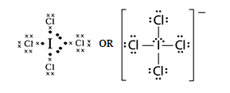
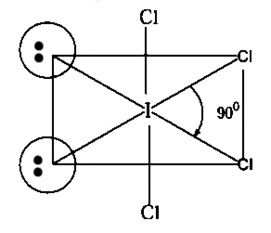
These six electron pairs can be arranged around central Iodine atom as away from each other as possible for minimum repulsion between them in [ICl₄]⁻ anion.
The approximate/predicted geometry of [ICl₄]⁻ anion will be Octahedral due to 6 electron pairs.
In a regular (undistorted) octahedral structure all six positions are equivalent/similar.
The two lone pairs compete with each other to expand in the space at cis position. Since lone pairs are attracted only by nucleus of central atom Iodine.
Two Chlorine atoms are at corners of square plane and remaining two Chlorine atoms are at trans position of square plane.
The bond angle Cl-I-Cl is 90⁰.
Incorrect structure
Two lone pair at equatorial position

Slide 26
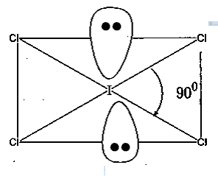
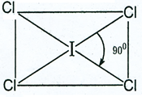
In a regular (undistorted) octahedral structure all six positions are equivalent/similar.
This is correct structure because
The two lone pairs can not compete with each other hence two lone pairs can expand more in the space at trans position. Since lone pairs are attracted only by nucleus of central atom Iodine.
Four Chlorine atoms are at corners of square plane.
The bond angle Cl-I-Cl is 90⁰.
Hence in octahedral structure lone pairs always occupy trans position and minimum (Lone pair – Bond pair) repulsion is observed. Therefore, ICl₄⁻ molecule shows square planar structure.
Correct structure
Two lone pair at axial position
Two lone pair at axial position

Slide 27
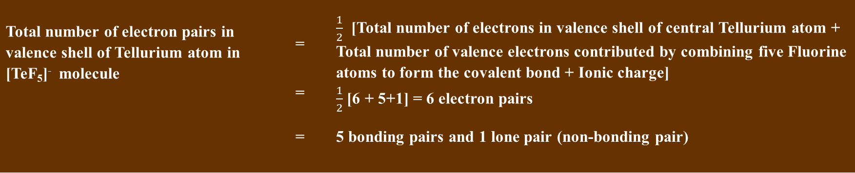
Prediction of Shapes of irregular molecules and ions
Geometry of molecule ion containing one lone pair electrons: e.g. SF₄ molecule
E) Penta flurotellurate (IV) anion [TeF₅]⁻
In Penta flurotellurate (IV) ,
Tellurium atom (Z=52) electron configuration [Kr] 4d¹⁰, 5s², 5p⁴. Tellurium atom has 6 valence electrons (sp³d² hybridization)
Fluorine atom (Z=9) electron configuration 1s², 2s², 2p⁵
Each Fluorine atom has one unpaired valence electron in 2p atomic orbital.
Each Fluorine atom forms 5 sigma covalent bonds with central Iodine atom.
Total number of electron pairs in valence shell of Tellurium atom in [TeF₅]⁻ ion is determined by following relation
Total number of electron pairs in valence shell of Tellurium atom in [TeF₅]⁻ molecule | = | $\frac{1}{2}$ [Total number of electrons in valence shell of central Tellurium atom + Total number of valence electrons contributed by combining five Fluorine atoms to form the covalent bond + Ionic charge]
 | = | $\frac{1}{2}$ [6 + 5+1] = 6 electron pairs
 | = | 5 bonding pairs and 1 lone pair (non-bonding pair)

Slide 28
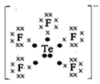
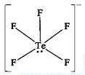
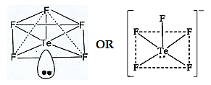
Electron dot structure
Electron dot structure
These six electron pairs can be arranged around central Tellurium atom as away from each other as possible for minimum repulsion between them in [TeF₅]⁻ anion.
The approximate/predicted geometry of [TeF₅]⁻ anion will be Octahedral due to 6 electron pairs.
The repulsion from the single lone pair causes the adjacent fluorine atoms to move upward. This produces a square pyramid with the Tellurium atom below the plane of the four fluorine atoms.
The one lone pair (non-bonding pairs) occupy at axial position of square of octahedral geometry.

Slide 29
The four bond pairs occupy at equatorial position and one bond pair occupy at axial position of octahedral geometry
The one lone pairs at axial position influence four bonding pairs at corners of square and one axial bonding pair cause minimum (Lone pair – Bond pair) repulsion.
Therefore, the bond angle F-Te-F is 79⁰
Hence [TeF₅]⁻ anion has square pyramidal structure.

Slide 30
Prediction of Shapes of irregular molecules and ions
Geometry of molecule ion containing one lone pair electrons: e.g. SF₄ molecule
F) Nitrite (III) anion [NO₂]⁻
In Nitrite ion [NO₂]⁻,
Nitrogen atom (Z=7) electron configuration 1s², 2s², 2p³. Nitrogen atom has 5 valence electrons (sp² hybridization)
Oxygen atom (Z=8) electron configuration 1s², 2s², 2p⁴. Oxygen atom has 6 valence electrons Thus Two Oxygen atom has 12 valence electrons.
One negative charge on molecule anion [NO₂]⁻.
Total number of valence electrons in Nitrogen atom in [NO₂]⁻ ion is determined by following relation
Total number of valence electrons in [NO₂]⁻ molecule ion | = | [Total number of valence electrons in central Nitrogen atom + Total number of valence electrons contributed by combining Two Oxygen atoms + Ionic charge]
 | = | [5 + 12+1] = 18 electron

Slide 31
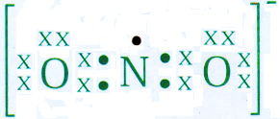

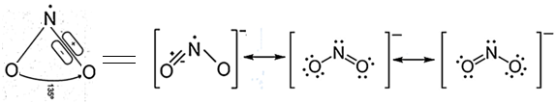
Each Oxygen atom has two unpaired electrons in 2p atomic orbital hence one unpaired valence electron in 2p atomic orbital of each Oxygen atom forms 2 sigma covalent bonds with central Nitrogen atom.
The Second unpaired electron in 2p atomic orbital of each Oxygen atom forms one pi covalent bonds with central Nitrogen atom.
Electron dot structure
Dash structure
On the basis of planar triangular structure in [NO₂]⁻ ion,
Nitrogen atom is at the centre, two corners occupied by two Oxygen atoms and the third corner occupied by a single electron in a triangle.
[NO₂]⁻ ion contain 18 electrons in the valence shell.
The Nitrogen atom forms two sigma bonds to with each Oxygen atom. Thus four electrons are used to form two sigma bonds. The Nitrogen atom has a lone pair (2s²).
The Oxygen atoms has the 4 lone pairs i.e. eight electrons.
Therefore, out of 18 valence electrons total of 14 electrons has been counted hence 4 electrons remaining which are used for pi bond formation.

Slide 32
The [NO₂]⁻ ion has V shaped structure.
It is a free radical i.e. it contains an unpaired electron.
It may be considered a nitrite ion from which one electron has been removed from the least electronegative nitrogen atom.
The species [NO₂]⁻ show the effect of steric repulsions of bonding and non-bonding
electrons.
Instead of having a lone pair on the nitrogen it has a single electron in a trigonal orbital. This single electron is expected to show less repulsion than lone pair (two electrons) therefore the bond angle O-N-O of 120⁰ between bonding pairs will increase to 134⁰ in order to decrease the repulsion between them.

Slide 33
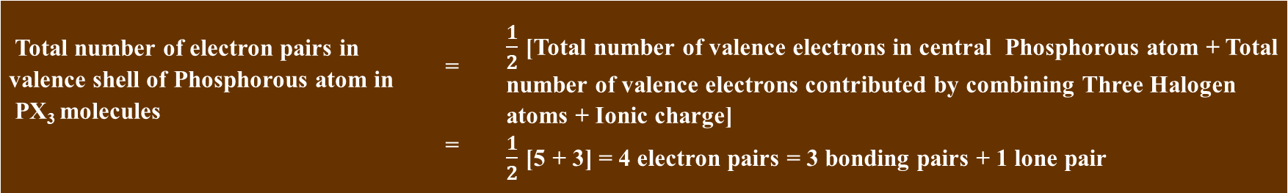
Prediction of Shapes of molecules
Geometry of molecule containing one lone pair electron: e.g. SF₄ molecule
G) Phosphorous trihalides PX₃ (PF₃ , PCl₃ , PBr₃ , PI₃ )
In PX₃ molecules,
Phosphorous atom (Z=) electron configuration 1s², 2s², 2p³ , 3s², 3p³. Phosphorous atom has 5 valence electrons (sp³ hybridization)
The atomic number of Fluorine Z= 9 , Chlorine Z= 17, Bromine Z= 35, Iodine Z= 53 and the general electronic configuration of halogens is [ ] ns2, np5. Each halogen atom has one unpaired valence electron in np atomic orbital hence each halogen atom forms 3 sigma covalent bonds with central Phosphorous atom.
Total number of electron pairs in valence shell of Phosphorus atom in PX₃ molecules is determined by following relation
Total number of electron pairs in valence shell of Phosphorous atom in PX₃ molecules | = | $\frac{1}{2}$ [Total number of valence electrons in central Phosphorous atom + Total number of valence electrons contributed by combining Three Halogen atoms + Ionic charge]
 | = | $\frac{1}{2}$ [5 + 3] = 4 electron pairs = 3 bonding pairs + 1 lone pair

Slide 34
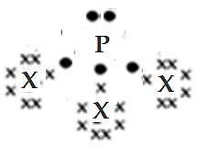
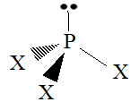
These four electron pairs can be arranged around central Phosphorus atom as away from each other as possible for minimum repulsion between them in PX₃ molecules.
The approximate geometry of PX₃ molecules will be tetrahedral due to 4 electron pairs.
In PX₃ molecules, four electron pairs are present in the outer valence shell of the Phosphorus atom i.e. three bond pairs and one lone pair. Due to presence of one lone pair, the bond angle X-P-X is reduced from the theoretical (ideal) tetrahedral angle of 109⁰28’ for PX₃ molecules due to electronegativity effect of halogens as follows
Electron dot structure
Dash structure
Molecule | PF₃ | PCl₃ | PBr₃ | PI₃
Bond angle | 97.7⁰ | 100.3⁰ | 101.0⁰ | 102.0⁰
Therefore, PX₃ molecule has distorted tetrahedral structure called as trigonal pyramidal structure because three bond pairs and one lone pair causes repulsion of (Lone pair – Bond pair) > (Bond pair – Bond pair)

Slide 35
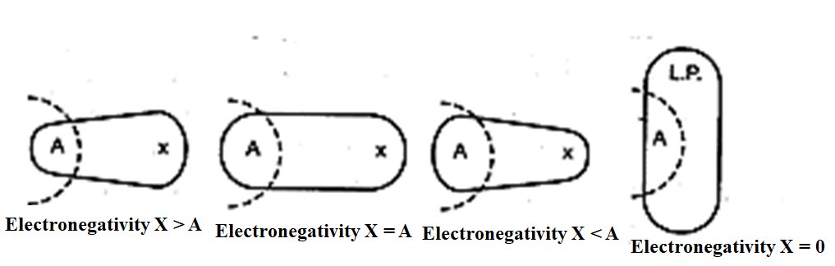
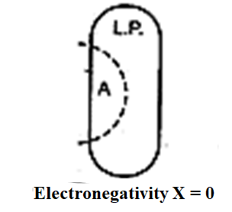
The importance of electron repulsion near the nucleus of the central atom is nicely shown by the bond angles in phosphorus trihalides molecules.
The X-P-X bond angle increases with the decrease in the electronegativity of the halogen X.
There is a effect of the decreasing electronegativity X on the size of a bonding pair of electrons.
The important factor is the iconicity (similarity between phosphorus and halides) of the P-X bond.
The more electronegative fluorine atom attracts the bonding electron pairs away from the phosphorus nucleus and this allows the lone pair to expand during which F-P-F angle decreases (Closes). The decrease in the bond angle is observed in non- metal fluorides.
The effect of decreasing electronegativity of halogen (X) atom on the size of bonding pair of electrons represented diagrammatically as follows
Electronegativity X > A
Electronegativity X = A
Electronegativity X < A
X = lone pair of electrons, and effective electronegativity of X = 0
Effect of decreasing electronegativity of halogen (X) atom on the size of bonding pair of electrons

Slide 36
Prediction of Shapes of molecules
Geometry of molecule containing one lone pair electron: e.g. SF₄ molecule
H) Carbonyl Fluoride or Fluorophosgene (COF₂)
In COF₂ molecules,
Carbon atom (Z=6) electron configuration 1s², 2s², 2p². Carbon atom has 4 valence electrons (sp²).
Oxygen atom (Z=8) electron configuration 1s², 2s², 2p⁴. The Oxygen atom has two unpaired electrons in 2p atomic orbital so that one unpaired valence electron in 2p atomic orbital forms one sigma covalent bonds with central atom. Second unpaired electrons in 2p atomic orbital of each Oxygen atom forms one pi covalent bonds with central Carbon atom.
Fluorine atom (Z=9) electron configuration 1s², 2s², 2p⁵. Each Fluorine atom has one unpaired electron in 2p atomic orbital so that each fluorine atom provides one unpaired valence electron in 2p atomic orbital forms 2 sigma covalent bonds with central Carbon atom.
Total number of valence electron in COF₂ molecule is determined by following relation
Total number of electron pairs in valence shell of Carbon atom in COF₂ molecule | = | [Total number of valence electrons in central Carbon atom + Total number of valence electrons contributed by combining One Oxygen atom + Total number of valence electrons contributed by combining Two Fluorine atoms+ Ionic charge]
 | = | [4 + 6 + 2(7)] = [4 + 6 + 14] = 24 valence electron

Slide 37
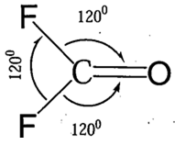
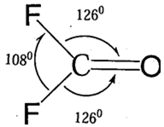
The fluorine and oxygen atoms are nearly of the same size and similar in electronegativity. Hence COF₂ have a symmetrical structure. There are no lone pairs of electrons on carbon atom. Hence the molecule is to be planar with approximately 120⁰ bond angle.
Since the COF₂ molecule is found to be planar but distorted slightly from a symmetrical trigonal arrangement.
The oxygen atom requires much more space than the fluorine atoms because
1) the oxygen atom is double bonded to the carbon and t the C = 0 bond length is less (120 pm) than the C – F (135 pm). Therefore, the Vander walls repulsions of the oxygen atom will be greater.
2) The double bond contains two pairs of electrons and it
may be considered as a sigma-pi pair or twin bent bond,
It is reasonable to assume that, sigma-pi pair electrons will require more space than a single bonding pair.
Therefore, the bond angle of 120⁰ F-C-F decreased to 108⁰ and the bond angle of 120⁰ F-C-O increased to 126⁰ due to electronegativity and size effects.

Slide 38
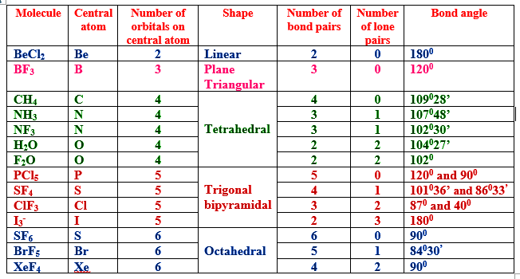

Slide 39
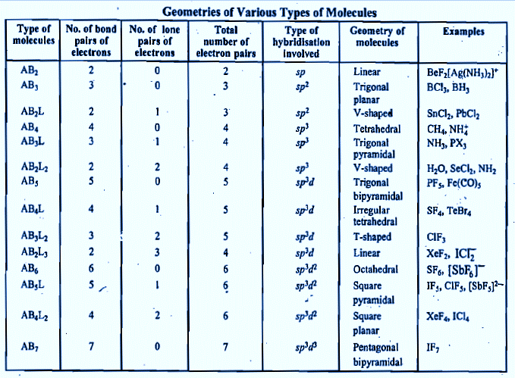

Slide 40
Summary of Valence Shell Electron Pair Repulsion (VSEPR) theory
VSEPR theory helps to predict the correct geometries of molecule on the basis of hybridisation of central atom and presence of lone pairs. The repulsion between lone pairs and bond pairs determine the geometry. According to VSEPR theory, the order of repulsion is L.P. - L.P. > L.P. - B.P. > B.P. - B.P. Thus, presence of lone pair causes decrease in bond angle than predicted.
Presence of electron pairs in a molecule determine the ideal geometries such as -
for two electron pairs, it is linear
for three electron pairs, it is trigonal
for four electron pairs, it is tetrahedral
for five electron pairs, it is trigonal bipyramidal
for six electron pairs, it is octahedral

Slide 41
The lone pairs take up more space around the central atom than bond pairs, since lone pair is associated with one nucleus while bond pair is shared between two nuclei.
Double bond occupies more space than single bond.
Bonding pairs to electronegative substituents occupy less space than those to more electropositive substituents.
If the central atom is in the third row or below in the periodic table, the lone pair will occupy a stereo-chemically inactive s atomic orbital and the bonding will be through p atomic orbitals and near 900 bond angles if the substituent electronegativity is ≤ 2.5
Since the VSEPR theory has been well accepted due to its high accuracy and correct predictions but the theoretical basis has some conflicts.

Slide 42
Thank

