Slide 1


Name: Dr. Jadhav Vilas Bhaskar
Designation: Associate Professor
Department: Chemistry
Jai Hind Educational Trust’s
Zulal Bhilajirao Patil College, Dhule

Slide 2
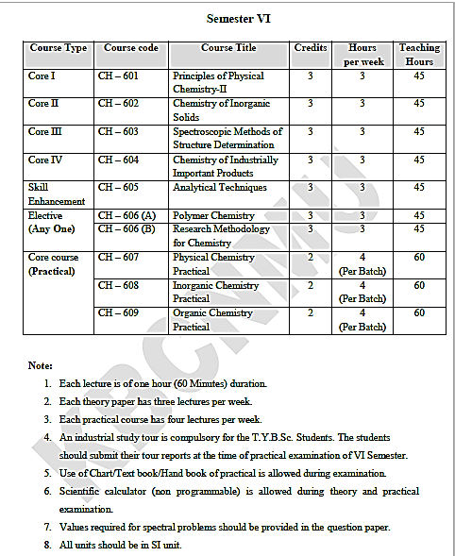

Slide 3
Core II
Inorganic Chemistry (CH – 602)
Credits : 3
Hours per week: 3
Teaching Hours : 45
Marks: 60

Slide 4
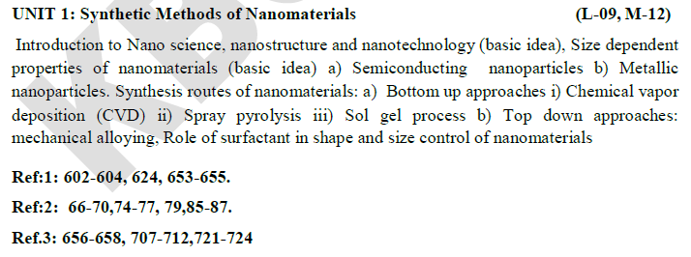

Slide 5
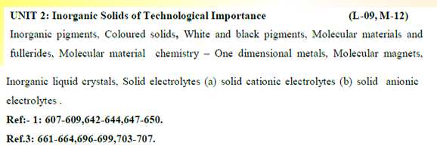

Slide 6
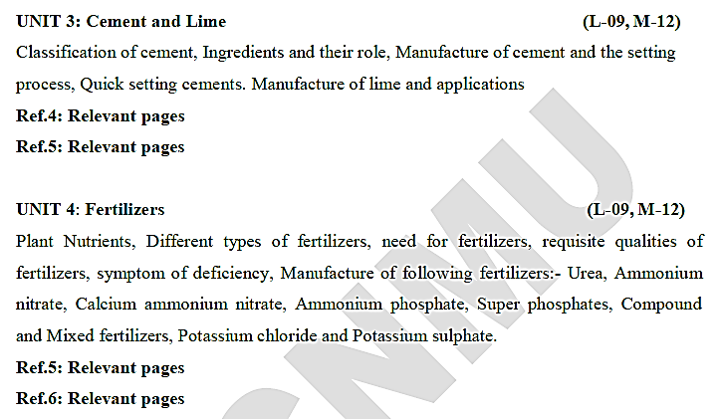

Slide 7
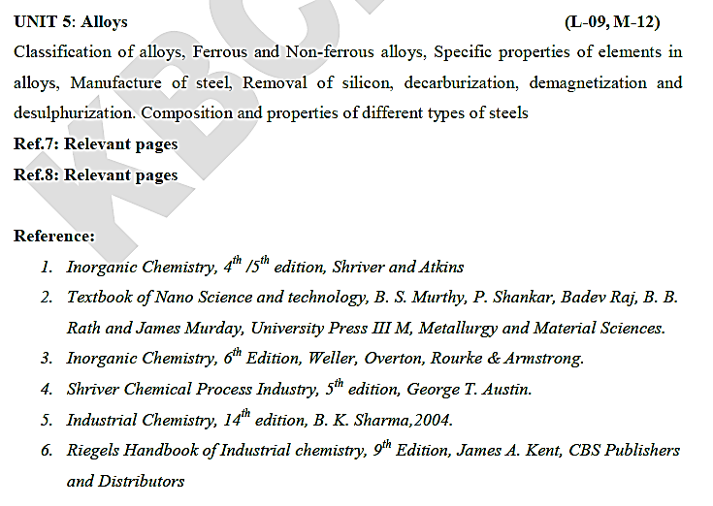
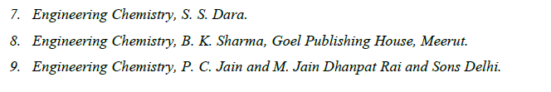

Slide 8
Synthesis Methods of Nanomaterials
Introduction
Nanoscience is to be introduced for thorough analysis and understanding of the properties of the matter that have length scales between 1 and 100 nm (Size).
Nanotechnology control the matter having dimension of 1-100 nanometre.
The properties such as optical, mechanical, electrical, thermal, chemical and magnetic properties make the nanomaterials quite different than the more sizable voluminous material.
These properties are responsible for the applications of Nano materials in the field of sensing technologies i.e. sensors
For example, Nano materials based biosensors provides information regarding the amalgamation of material science, molecular engineering, chemistry and biotechnology, can provide a robust (strong) sensitivity and specificity of biomolecule detection, hold the many fold capability of detecting or manipulating atoms and molecules, and have an exceptional potential in applications such as biomolecular perception, pathogenic diagnosis and environment monitoring.

Slide 9
  Size dependent properties of nanomaterials
    Semiconducting nanoparticles:
Quantum dots are essential tiny particle plays a vital role to provide scientific explanation of the different properties of semiconducting nanoparticles.
Quantum dots are well-known semiconducting materials and their sizes are found in the range of 2 to 7 nm.
While, the material whose size ranges from 8 to 100 nm is commonly called as nanoparticles.
Quantum dots are composed of thousands of atoms, and are investigated intensively for their optical properties.
These semiconducting nanoparticles are generally called quantum dots because quantum effects become important in these three dimensionally confined particles (dots).
Quantum dot have generally been explained through band theory in the science of electronics specially semiconductors, Since the conducting ability of semiconducting material is to be referred in terms of band gap, which is the energy difference between valance band (top) and conduction band (bottom).

Slide 10
Metals that are classified as semiconductor or semiconducting materials electronically have partially filled valence band separated from the empty conduction band by the region so called band gap.
Consider interacting molecular orbital are generally HOMO and LUMO. HOMO (Highest Occupied Molecular Orbital) of one molecule, while LUMO (Lowest Unoccupied Molecular Orbital) of another molecule.
HOMO and LUMO is the pair that lies close in energy of any pair of orbital’s in the two molecules, which allow them to interact very strongly.
These orbitals are also called as a Frontier Molecular Orbital’s, because they lie at the outermost boundaries of electrons of the molecules.

Slide 11
Metallic Nanoparticles:
The principal type of optical excitation that occurs is the collective oscillation (occur at the interface of a metal with a dielectric medium and are called as surface plasmone) of electrons in the valence band of the metal.
Surface Plasmons (SP) resonance is the most outstanding optical property of metallic nanostructures. It consists of a collective oscillation of conduction electrons excited by the electromagnetic field of light. SP resonance is in the origin of optical properties hardly achievable with other physical processes
The significant characteristics of Plasmon absorption depend strongly on the metal and dielectric surroundings as well as shape and size of the nanoparticles.
Nowadays, several metallic nanoparticles have been used for various applications in almost every domain of the modern day science. Such as gold and silver nanoparticles exhibit a broad spectrum of optical property hence used as a pigment in paint and coloring industries, they have also an exceptional medical applications.
Gold nanoparticles are common example of metallic nanoparticles and have found practical applications as a biological and chemical sensor, smart bombs for cancer therapy.

Slide 12
  Synthesis Routes
However, one of the most popular ways of classifying the synthesis route is based on how the nanostructures are built, and such an approach leads to two routes, namely the bottom-up and the top-down approaches.
Many of the bottom-up approaches have difficulties in scale up while top-down approaches can be easily scaled up.

Slide 13
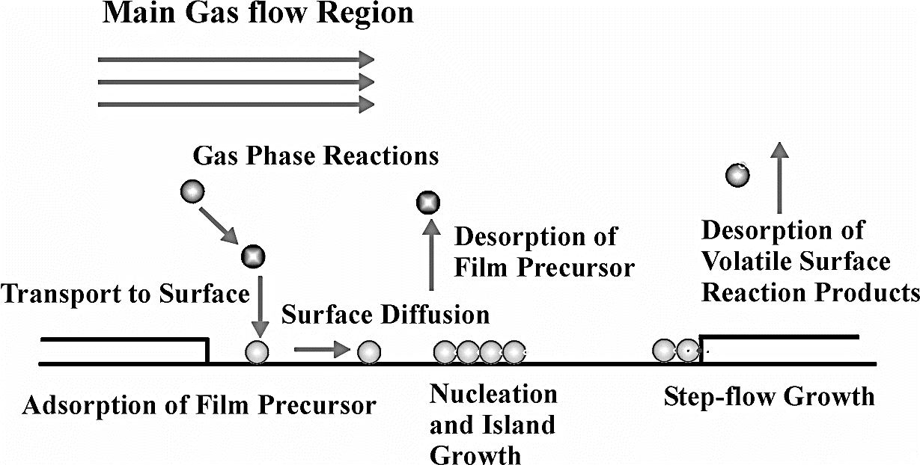
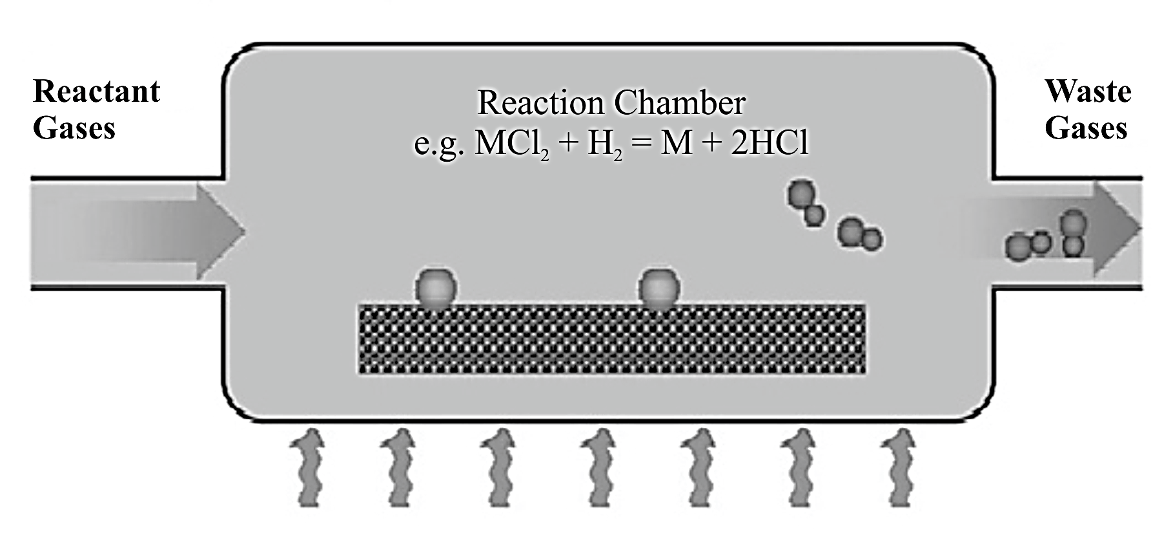
Bottom-Up Approaches:
In general, the bottom-up approach consists of, one dimensional self-assembly of individual atoms and molecules to form nanostructured materials in at least. All the bottom-up techniques used liquid or gas as the starting material.
Usually, the bottom-up approach technique can give very fine nanostructures of individual nanoparticles called as nano shells which have narrow size if the process parameters are very effectively designed and controlled.
1) Chemical Vapour Deposition (CVD): The process in which one or more gaseous adsorption species react or decompose on a hot surface to form stable solid products.
Main step occurs in CVD process summarized as follows:
The transport of reacting gaseous species at the surface for adsorption.
Heterogeneous surface reaction can be catalyzed by the surface
Surface diffusion of the species to the growth sites
Nucleation and growth of the film
Desorption of gaseous reaction products and transportation of reaction products away from the surface.
The detailed synthesis process is as shown in figure
The reacting gasses flow is passed over hot filament or film. The resulting gas gets adsorbed over hot filament. The gas molecules are diffused over the surface towards growth side, then over the surface the nucleation and growth of the film is started. The desorption of the gases from the surface resulting in to desired reaction products.

Slide 14
Thermally activated CVD:
Thermally activated CVD is the conventional CVD technique in which the conditions of high temperature has been achieved by the resistive heating of hot wall reactors for the dissociation of gaseous species. Therefore, it is very essential to use the substrate which have melting point much lower than the reaction temperature. In general, hot tungsten filament is commonly used to heat reacting gases in close vicinity of the substrate. Now a day, hot filament CVD has been used to grow one dimensional silicon carbide nanorods.

Slide 15
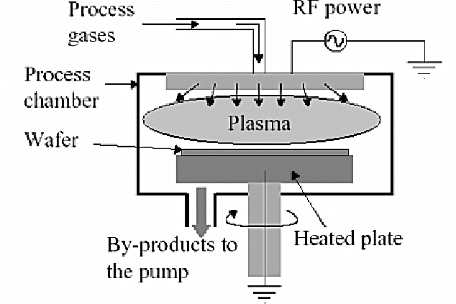
Plasma enhanced CVD: Plasma enhanced CVD has a distinct advantage over thermal CVD due to its lower deposition temperature. In this technique the plasma is generated by various energy resources such as DC(Direct current),RF(Radio frequency), microwave and electron cyclotron resonance microwave (ECR-MW) radiation. Amongst these the DC plasma technique is based on the generation of plasma consisting of electrons and ions by ionizing and dissociating the reacting gases by electrical discharge. However, microwave plasma is very attractive and widely used technology because in this technique the excitation of microwave frequency can oscillate the electrons. Thus, high ionization factors are generated as electrons collide with gas atom and molecules.
In this process, the reacting gas molecules are passed through the process chamber and then gases molecules gets adsorbed over plasma. These gases molecules immediately get desorbed due to DC and RF power. These gases products are desorbed in the form of wafers as the bi-products. These bi-products are collected in the pump and get separated finally

Slide 16
2) Spray conversion processing: Spray conversion processing strategy is the most convenient and widely accepted route in which the atomization of chemical precursors has been carried out in to aerosol droplets (that are dispersed throughout a gas medium). Thereafter, the aerosols are then transported in to a heated reactor where the solution is evaporated to form ultrafine particles or thin films. The atomic cloud aerosol generates larger droplets due to the ultrasonic spraying method that results the smaller droplets. This having a significant influence on the surface morphology of the material. Spray pyrolysis is very effective, cost effective strategy utilizes simple equipment’s, which leads the formation of a thin film with large surface area of substrate coverage and potential homogeneity of mass synthesis. Following key steps are involved in spray pyrolysis technique,
The evaporation of the solvent from the surface of the droplets.
Drying of the droplets containing the precipitate solute.
The annealing of the precipitate at considerably high temperature (thermolysis).
Formation of microporous particles of defined phase composition, and
Formation and sintering of solid particles.
Spray pyrolysis can be used to prepare several metal oxide nanoparticles such as ZnO, ZrO₂ and Al₂O₃ etc.

Slide 17
3) Sol-gel process: The sol-gel process is recognized as one of the most versatile processes for the preparation of highly advanced materials, including ceramics and organic-inorganic hybrids. In the recent years a significant development has been advanced towards the generalization of this technology in every scientific laboratory where tremendous work on the production of nanoparticles is in progress. In other words, the sol-gel method involves the transition of a solution system from a liquid "sol" (mostly colloidal) into a solid "gel" phase. Generally, inorganic metal salts or metal cored organic compounds such as metal alkoxides have been employed in the preparation of the"sol". Furthermore, a typical sol-gel process consists of a series of hydrolysis and polymerization reactionshas been performed on a starting precursor to form a colloidal suspension, or a "sol".

Slide 18
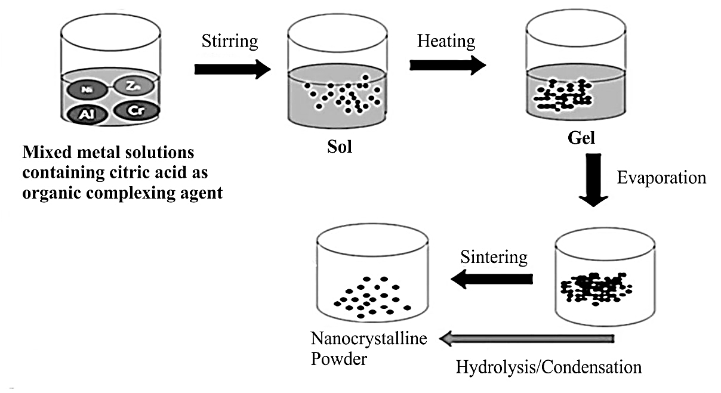
Experimental technique of the sol-gel process:
In the experimental section the preparation of metal oxide nanoparticles by the sol-gel process, initiated with the preparation of aqueous solution of metal salts, is followed by the treatment of monohydrated citric acid as a ligand molecule with constant stirring. The resulting solution after vigorous stirring is called as a Sol. Thereafter the Sol is to be heated to an appropriated temperature in order to remove excess water gives a sticky product called as a Gel. Finally, the resulting gel is sintered (heated and converted to porous material without melting) to yield nano-crystalline powder (nanoparticles)

Slide 19
B) Top-down Approach: Where as in the second top-down approach, a microcrystalline material is fragmented to give nanocrystalline material, and all the solid-state routes fall into top-down category. Usually top-down techniques do not produced individual nanoparticles; however, they can produce bulk nano structured materials.
Amongst all top-down approaches for the formation of nanomaterials, high energy ball milling, has been widely exploited for the synthesis of various nanomaterials, nanograins, nanoalloy, nanocomposites and nano -quasi-crystalline materials. Notably, a mechanical alloying techniques have been advanced very aptly to produce amorphous and nanocrystalline alloys as well as metal/non-metal nanocomposite materials by milling and post annealing, of elemental or compound powders under inert atmosphere conditions.
Mechanical alloying: Mechanical alloying is a non-equilibrium processing technique which deals with the milling of different elemental powders under inert atmospheric conditions has been utilized to create one mixed powder with the same composition as the constituents. In high-energy ball milling technique, plastic deformation, cold-welding and fracture are very significant factors, in which the deformation leads to a change in particle shape, cold-welding leads to an increase in particle size and fracture leads to decrease in particle size resulting in the formation of fine dispersed alloying particles in the grain-refined soft matrix.

Slide 20
Various kind of aluminium/nickel/magnesium/copper based nanoalloyshas been effectively utilized in mechanical milling for the preparation of resistant spray coatings, oxide and carbide strengthened aluminium alloys, and many other nano composites in excellent yield. To date quite a large number of research articles, books, monographs and reviews documented in the literature, which signifies the applications of mechanical milling in the synthesis of various nanomaterials, nanocomposites, nanocarbons and nano quasi-crystalline materials.
The ball-powder-ball collision is a key process in mechanical milling, in which powder particles are trapped between the colliding balls and undergo deformation and/or fracture processes which define the ultimate structure of the powder. The nature of these processes depends upon the mechanical behavior of the powder components, their phase equilibrium, and the stress state during milling. As a part of the study, it is convenient to classify the powder components into (i) ductile - ductile, (ii) ductile - brittle, and (iii) brittle - brittle systems for their effective utilization.

Slide 21
Role of surfactants in shape and size control of nanomaterials:
The shapes and sizes of the nanoparticle materials has been considered very diverse and which include spheres, cubes, nanorods, nanowires, nanopyramids, and so on. Till this date, quite a large number of investigations, devoted to study the interactions between nanoparticles and the surface-active agents. Such fundamental studies are considered as a base for solving process-engineering tasks such as controlling fundamental properties of nanoparticles, such as their shape and size, and morphology, as well as for solving issues dealing with environment protection. Tremendous literature has been cited which emphasizes on the modern state of the use of surfactants in the synthesis of the nanoparticles.
Additionally, surfactants provide extra stability to the nanoparticles and the surface forces, which play a major role in the stability as well as shape and size of the nanoparticles.

Slide 22
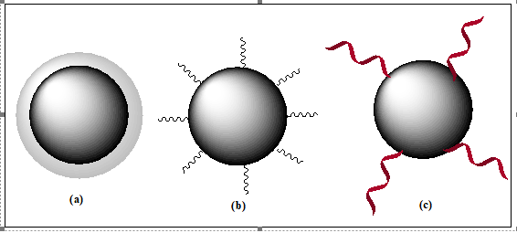
It has been considered that, once the nanoparticles have been produced and their purity has been confirmed, they are subjected to the surface modifications. The reasons behind surface modifications are as follows,
Surface modification passivating a very reactive nanoparticle,
Surface modification stabilizing a very aggregative nanoparticle in a medium (which may be a solvent or a polymer melt) where the nanoparticles are assumed to be dispersed,
Surface modification functionalizing the nanoparticle for applications such as molecular recognition, or promoting the assembly of nanoparticles. The schematic presentation of surface modification has been shown in the following Figure 1.4 .
Fig. 1.4. : Several approaches for surface modifications, (a) The treatment for the charging of the surface or coating with ligands, make the interfacial tension at the nanoparticle-medium interface close to zero which offers high thermodynamic stability to the nanoparticle dispersion, (b) Inter-particle electrostatic and/or steric repulsions due to surface adsorption of a surfactant or a block copolymer provides kinetic stability of the nanoparticle dispersion, (c) Use of linker molecules for surface modifications enhance the functionality of nanoparticles in one of many ways including hydrophobic or hydrophilic, the ability to bind to specific molecular recognition elements, DNA, enzymes, bridge to other nanoparticles, etc.

Slide 23
Generally, linker molecules are used for the process of surface modification and the most commonly used surface modification methods involves grafting thiolated surfactants or polymers, adsorption of charged surfactants, charged ligands or polymer brushes, attachment of biological molecules such as DNA, peptides, proteins, antigens, streptavidin or coating a continuous polymer film on nanoparticles. For example, the thiol surfactants which are allowed to bind to the gold surface by Au-S linkage can not only impart the stability to gold nanoparticles but also enhance the properties of the resulting hybrid nanoparticles.
Recently, thiols have widely been used to enhance the stability of the dispersions of gold nanoparticles in organic solvents.

