Slide 1


Name: dr. Jadhav vilas bhaskar
Designation: Associate Professor
Department: Chemistry
Jai Hind Educational Trust’s
Zulal Bhilajirao Patil College, Dhule
Inorganic Chemistry (CH – 602)

Slide 2
Cement and Lime
Introduction
Cement has been known around us for at least 12 million years.
When the earth itself was undergoing intense geologic changes natural cement was being generated.
This natural cement was used humans since million years ago.
Eventually, human discovered how to make cement from other materials.
Cement is the powdered material but it becomes a very hard solid structure in several hours when mixed with water and which continue to improve quality with age.
Now a days artificially manufactured commercial cement is having greater strength and quick setting property which is the most widely used materials required for the construction of homes, buildings, roads, dams, bridges etc.
Classification of Cement
Cement is a substance which sets to a hard mass in presence of water. The cement can be classified into the following types such as -
A) Natural cement B) Pozzolana cement C) Portland cement

Slide 3
A) Natural cement:
It was made by calcination natural clay bearing limestones, which hydraulic to obtained natural cement.
e.g. Gypsum CaSO₄.2H₂O that is hydrated calcium sulphate, gypsum losses its water of crystallization easily on gentle heating to yield various plasters. These dehydrated substances when mixed with water reform as crystalline mass of synthetic gypsum.
B) Pozzolana cement:
It was made from lime and pozzolana mixed with water to produce pozzolana cement. Pozzolana means a volcanic ash containing significant quantities SiO₂ and Al₂O₃. Pozzolanas can be subdivided divided into -
a) Natural pozzolanic materials such as volcanic ash.
b) Industrial pozzolanic materials such as fire clay rice husk ash etc.

Slide 4
C) Portland cement
Joseph Aspidin an English Brick layer (1924) , found that a strongly heated mixture of limestone and clay, when mixed with a small amount of water, set in few hours to a hard stone like substance. After setting, the stone like mass resembled famous Portland rock of England and hence it was named as Portland cement.
Cement is the most important building material. Cement is an adhesive substance that unites fragments or masses of solid matter to a compact whole.
Definition Portland cement :
  Portland cement is chemically defined as the finely ground mixture of calcium aluminates and silicates of varying compositions, which hydrate when mixed with water to form a rigid solid structure with good compressive strength.
  Portland cement is defined as a product obtained by intimately mixing together calcareous (materials which supplies Lime), and argillaceous materials (which supplies Silica, Alumina, Iron oxide), burning them at a clinkering temperature and grinding the resulting clinker.

Slide 5
Types of Portland cement
Portland cement has different types, depending upon the rate of setting, heat of evolution and strength.
Type 1: Regular Portland cements:
They are used for general concrete construction. It harden to full strength in about 28–30 days. They contain 60% C₃S, 10–30% C₂S, 7–13% C₃A, 7% C₄AF.
White cements, oil wall cement, Quick setting cements etc. belongs to this class.
Type 2: Modified Portland cements:
It is also called as sulphate resisting cements, which are used where moderate heat of hydration is required. The heat evolved should not exceed 70–80 cal/gm after one weak to 4 weeks. The C2S/C3S ratio is higher. They contain 51% C3S, 24% C2S, 6% C3A, 11% C4AF.
Type 3: High-early-strength (HES) cements:
These cement contain higher percentage of C3S and C3A to increase the hydration rate and quicker hardening. They are used for road constructions. They contain 56% C3S, 19% C2S, 10% C3A, 7% C4AF.

Slide 6
Type 4: Low heat Portland cements:
These cement contain lower percentage of C₃S and C₃A and decrease the heat evolution. The heat evolved should not exceed 60 and 70 cal/gm after 7 and 28 days respectively. They are used for massive structure work (dams). They contain 28% C₃S, 49% C₂S, 41% C₃A, 12% C₄AF.
Type 5: Sulphate resisting Portland cements:
These are good for sea water contract. They resist the sulphate better than others. They contain lower percentage of C₃A (<4%) and higher in C₄AF. They contain 38% C₃S, 43% C₂S, 4% C₃A, 9% C₄AF.

Slide 7
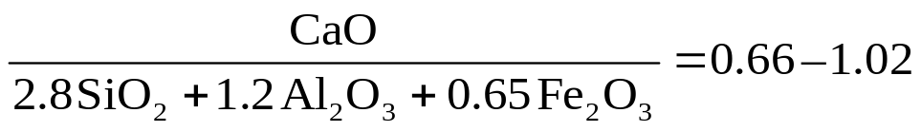
White Cement:
This cement is white in colour and not containing tetra calcium alumino ferrite C₄AF and low amount of MgO. This cement is specially used for the decorative purposes otherwise has properties similar to Type I.
Chemical Specifications of Cement: (Indian standard institute (ISI)-
  %Al₂O₃ / %Fe₂O₃ not less than 0.66.
  Reaction:
  Insoluble residue not more than 1.5%.
  Magnesia not more than 5%.
  Total Sulphur content (SO₃) not more than 2.75%.
  Total loss on ignition not more than 4%.
  Fineness: After sieving the residue by weight on B.S.170 mesh test sieve not to exceed 10%.
  Setting time: 30 minute as initial setting time and 600 minutes as final setting time.
  Tensile strength: Not less than 300 lbs/sq. inch after 72 hours. Not less than 375 lbs/sq. inch after 7 days.

Slide 8
  9. Compressive strength: Not less than 1600 lbs/sq. inch after 72 hours and not less than 2500 lbs/sq. inch after 7 days.
  10. Heat of hydration: Not more than 65 calories per gm after 7 days and not more than 75 calories per gm after 28 days.
  11. Composition: On an average, the composition of an Indian Portland cement is,
SiO₂ | Fe₂O₃ | Al₂O₃ | CaO | MgO | SO₃ | Loses
23% | 2.19% | 5.97% | 64.86% | 1.0% | 1.75% | 0.75%
Average composition of cement: (clinker compounds)
Sr. No. | Name | Chemical formula | Code
1 | Dicalcium silicate | 2CaO.SiO₂ | C₂S
2 | Tricalcium silicate | 3CaO.SiO₂ | C₃S
3 | Tricalcium Aluminate | 3CaO.Al₂O₃ | C₃A
4 | Tetracalcium Aluminoferrite | 4 CaO.Al₂O₃.Fe₂O₃ | C₄AF
5 | Magnesium Oxide (Magnesia) | MgO | M
6 | Lime | CaO | C.

Slide 9
Raw Materials:
The essential raw materials are limestone and clay, which supply principle ingredients like CaO, Al₂O₃, SiO₂, Fe₂O₃, CaO and Fe₂O₃ obtained from limestone. SiO₂ and Al₂O₃ obtained from clay.
  Calcareous materials: (Material rich in calcium, lime): These are limestone, marl, chalk, cement rock, marine shells, alkali waste (containing precipitated CaCO₃).
  Argillaceous Materials: (Materials rich in silica, iron oxide, alumina): These are clay, shale, slate, blast furnace slag, ashes, cement rock, sand, waste bauxite, iron ore used in small amounts to adjust the composition of the mixture. gypsum (~4%) is added to regulate the setting time of cement.
Certain constituents are undesirable in cement.
MgO content is not allowed to exceed 5%, as higher MgO content makes the cement unsound.
Chalk often contains flint pebbles and marl may contain excess silica sand, this gives excessive verification during the clinker formation.
Mn₂O₃ if present more than 3% imparts brown colour to the cement.
P₂O₅ causes difficulties in burning the clinker and retards developments of strength
The proportion of raw materials is,

Slide 10
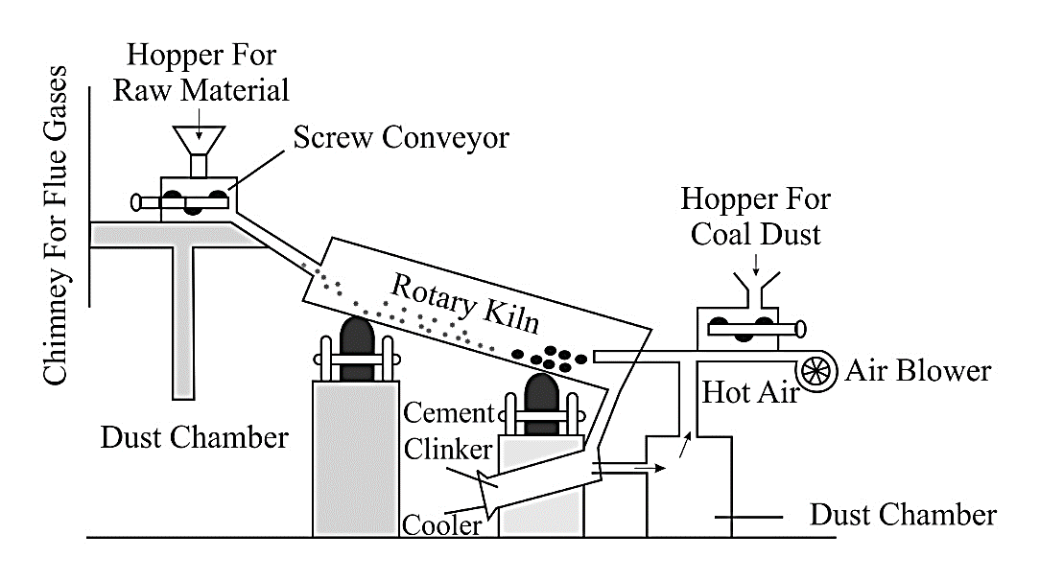
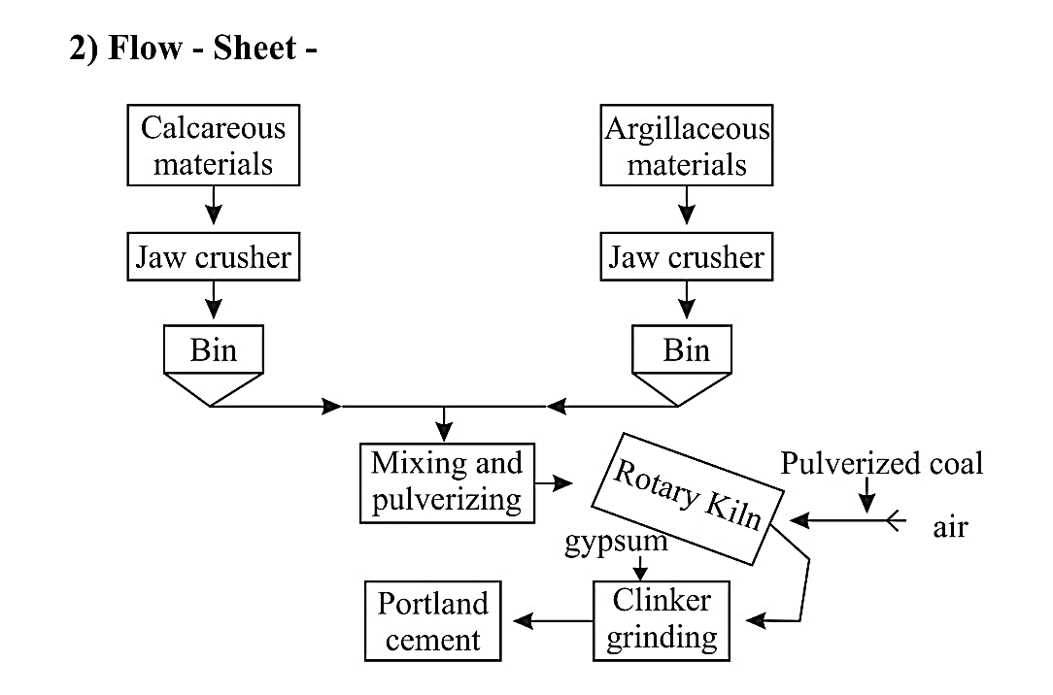
Manufacture of Portland cement
Manufacture of Portland cement by Dry process:
Raw materials: Dry process is slow, costly and cement produced is of low quality. Fuel consumption is low. It can only be used when raw materials are quite hard. It is applicable to natural cement rock and to mixtures of lime stone and clay, shale, slate.
Manufacture of Portland Cement (Dry Process)
Flow sheet for dry process

Slide 11
3) Process description:
The calcareous materials and argillaceous materials are crushed separately by jaw or roller crusher. This crushed raw materials are stored into huge bins. This crushed materials are mixed in the proper proportion by automatic weighing machines. This material is then finely ground in tube mills. Before entering the kiln a thorough mixing and blending by air is done. Then this dry powdered materials is fed into a rotary kiln.
The length of rotary kiln is about 45 meters and it is rotated at a rate from 1/2 to 2 rpm (revolution per minute). Kiln is slightly inclined, so that materials fed in at the upper end travel slowly to the lower firing end in one to three hrs.
The kiln is heated by burning oil, gas, pulverized coal, using preheated air from cooling the clinker. The kiln is lined with high alumina and high magnesia bricks to withstand abrasions and chemical attack at high temperature in the clinkering zone.
In the first portion of the kiln, water is evaporated, lime stone decomposes to lime. Then alumina and silica combine at 1400–1500⁰C with lime to form hard, granular, greenish black or grey coloured masses from 3-20 mm in size. This is called as clinker.
The clinker is removed from lower end of the kiln and cooled by rotary coolers. The cooled clinker is ground finely with 2% gypsum. The product thus obtained is called Portland cement. It is packed in air-tight bags and marketed.

Slide 12
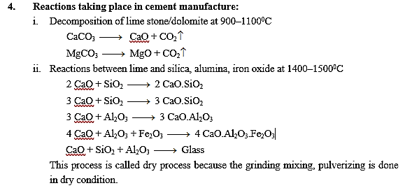

Slide 13
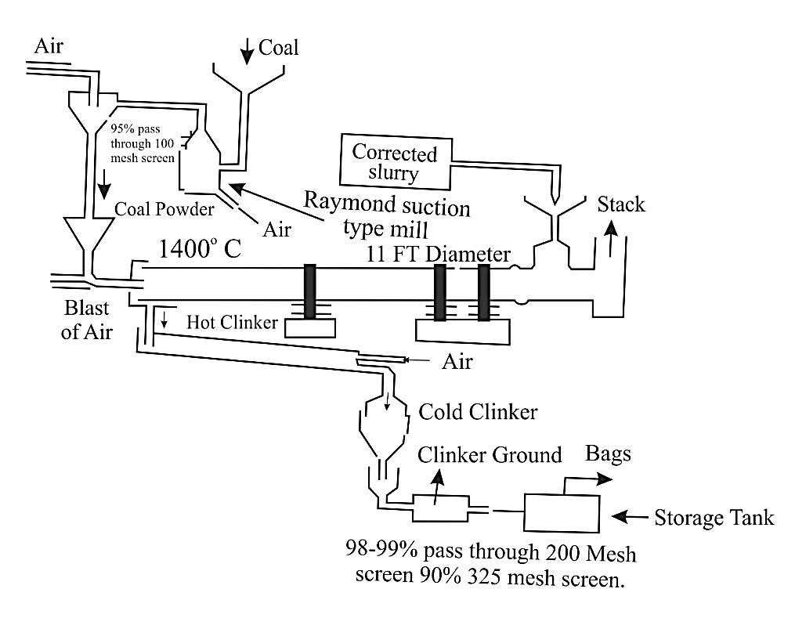
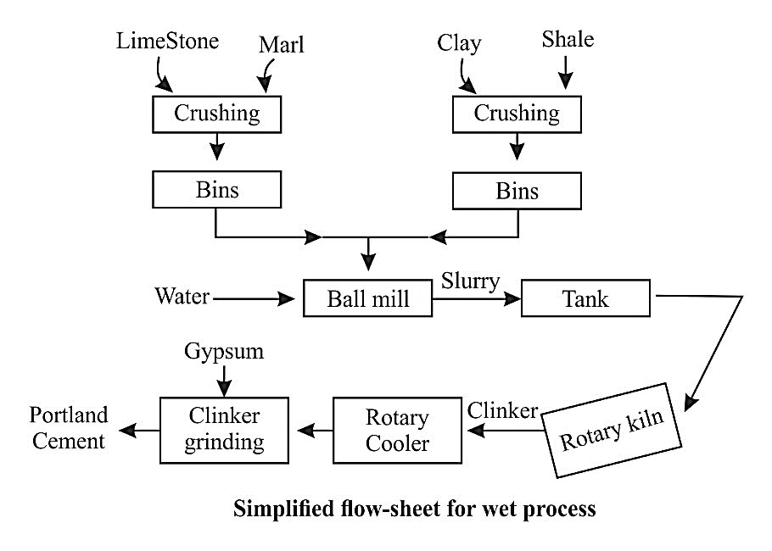
Manufacture of Portland cement by Wet process:
Raw materials:
The wet process is preferred when the raw materials limestone, clay shale are soft. The climate is fairly moist and fuel is chief.
B) Flow Sheet:

Slide 14
The steps involved:
Treatment of Raw materials:
The limestone is crushed to suitable size particles by suitable mill. The soft clay is washed with water in wash mills to remove soluble and foreign materials (flint). The clay is mixed with water (60%) to form slurry.
The powdered limestone is then mixed with a calculated quantity of clay slurry in a special ball mill for wet grinding.
This resulting slurry (raw slurry) contains ~40% water. This slurry is pass to correction tank for correction of composition.
Calcination (Burning to 1400–1600⁰C):
The slurry is filtered in a continuous rotary filter and fed into rotary kiln through hopper.
The rotary kiln is long cylindrical steel furnace lined inside with fire bricks. It is 150 m long and about 4 m in diameter.
It is mounted on rotating glass at inclination of 150 and rotates at a speed of ½ rpm.

Slide 15
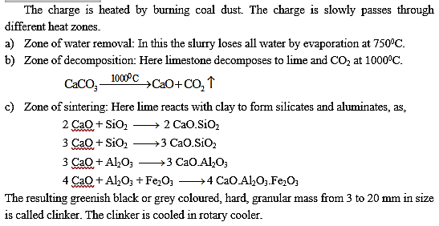

Slide 16
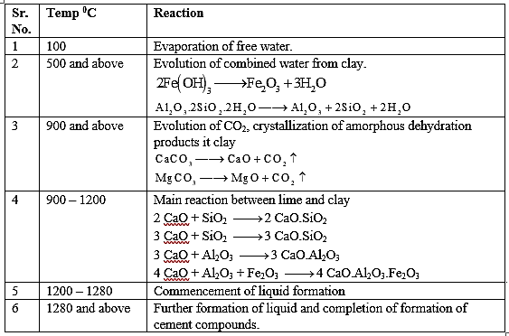
Powdering of clinker:The cooled clinker is mixed with 2–4% of gypsum and ground to a fine powder in grinding machines. The cement thus formed is packed in airtight bags to exclude moisture and then marketed. In wet process, the fuel consumption is higher, the process is comparatively faster, the cement produced is of superior quality and the process is used for hard as well as soft materials. It is cheaper and widely used.
Reaction during clinker formation

Slide 17
Setting and Hardening of cement:
When cement is mixed with water and allow to stand, it sets to a hard rigid mass by a series of complex reactions. Hydration reaction begins, resulting in the formation of gel and crystalline products.
The process of solidification consists of setting and hardening.
Setting is regarded as stiffening of original paste mass because of initial gel formation.
Hardening is regarded as development of strength because crystallization.
First setting occur within 24 hrs and subsequent hardening required 15–20 days.
The chemical changes taking place during setting and hardening are not clearly understand.
According to Lechatelier, setting or hardening of cement is due to interlocking of the crystals formed during hydration.
According to colloidal theory of Michaelis, the hydration products of silicates form rigid cells and strength is developed because of the hardening of gel.
Initial setting of cement is mainly due to the hydration of tricalcium aluminate (C₃A), because its reaction is complete within 7 days.
C₂S also undergoes hydrolysis and form tobermonite gel which has high surface area and very high adhesive property. Hence C₂S also contribute to initial setting.

Slide 18
Final setting and hardening of cement is mainly due to the formation of tobermonite gel and crystallization of Ca(OH)₂ and hydrated tricalcium aluminate, 3CaO.Al₂O₃.6H₂O.
Hydration of cement is an exothermic reaction and so there is rise in temperature. Heat is evolved during first 7 days of hardening. The compounds responsible for evolution of heat C₃A, C₃S, C₄AF, C₂S in descending order. The heat evolved used in the setting of cement.
Functions of compounds:
C₂S, C₃S are responsible for final strength at one year.
C₃S is responsible for early strength at 7 days.
C₃A is responsible for setting by retardation by gypsum.
Fe₂O₃, Al₂O₃, alkalies Mg are responsible for lowering the clinkering temperature.
3CaO.Al₂O₃ is responsible for initial set called as flash set.
Cement and lime: The following points differences between ordinary cement and lime
The cement is used for the gain of earliest strength where as lime gains the strength slowly
The cement and lime colour are different.
The cement and lime both is a binding material having good ultimate strength but lime experiences less easily strength as compared to cement.

Slide 19
Quick Setting Cement:
As the name indicates Quick setting cement , these are used where quick setting is needed/required.
The quick setting cement is manufactured by adding a small percentage of aluminium sulphate and then it is finely grinded with cement. And also for quick setting action a small percentage of gypsum or retarder is added.
The aluminium sulphate is mainly added to accelerate the setting time fast. Quick setting cement when mixed with water starts to set in five minutes and become hard like stone in just 30 minutes.
It is one of the type of cements where the initially set in 5 mins and final set is achieved in 30 mins, which is used in the special conditions of construction like in running water.
Uses:
1. It is used in under water construction.
2. It is also used in rainy & cold weather conditions.
3. Where, quick strength is needed in short span of time.
Disadvantages:
1. When water is added the work should be completed fast or else it sets and difficult to mix.
2. It is not widely available.
3. It is expensive.

Slide 20

Manufacturing of Lime:
Lime is a calcium-containing inorganic mineral composed primarily of oxides, and hydroxide, usually calcium oxide and/or calcium hydroxide.
It is also the name for calcium oxide which occurs as a product of coal-seam fires and in altered lime stone xenoliths in volcanic ejecta.
The word lime originates with its earliest use as building mortar and has the sense of sticking or adhering.
In the lime industry, limestone is a general term for rocks that contain 80% or more of calcium or magnesium carbonate, including marble, chalk, oolite, and marl. Further classification is done by composition as high calcium, argillaceous (clayey), silicious, conglomerate, magnesian, dolomite, and other limestones.
Uncommon sources of lime include coral, sea shells, calcite and ankerite.
Limestone is extracted from quarries or mines. Part of the extracted stone, selected according to its chemical composition and optical granulometry, is calcinated at about 1,000⁰C (1,830⁰F) in different types of lime kilns to produce quicklime according to the reaction:

Slide 21

Before use, quicklime is hydrated, that is combined with water, called slaking, so hydrated lime is also known as slaked lime, and is produced according to the reaction:
Dry slaking is slaking quicklime with just enough water to hydrate the quicklime, but to keep it as a powder; it is referred to as hydrated lime.
In wet slaking, a slight excess of water is added to hydrate the quicklime to a form referred to as lime putty.
Because lime has an adhesive property with bricks and stones, it is often used as binding material in masonry works. It is also used in whitewashing as wall coat to adhere the whitewash onto the wall.
Lime used in building materials is broadly classified as "pure", "hydraulic", and "poor" lime; can be natural or artificial; and may be further identified by its magnesium content such as dolomitic or magnesium lime.
Uses include lime mortar, lime plaster, lime render, lime-ash floors, tabby concrete, whitewash, silicate mineral paint, and limestone blocks which may be of many types. That depends on how they are used.

Slide 22
Lime Cycle:
The process by which limestone (calcium carbonate) is converted to quicklime by heating, then to slaked lime by hydration, and naturally reverts to calcium carbonate by carbonation is called the lime cycle. The conditions and compounds present during each step of the lime cycle have a strong influence of the end product, thus the complex and varied physical nature of lime products.
An example is when slaked lime (calcium hydroxide) is mixed into a thick slurry with sand and water to form mortar for building purposes. When the masonry has been laid, the slaked lime in the mortar slowly begins to react with carbon dioxide to form calcium carbonate (limestone) according to the reaction:
The carbon dioxide that takes part in this reaction is principally available in the air or dissolved in rainwater, so pure lime mortar will not recarbonate under water or inside a thick masonry wall.

Slide 23
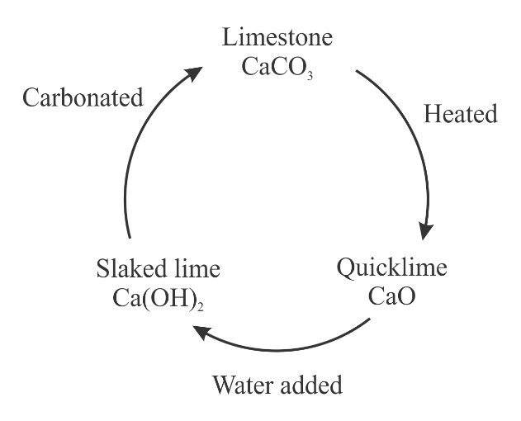
The lime cycle for dolomitic and magnesium lime is not well understood but more complex because the magnesium compounds also slake to periclase which slake more slowly than calcium oxide and when hydrated produce several other compounds thus these limes contain inclusions of portlandite, brucite, magnesite, and other magnesium hydroxycarbonate compounds. These magnesium compounds have very limited, contradictory research which questions whether they "may be significantly reactive with acid rain, which could lead to the formation of magnesium sulphate salts." Magnesium sulphate salts may damage the mortar when they dry and recrystalize due to expansion of the crystals as they form which is known as sulphate attack.

Slide 24
Role of gypsum: (CaSO₄.2H₂O):
2 – 3% Gypsum acts as retarder, to prevent a quick stiffening of cement paste.
When no retarder is present in cement C₃A reacts with water (forming C₃A hydrates) with high rapidify and with evolution of large amount of heat and its hydration contributes to the initial set of the cement (flash set). This produces rigidity in the cement paste.
When cement containing retarder is treated with water the solubility of C₃A is reduced by CaSO₄ or the precipitation of calcium aluminium hydrate and is replaced by forming insoluble C₃A.3CaSO₄.31H₂O.
Thus concentration of C₃A in solution is reduced below the point where C₃A hydrates could separate out. During this time C₃S is hydrated and initial set is brought by C₃S hydrate formation. The remaining C₃A hydrate is contributing to the further setting.

